Slide 1
EXAMPLES OF STATIC INVERSE PROBLEMS
Module - 11
S. Lakshmivarahan
School of Computer Science
University of Oklahoma
Norman, Ok – 73069, USA
varahan@ou.edu
Date 10/23/2015

Slide 2
THREE EXAMPLES
Recovery of vertical temperature profile of the atmosphere from satellite radiance measurement – linear problem
1-D Spatial linear and 2-D bilinear interpolation – linear problem
A nonlinear least squares problem

Slide 3
VERTICAL TEMPERATURE PROFILE
Problem is to retrieve the vertical temperature profile of the atmosphere from satellite radiance measurements

Slide 4
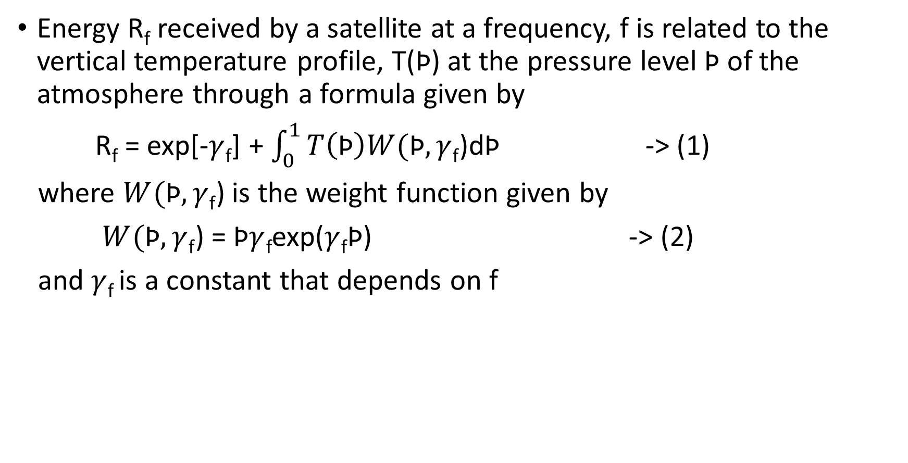
PROBLEM 1: SATELLITE RADIANCE – A MODEL
Energy R_{f} received by a satellite at a frequency, f is related to the vertical temperature profile, T(Ϸ) at the pressure level Ϸ of the atmosphere through a formula given by
R_{f} = exp[-$γ$_{f}] + $\int_{0}^{1}{T\left(\text{Ϸ}\right)W(\text{Ϸ},γ}$_{f})d$\text{Ϸ}$ -> (1)
where $W(\text{Ϸ},γ$_{f}) is the weight function given by
$W(\text{Ϸ},γ$_{f}) = $\text{Ϸ}γ$_{f}exp($γ$_{f}$\text{Ϸ}\text{)}$ -> (2)
and $γ$_{f} is a constant that depends on f

Slide 5
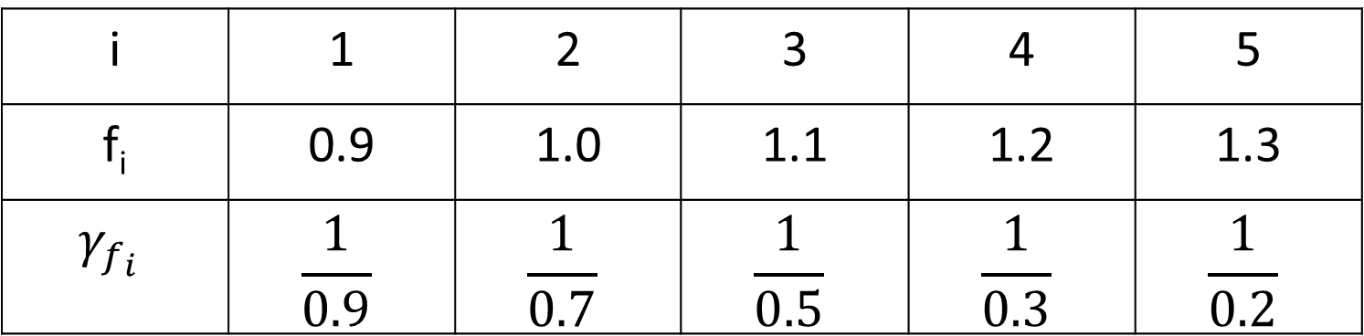

INPUT DATA
The values of f and $γ$_{f} relevant to the problem are given by
i | 1 | 2 | 3 | 4 | 5
f_{i} | 0.9 | 1.0 | 1.1 | 1.2 | 1.3
$$γ_{f_{i}}$$ | $$\frac{1}{0.9}$$ | $$\frac{1}{0.7}$$ | $$\frac{1}{0.5}$$ | $$\frac{1}{0.3}$$ | $$\frac{1}{0.2}$$

Slide 6
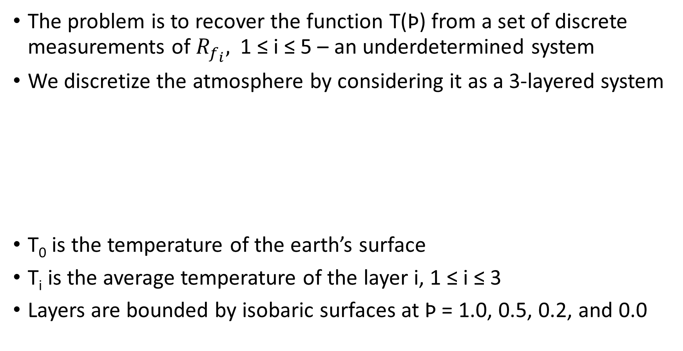
A DISCRETE MODEL
The problem is to recover the function T(Ϸ) from a set of discrete measurements of $R_{f_{i}},$ 1 ≤ i ≤ 5 – an underdetermined system
We discretize the atmosphere by considering it as a 3-layered system
T₀ is the temperature of the earth’s surface
T_{i} is the average temperature of the layer i, 1 ≤ i ≤ 3
Layers are bounded by isobaric surfaces at Ϸ = 1.0, 0.5, 0.2, and 0.0
Ϸ = 0.0
T₃ Layer 3
Ϸ = 0.2
T₂ Layer 2
Ϸ = 0.5
T₁ Layer 1
T₀
Ϸ = 1.0

Slide 7
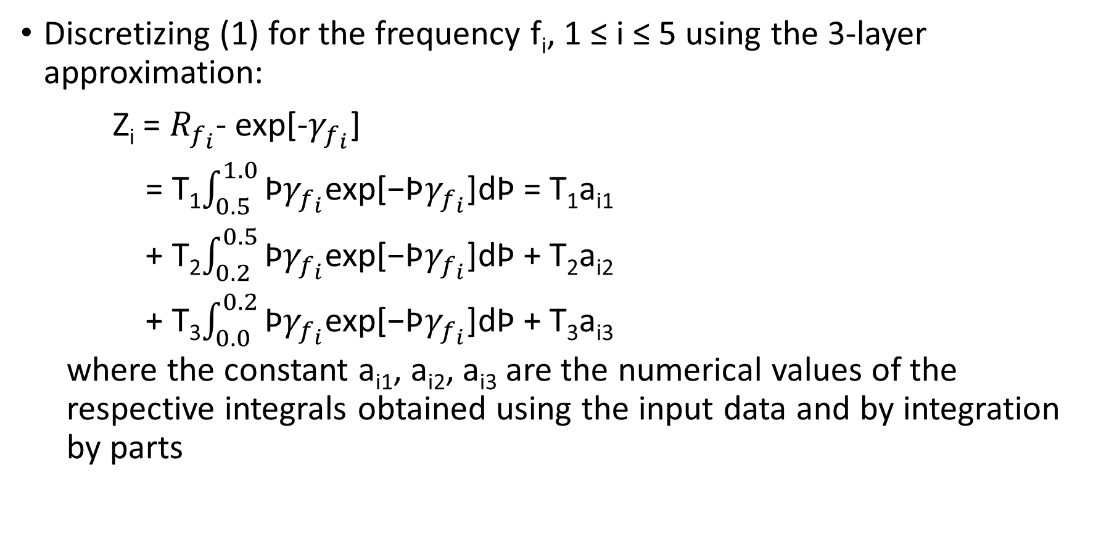
A DISCRETE RELATION
Discretizing (1) for the frequency f_{i}, 1 ≤ i ≤ 5 using the 3-layer approximation:
Z_{i} = $R_{f_{i}}$- exp[-$γ_{f_{i}}$]
= T₁$\int_{0.5}^{1.0}{\text{Ϸ}γ_{f_{i}}\text{exp}\text{[−}\text{Ϸ}γ_{f_{i}}\text{]}}$d$\text{Ϸ}$ = T₁a_{i1}
+ T₂$\int_{0.2}^{0.5}{\text{Ϸ}γ_{f_{i}}\text{exp}\text{[−}\text{Ϸ}γ_{f_{i}}\text{]}}$d$\text{Ϸ}$ + T₂a_{i2}
+ T₃$\int_{0.0}^{0.2}{\text{Ϸ}γ_{f_{i}}\text{exp}\text{[−}\text{Ϸ}γ_{f_{i}}\text{]}}$d$\text{Ϸ}$ + T₃a_{i3}
where the constant a_{i1}, a_{i2}, a_{i3} are the numerical values of the respective integrals obtained using the input data and by integration by parts

Slide 8
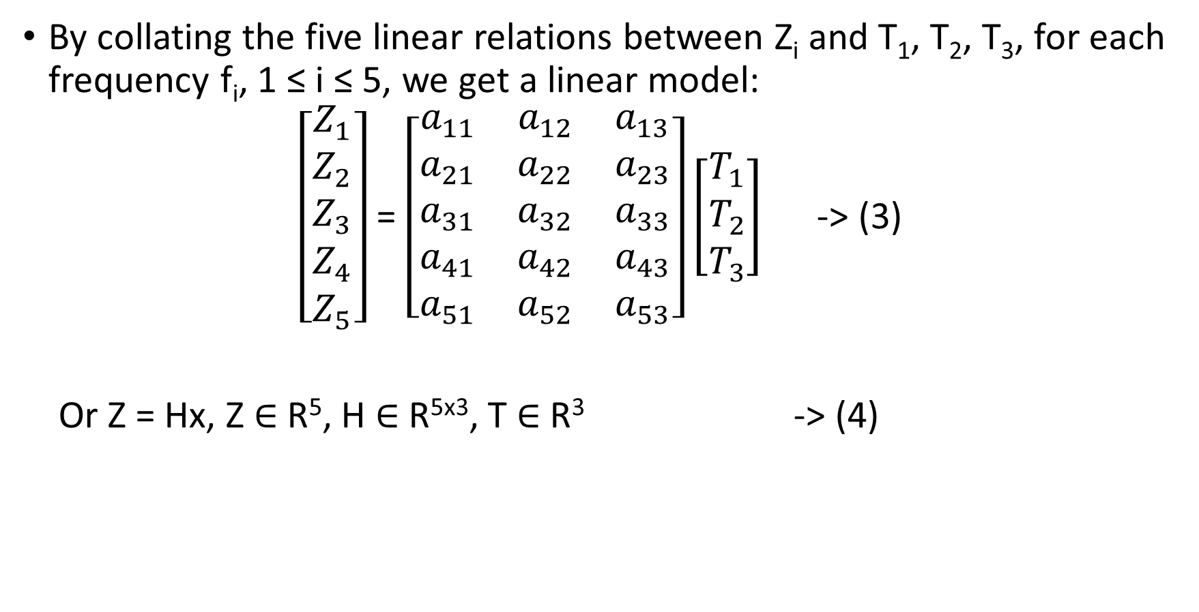
A LINEAR MODEL
By collating the five linear relations between Z_{i} and T₁, T₂, T₃, for each frequency f_{i}, 1 ≤ i ≤ 5, we get a linear model:
$\left[\begin{aligned}\begin{aligned}\begin{aligned}Z_{1} \\ Z_{2} \\ Z_{3}\end{aligned} \\ Z_{4}\end{aligned} \\ Z_{5}\end{aligned}\right]$ = $\left[\begin{matrix}a_{11} & a_{12} & a_{13} \\ a_{21} & a_{22} & a_{23} \\ a_{31} & a_{32} & a_{33} \\ a_{41} & a_{42} & a_{43} \\ a_{51} & a_{52} & a_{53}\end{matrix}\right]\left[\begin{aligned}T_{1} \\ T_{2} \\ T_{3}\end{aligned}\right]$ -> (3)
Or Z = Hx, Z $∈$ R⁵, H $∈$ R^{5x3}, T $∈$ R³ -> (4)

Slide 9
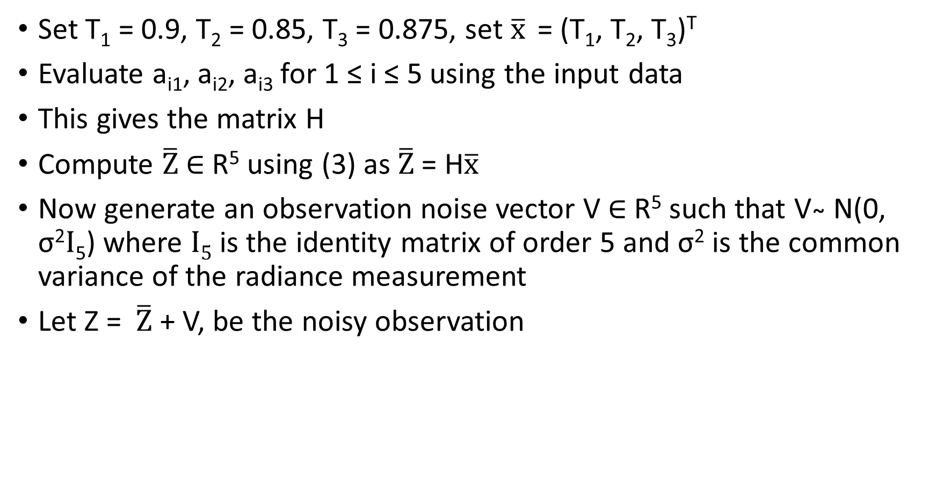
A TWIN EXPERIMENT – COMPUTER PROJECT: GENERATE OBSERVATION
Set T₁ = 0.9, T₂ = 0.85, T₃ = 0.875, set $\overline{x}$ = (T₁, T₂, T₃)^{T}
Evaluate a_{i1}, a_{i2}, a_{i3} for 1 ≤ i ≤ 5 using the input data
This gives the matrix H
Compute $\overline{Z}$ $∈$ R⁵ using (3) as $\overline{Z}$ = H$\overline{x}$
Now generate an observation noise vector V$∈$ R⁵ such that V ̴ N(0, σ²$I$₅) where $I5$ is the identity matrix of order 5 and σ² is the common variance of the radiance measurement
Let Z = $\overline{Z}$ + V, be the noisy observation

Slide 10
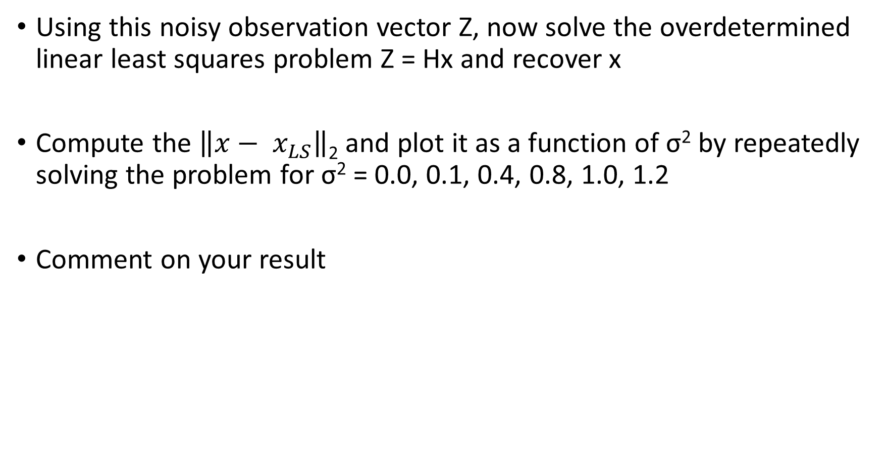
A TWIN EXPERIMENT – RECOVER T FROM NOISY OBSERVATION
Using this noisy observation vector Z, now solve the overdetermined linear least squares problem Z = Hx and recover x
Compute the $\left\|x− x_{LS}\right\|$₂ and plot it as a function of σ² by repeatedly solving the problem for σ² = 0.0, 0.1, 0.4, 0.8, 1.0, 1.2
Comment on your result

Slide 11
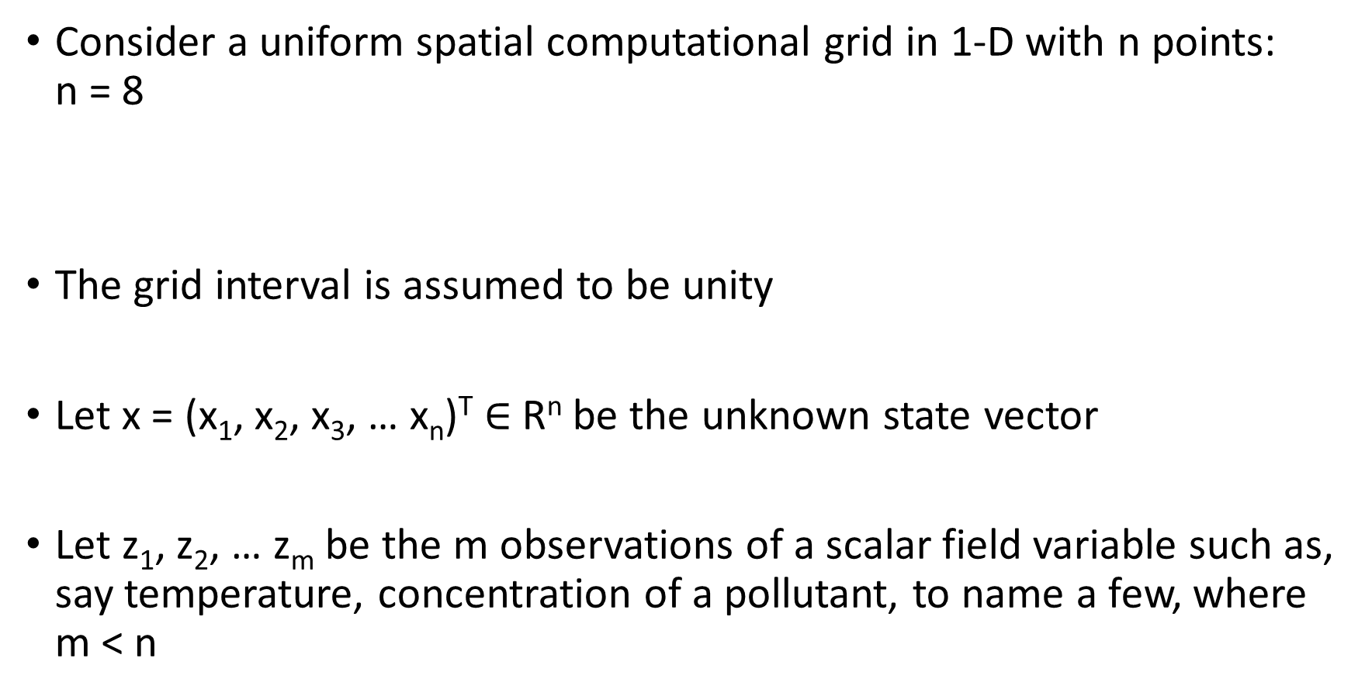
PROBLEM 2: SPATIAL INTERPOLATION – 1-D
Consider a uniform spatial computational grid in 1-D with n points: n = 8
The grid interval is assumed to be unity
Let x = (x₁, x₂, x₃, … x_{n})^{T} $∈$ R^{n} be the unknown state vector
Let z₁, z₂, … z_{m} be the m observations of a scalar field variable such as, say temperature, concentration of a pollutant, to name a few, where m < n
z₁
z₂
z₃
z₄
a₁
a₂
a₃
a₄
1
2
3
4
5
6
7
8

Slide 12
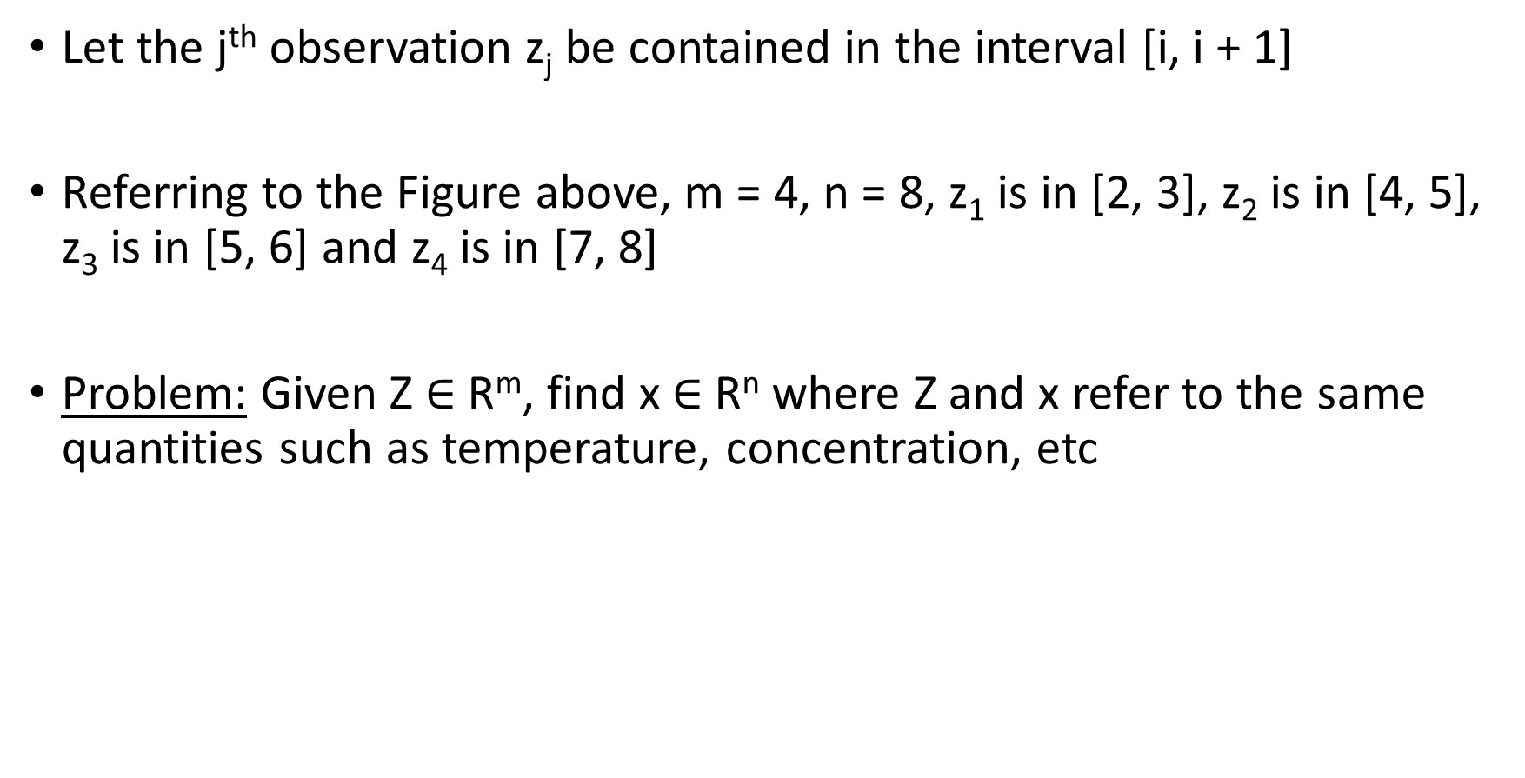
DISTRIBUTION OF THE OBSERVATIONS
Let the j^{th} observation z_{j} be contained in the interval [i, i + 1]
Referring to the Figure above, m = 4, n = 8, z₁ is in [2, 3], z₂ is in [4, 5], z₃ is in [5, 6] and z₄ is in [7, 8]
Problem: Given Z $∈$ R^{m}, find x $∈$ R^{n} where Z and x refer to the same quantities such as temperature, concentration, etc

Slide 13

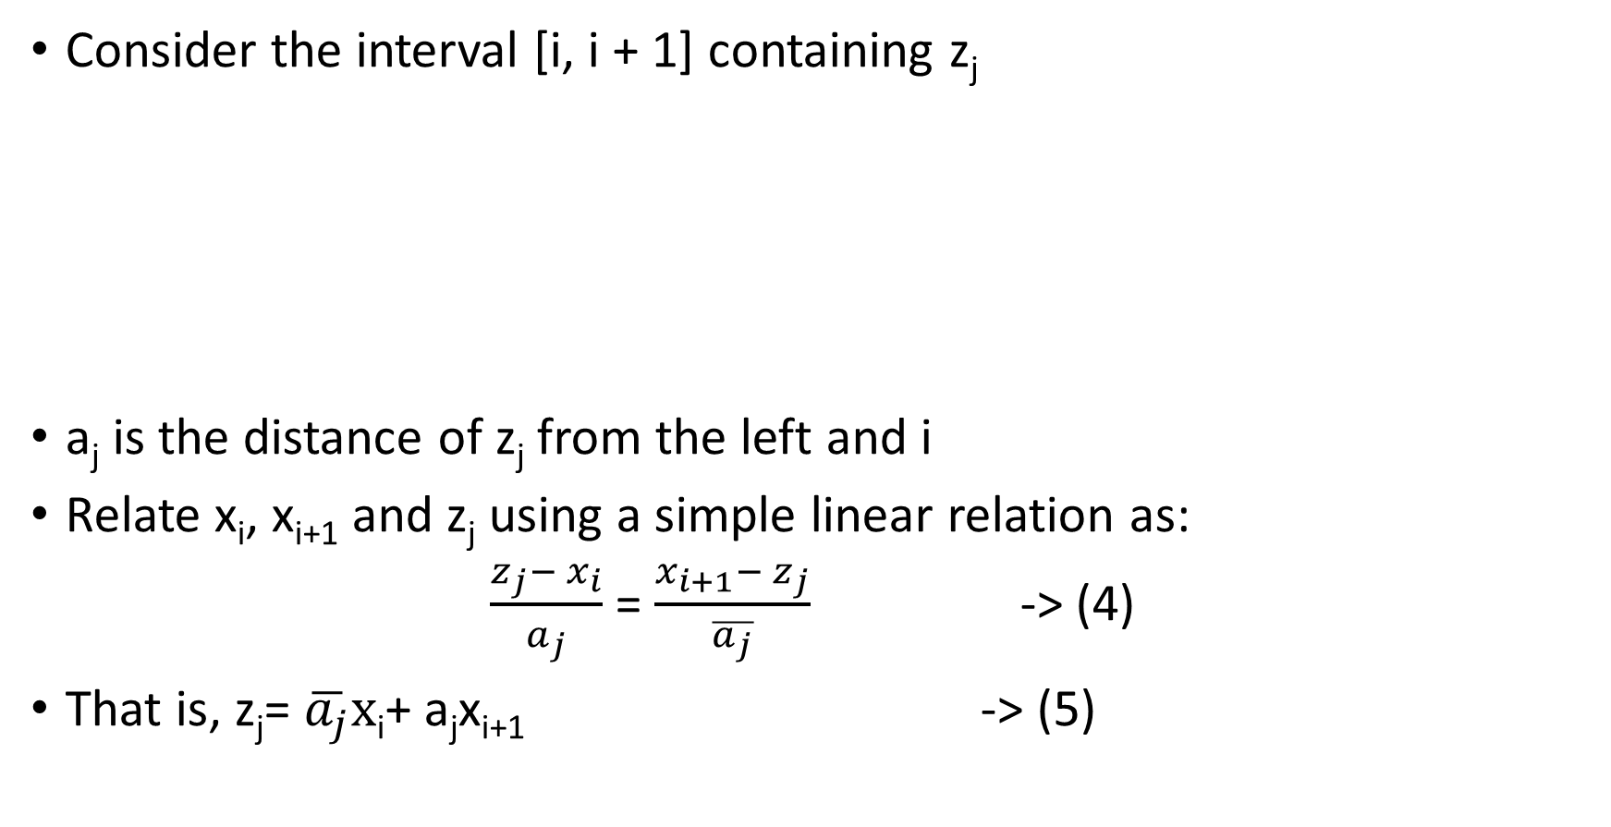

A LINEAR INTERPOLATION
Consider the interval [i, i + 1] containing z_{j}
a_{j} is the distance of z_{j} from the left and i
Relate x_{i}, x_{i+1} and z_{j} using a simple linear relation as:
$\frac{z_{j}− x_{i}}{a_{j}}$ = $\frac{x_{i+1}− z_{j}}{\overline{a_{j}}}$ -> (4)
That is, z_{j}= $\overline{a_{j}}x$_{i}+ a_{j}x_{i+1} -> (5)
a_{j} + $\overline{a_{j}} =1$
x_{i}
z_{j}
x_{i+1}
i + 1
i
a_{j}
$$\overline{a_{j}}$$

Slide 14
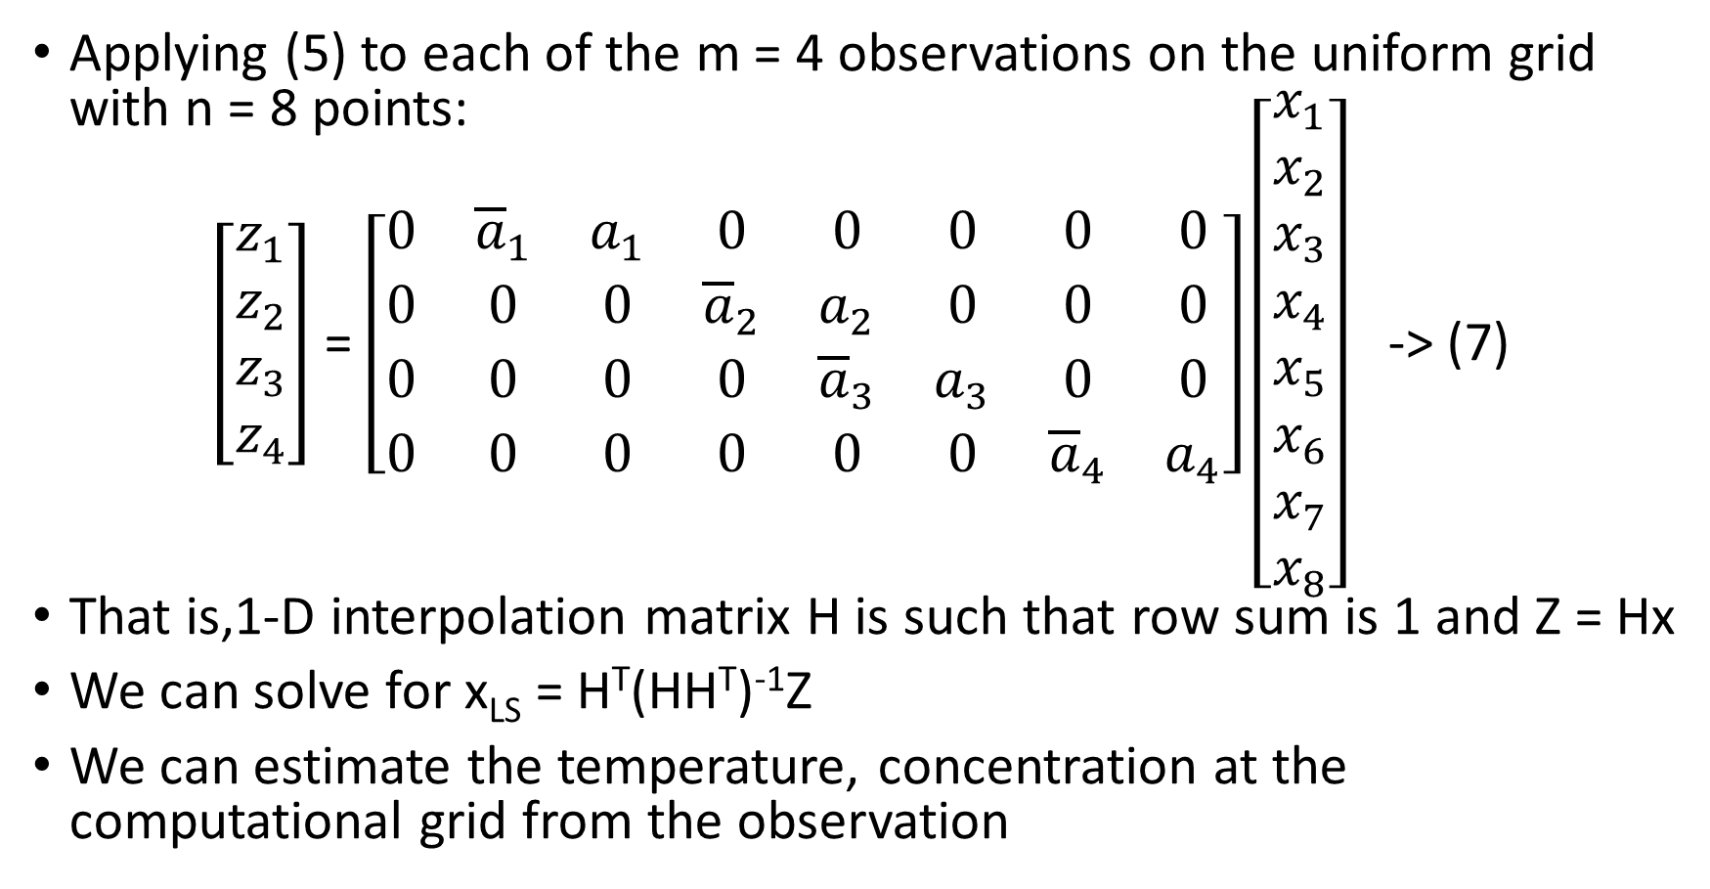
A LINEAR INVERSE PROBLEM: UNDERDETERMINED CASE
Applying (5) to each of the m = 4 observations on the uniform grid with n = 8 points:
$\left[\begin{aligned}z_{1} \\ z_{2} \\ z_{3} \\ z_{4}\end{aligned}\right]$ = $\left[\begin{matrix}0 & {\overline{a}}_{1} & a_{1} & 0 & 0 & 0 & 0 & 0 \\ 0 & 0 & 0 & {\overline{a}}_{2} & a_{2} & 0 & 0 & 0 \\ 0 & 0 & 0 & 0 & {\overline{a}}_{3} & a_{3} & 0 & 0 \\ 0 & 0 & 0 & 0 & 0 & 0 & {\overline{a}}_{4} & a_{4}\end{matrix}\right]\left[\begin{aligned}x_{1} \\ x_{2} \\ x_{3} \\ x_{4} \\ x_{5} \\ x_{6} \\ x_{7} \\ x_{8}\end{aligned}\right]$ -> (7)
That is,1-D interpolation matrix H is such that row sum is 1 and Z = Hx
We can solve for x_{LS} = H^{T}(HH^{T})⁻¹Z
We can estimate the temperature, concentration at the computational grid from the observation
1 2 3 4 5 6 7 8

Slide 15
SPATIAL INTERPOLATION – 2D
Consider 2-D version with n = n_{x}n_{y} grid points arranged in an n_{x} by n_{y} uniform grid:
The left numbering is row major order scheme and the right is the standard (i, j) notation
The node label k in row major order related to the (i, j) scheme as
k = (i -1)n_{x} + j
With n_{x} = 4, the node label 7 correspond to (2,3) since 7 = (2-1)*4+3
13
14
15
16
41
42
43
44
z₄
31
34
9
12
n_{y} = 4
32
33
n_{y} = 4
10
11
z₃
5
8
21
22
24
6
7
23
z₁
z₂
1
2
3
4
11
12
13
14
n_{x}= 4
n_{x}= 4

Slide 16



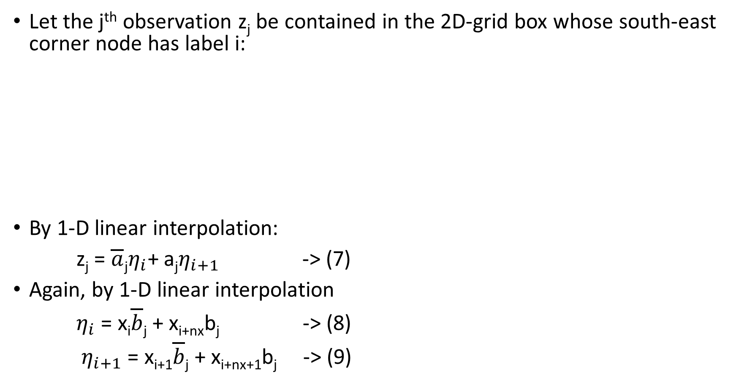



A BILINEAR INTERPOLATION
Let the j^{th} observation z_{j} be contained in the 2D-grid box whose south-east corner node has label i:
By 1-D linear interpolation:
z_{j} = $\overline{a}$_{j}$η_{i}$+ a_{j}$η_{i+1}$ -> (7)
Again, by 1-D linear interpolation
$η_{i}$ = x_{i}$\overline{b}$_{j} + x_{i+nx}b_{j} -> (8)
$η_{i+1}$ = x_{i+1}$\overline{b}$_{j} + x_{i+nx+1}b_{j} -> (9)
i + n_{x}
i + n_{x} + 1
$\overline{b}$_{j}
a_{j} + $\overline{a}$_{j} = 1
$$η_{i}$$
$$η_{i+1}$$
z_{j}
b_{j} + $\overline{b}$_{j} = 1
b_{j}
i
a_{j}
$\overline{a}$_{j}
i + 1

Slide 17
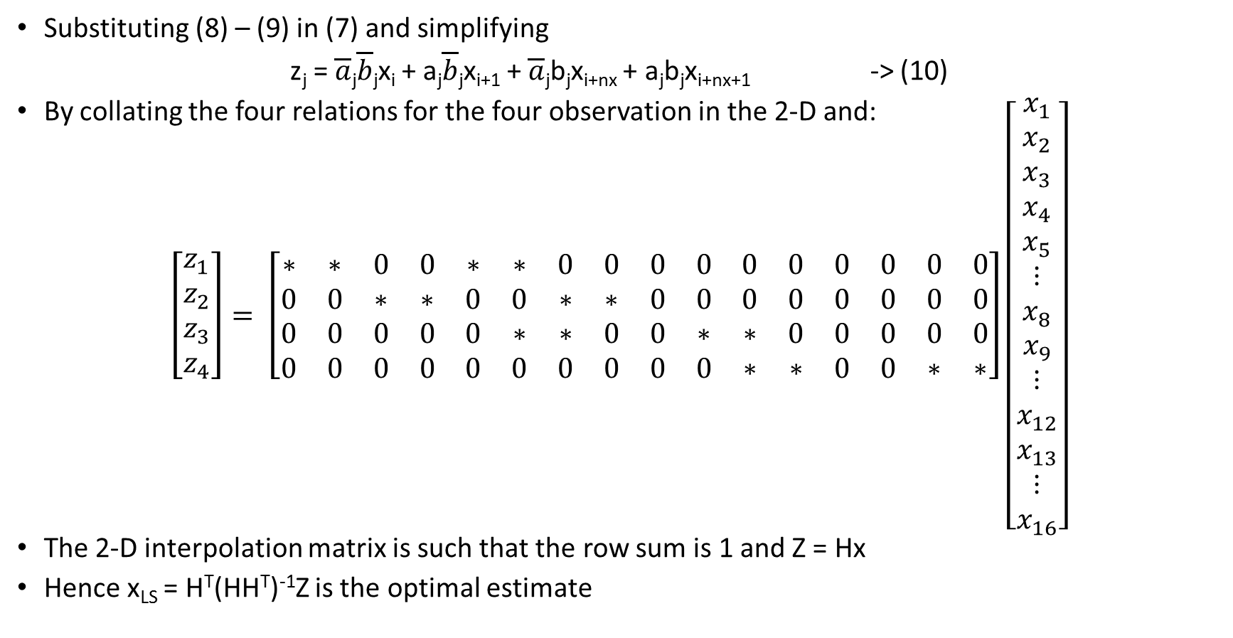
A LINEAR INVERSE PROBLEM
Substituting (8) – (9) in (7) and simplifying
z_{j} = $\overline{a}$_{j}$\overline{b}$_{j}x_{i} + a_{j}$\overline{b}$_{j}x_{i+1} + $\overline{a}$_{j}b_{j}x_{i+nx} + a_{j}b_{j}x_{i+nx+1} -> (10)
By collating the four relations for the four observation in the 2-D and:
$$\left[\begin{aligned}z_{1} \\ z_{2} \\ z_{3} \\ z_{4}\end{aligned}\right]= \left[\begin{matrix}∗ & ∗ & 0 & 0 & ∗ & ∗ & 0 & 0 & 0 & 0 & 0 & 0 & 0 & 0 & 0 & 0 \\ 0 & 0 & ∗ & ∗ & 0 & 0 & ∗ & ∗ & 0 & 0 & 0 & 0 & 0 & 0 & 0 & 0 \\ 0 & 0 & 0 & 0 & 0 & ∗ & ∗ & 0 & 0 & ∗ & ∗ & 0 & 0 & 0 & 0 & 0 \\ 0 & 0 & 0 & 0 & 0 & 0 & 0 & 0 & 0 & 0 & ∗ & ∗ & 0 & 0 & ∗ & ∗\end{matrix}\right]\left[\begin{aligned}x_{1} \\ x_{2} \\ x_{3} \\ x_{4} \\ x_{5} \\ ⋮ \\ x_{8} \\ x_{9} \\ ⋮ \\ x_{12} \\ x_{13} \\ ⋮ \\ x_{16}\end{aligned}\right]$$
The 2-D interpolation matrix is such that the row sum is 1 and Z = Hx
Hence x_{LS} = H^{T}(HH^{T})⁻¹Z is the optimal estimate
1 2 3 4 5 6 7 8 9 10 11 12 13 14 15 16
* - represents non-zero element based on (10)

Slide 18

PROBLEM 3: A NON LINEAR PROBLEM
Con sider a three layered atmosphere
Let T(Ϸ) = x₁(Ϸ - x₂)² + x₃ , 0 ≤ Ϸ ≤ 1 -> (9)
Let x = (x₁, x₂, x₃)^{T} $∈$ R³ be the unknown
Ϸ = 0.0
T₃ Layer 3
Ϸ = 0.2
T₂ Layer 2
Ϸ = 0.5
T₁ Layer 1
T₀
Ϸ = 0.0

Slide 19
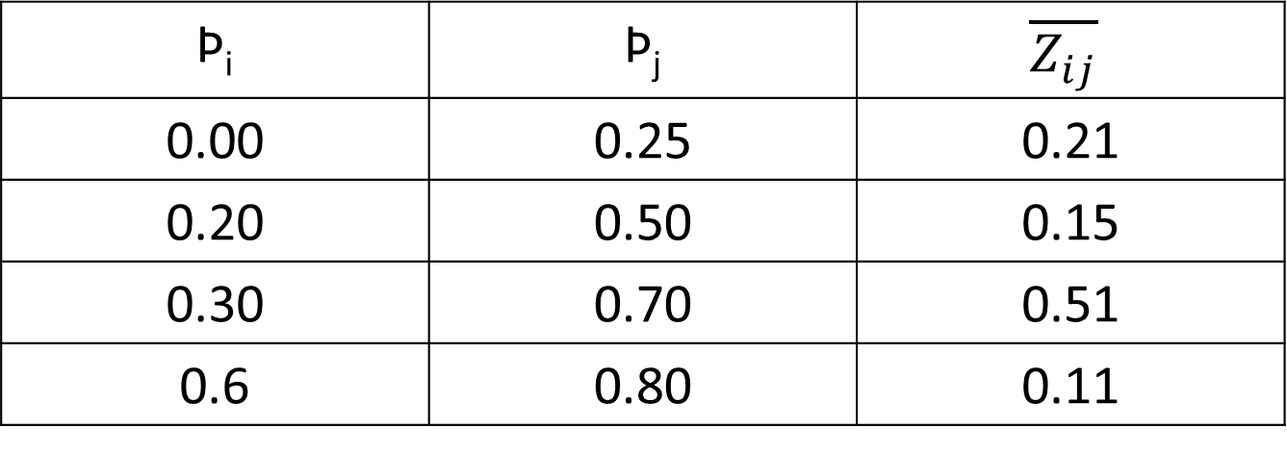

RELATION BETWEEN TEMPERATURE AND RADIANCE
The observations are measures of overlapping fractions of the area under the curve:
$\overline{Z_{ij}}= \int_{{\text{Ϸ}}_{i}}^{{\text{Ϸ}}_{j}}{T\left(\text{Ϸ}\right)d\text{Ϸ}}$ -> (10)
The observations are given by
$\text{Ϸ}$_{i} | $\text{Ϸ}$_{j} | $$\overline{Z_{ij}}$$
0.00 | 0.25 | 0.21
0.20 | 0.50 | 0.15
0.30 | 0.70 | 0.51
0.6 | 0.80 | 0.11

Slide 20
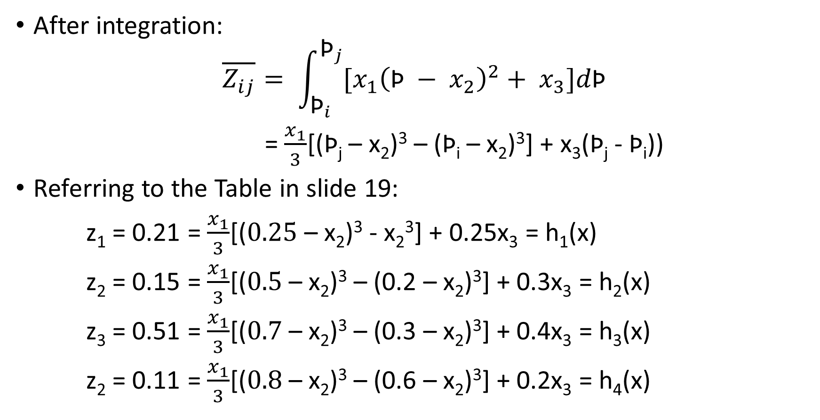
THE MODEL EQUATIONS
After integration:
$$\overline{Z_{ij}}= \int_{{\text{Ϸ}}_{i}}^{{\text{Ϸ}}_{j}}{[x_{1}{\left(\text{Ϸ} − x_{2}\right)}^{2}+ x_{3}]d\text{Ϸ}}$$
= $\frac{x_{1}}{3}$[($\text{Ϸ}$_{j} – x₂)³ – ($\text{Ϸ}$_{i} – x₂)³] + x₃($\text{Ϸ}$_{j} - $\text{Ϸ}$_{i}))
Referring to the Table in slide 19:
z₁ = 0.21 = $\frac{x_{1}}{3}$[($0.25$– x₂)³ - x₂³] + 0.25x₃ = h₁(x)
z₂ = 0.15 = $\frac{x_{1}}{3}$[($0.5$– x₂)³ – (0.2 – x₂)³] + 0.3x₃ = h₂(x)
z₃ = 0.51 = $\frac{x_{1}}{3}$[($0.7$– x₂)³ – (0.3 – x₂)³] + 0.4x₃ = h₃(x)
z₂ = 0.11 = $\frac{x_{1}}{3}$[($0.8$– x₂)³ – (0.6 – x₂)³] + 0.2x₃ = h₄(x)

Slide 21

NONLINEAR INVERSE PROBLEM
Let Z = h(x) with Z = (z₁, z₂, z₃, z₄)^{T}
h(x) = (h₁(x), h₂(x), h₃(x), h₄(x))^{T}
Compute r(x) = Z – h(x)
compute f(x) = (Z- h(x))^{T}(Z – h(x))
Set $∇$_{x}f(x) = 0 and solve for x
Check if $∇_{x}^{2}$f(x) is PD

Slide 22
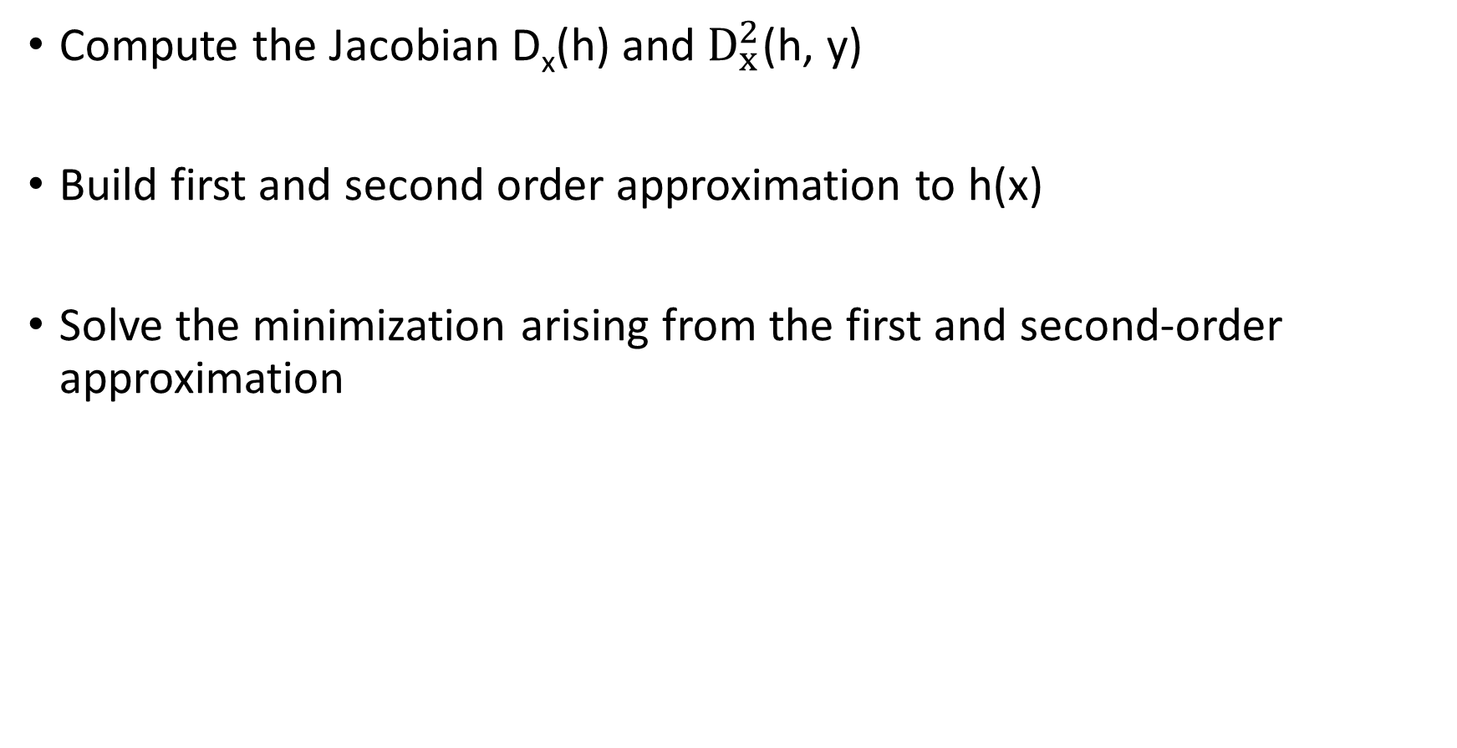
APPROXIMATIONS
Compute the Jacobian D_{x}(h) and $D_{x}^{2}$(h, y)
Build first and second order approximation to h(x)
Solve the minimization arising from the first and second-order approximation

Slide 23
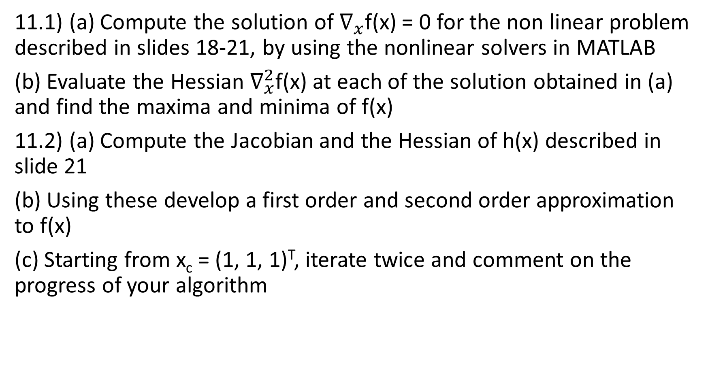
EXERCISES
11.1) (a) Compute the solution of $∇_{x}$f(x) = 0 for the non linear problem described in slides 18-21, by using the nonlinear solvers in MATLAB
(b) Evaluate the Hessian $∇_{x}^{2}$f(x) at each of the solution obtained in (a) and find the maxima and minima of f(x)
11.2) (a) Compute the Jacobian and the Hessian of h(x) described in slide 21
(b) Using these develop a first order and second order approximation to f(x)
(c) Starting from x_{c} = (1, 1, 1)^{T}, iterate twice and comment on the progress of your algorithm

Slide 24
REFERENCES
This module follows closely chapters 5 through 7 of LLD (2006)

