Slide 1
ON-LINE/SEQUENTIAL/RECURSIVE LEAST SQUARES PROBLEM
Module - 10
AN OVERVIEW
S. Lakshmivarahan
School of Computer Science
University of Oklahoma
Norman, Ok – 73069, USA
varahan@ou.edu
Date 10/23/2015

Slide 2
OFF-LINE VS ONLINE PROBLEMS
So far we have assumed that the number m of observations are fixed and all the observations are known in advance
This treatment is known as fixed sample or off-line version of the least squares problem
It is conceivable that all the observations are not known in advance but be arriving in a sequence, one at a time
In this case, it is prudent to get an optimal estimate x_{LS}(m) based on m observation
Then, update it to obtain x_{LS}(m+1) when a new observation arrives on the scene

Slide 3
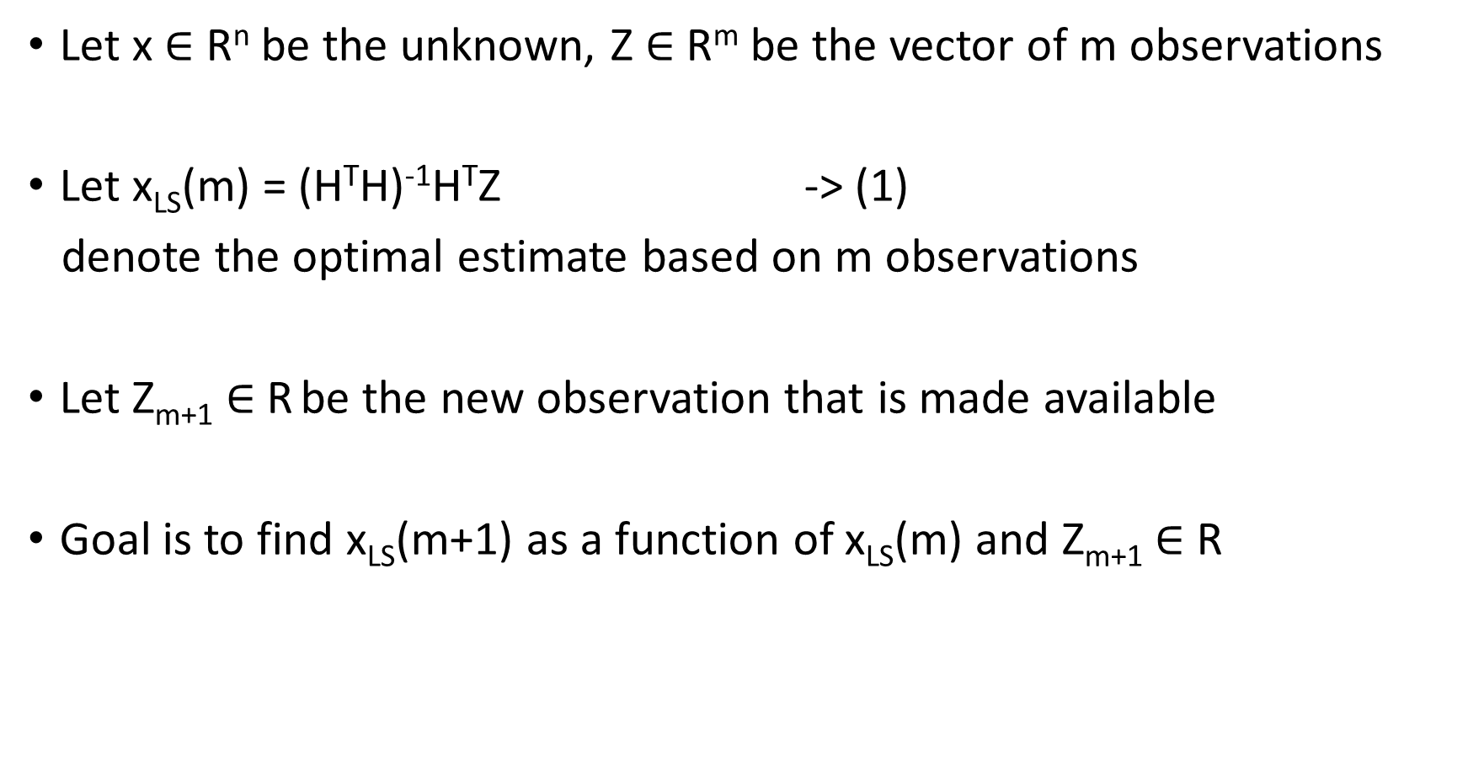
A SEQUENTIAL/RECURSIVE FRAMEWORK
Let x $∈$ R^{n} be the unknown, Z $∈$ R^{m} be the vector of m observations
Let x_{LS}(m) = (H^{T}H)⁻¹H^{T}Z -> (1)
denote the optimal estimate based on m observations
Let Z_{m+1} $∈$ R be the new observation that is made available
Goal is to find x_{LS}(m+1) as a function of x_{LS}(m) and Z_{m+1} $∈$ R

Slide 4
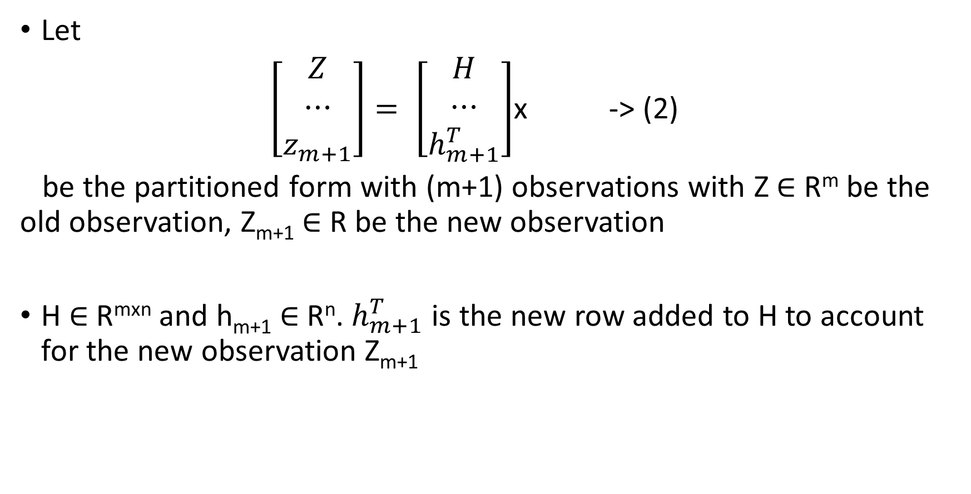
A SEQUENTIAL FORMULATION
Let
$\left[\begin{aligned}Z \\ ⋯ \\ z_{m+1}\end{aligned}\right]= \left[\begin{aligned}H \\ ⋯ \\ h_{m+1}^{T}\end{aligned}\right]$x -> (2)
be the partitioned form with (m+1) observations with Z $∈$ R^{m} be the old observation, Z_{m+1} $∈$ R be the new observation
H $∈$ R^{mxn} and h_{m+1} $∈$ R^{n}. $h_{m+1}^{T}$ is the new row added to H to account for the new observation Z_{m+1}

Slide 5
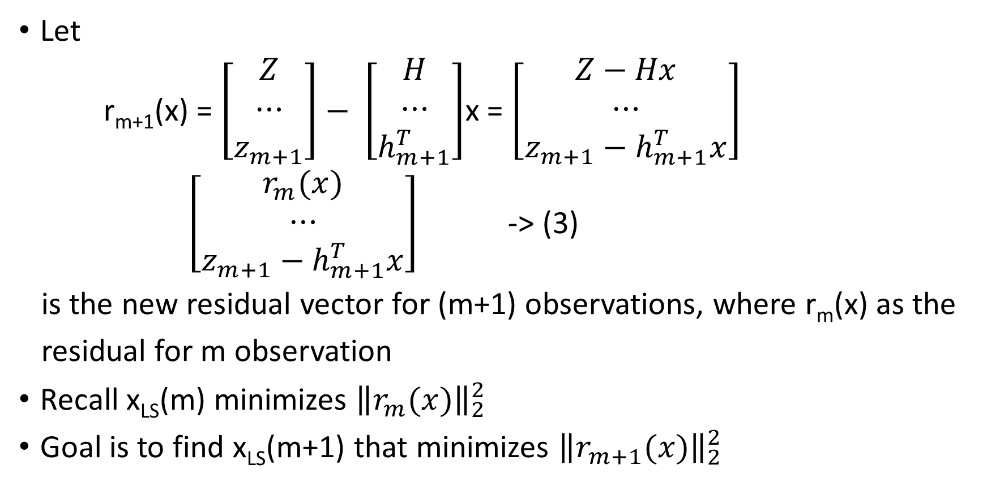
A RECURSIVE VIEW OF RESIDUALS
Let
r_{m+1}(x) = $\left[\begin{aligned}Z \\ ⋯ \\ z_{m+1}\end{aligned}\right]− \left[\begin{aligned}H \\ ⋯ \\ h_{m+1}^{T}\end{aligned}\right]$x = $\left[\begin{aligned}Z−Hx \\ ⋯ \\ {z_{m+1}−h}_{m+1}^{T}x\end{aligned}\right]$
$\left[\begin{aligned}r_{m}(x) \\ ⋯ \\ {z_{m+1}−h}_{m+1}^{T}x\end{aligned}\right]$ -> (3)
is the new residual vector for (m+1) observations, where r_{m}(x) as the
residual for m observation
Recall x_{LS}(m) minimizes ${\left\|r_{m}(x)\right\|}_{2}^{2}$
Goal is to find x_{LS}(m+1) that minimizes ${\left\|r_{m+1}(x)\right\|}_{2}^{2}$

Slide 6
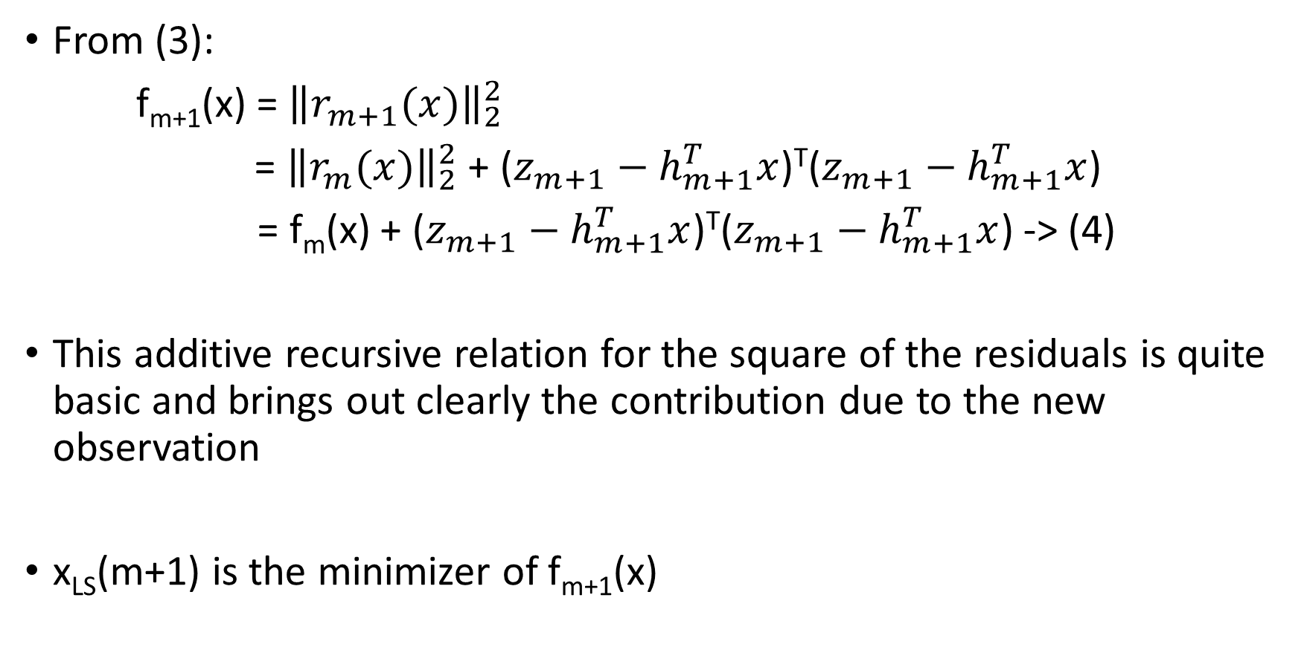
A RECURSIVE VIEW OF SQUARE OF RESIDUALS
From (3):
f_{m+1}(x) = ${\left\|r_{m+1}(x)\right\|}_{2}^{2}$
= ${\left\|r_{m}(x)\right\|}_{2}^{2}$ + (${z_{m+1}−h}_{m+1}^{T}x$)^{T}(${z_{m+1}−h}_{m+1}^{T}x$)
= f_{m}(x) + (${z_{m+1}−h}_{m+1}^{T}x$)^{T}(${z_{m+1}−h}_{m+1}^{T}x$) -> (4)
This additive recursive relation for the square of the residuals is quite basic and brings out clearly the contribution due to the new observation
x_{LS}(m+1) is the minimizer of f_{m+1}(x)

Slide 7
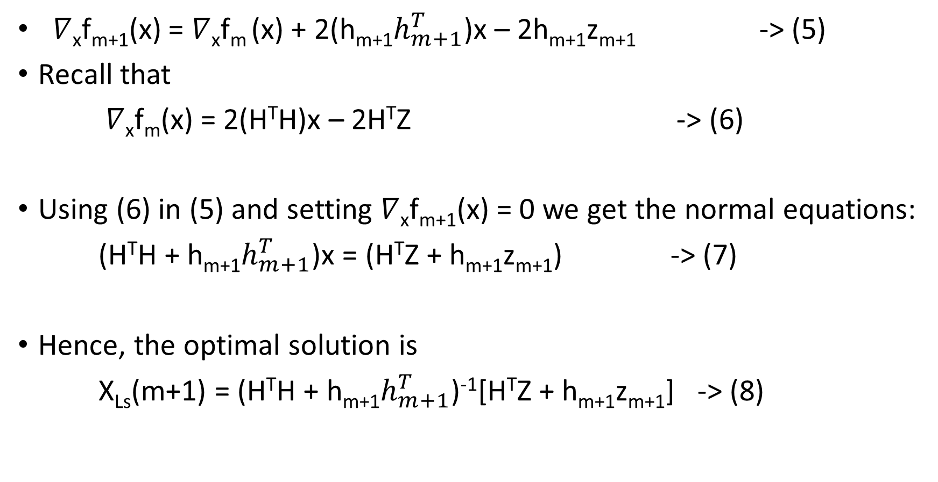
OPTIMAL SOLUTION
$∇$_{x}f_{m+1}(x) = $∇$_{x}f_{m} (x) + 2(h_{m+1}$h_{m+1}^{T}$)x – 2h_{m+1}z_{m+1} -> (5)
Recall that
$∇$_{x}f_{m}(x) = 2(H^{T}H)x – 2H^{T}Z -> (6)
Using (6) in (5) and setting $∇$_{x}f_{m+1}(x) = 0 we get the normal equations:
(H^{T}H + h_{m+1}$h_{m+1}^{T}$)x = (H^{T}Z + h_{m+1}z_{m+1}) -> (7)
Hence, the optimal solution is
X_{Ls}(m+1) = (H^{T}H + h_{m+1}$h_{m+1}^{T}$)⁻¹[H^{T}Z + h_{m+1}z_{m+1}] -> (8)

Slide 8
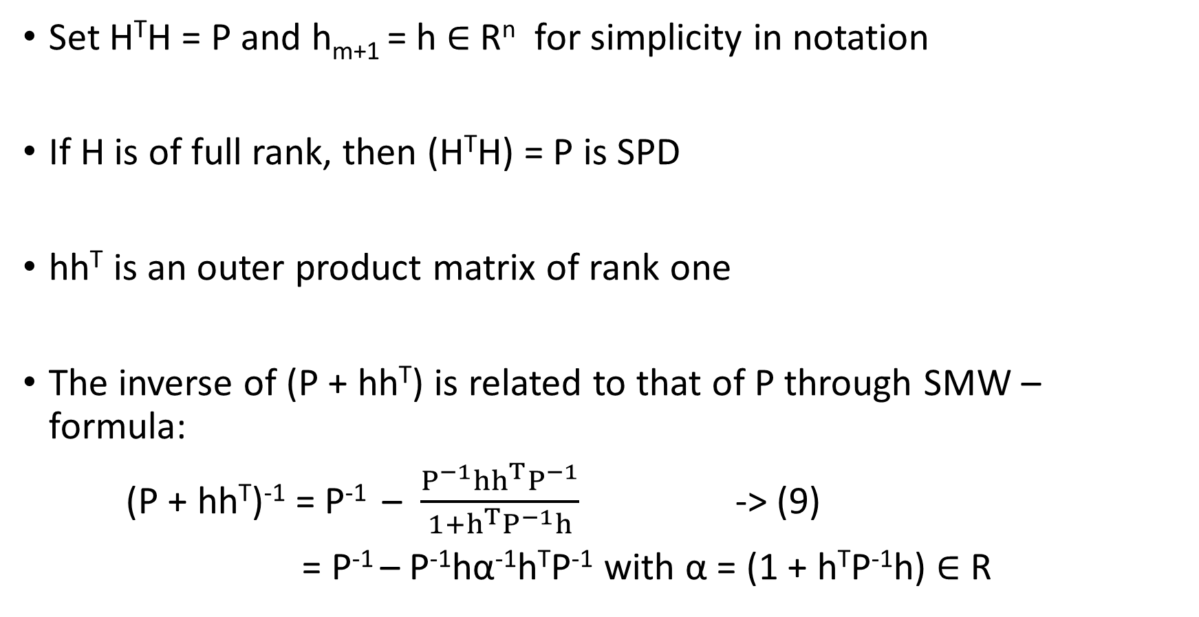
SHERMAN-MORRISON-WOODBURY (SMW) - FORMULA
Set H^{T}H = P and h_{m+1} = h $∈$ R^{n} for simplicity in notation
If H is of full rank, then (H^{T}H) = P is SPD
hh^{T} is an outer product matrix of rank one
The inverse of (P + hh^{T}) is related to that of P through SMW – formula:
(P + hh^{T})⁻¹ = P⁻¹ – $\frac{P^{−1}hh^{T}P^{−1}}{1+h^{T}P^{−1}h}$ -> (9)
= P⁻¹ – P⁻¹hα⁻¹h^{T}P⁻¹ with α = (1 + h^{T}P⁻¹h) $∈$ R

Slide 9
A RECURSIVE FORM FOR OPTIMAL SOLUTION
Rewrite (8) as
X_{Ls}(m+1) = (P + hh^{T})⁻¹[H^{T}Z + hz_{m+1}] -> (10)
Use (9) in (10) to get
X_{Ls}(m+1) = (P⁻¹ – P⁻¹hα⁻¹h^{T}P⁻¹][H^{T}Z + hz_{m+1}] -> (11)
Since P⁻¹H^{T}Z = (H^{T}H)⁻¹H^{T}Z = X_{Ls}(m):
X_{Ls}(m+1) = X_{Ls}(m) + P⁻¹hz_{m} – P⁻¹hα⁻¹h^{T}x_{LS}(m) - P⁻¹hα⁻¹(h^{T}P⁻¹h)z_{m+1}
-> (12)

Slide 10
A RECURSIVE FORM
But
P⁻¹hα⁻¹(h^{T}P⁻¹h)z_{m+1} = P⁻¹hα⁻¹(α - 1)z_{m}
= P⁻¹hz_{m} - P⁻¹h α⁻¹z_{m} -> (13)
Substitute (13) in (12):
X_{Ls}(m+1) = X_{Ls}(m) + P⁻¹hα⁻¹[z_{m+1} – h^{T}x_{LS}(m)] -> (14)
z_{m+1} – h^{T}x_{LS}(m) is called the innovation or the new information from z_{m+1}

Slide 11
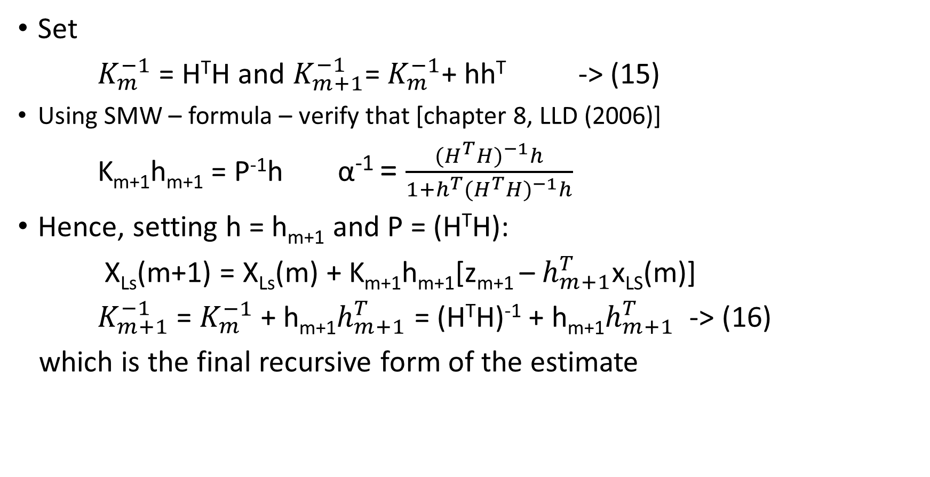
RECURSIVE STRUCTURE OF P⁻¹hα⁻¹
Set
$K_{m}^{−1}$ = H^{T}H and $K_{m+1}^{−1}$= $K_{m}^{−1}$+ hh^{T} -> (15)
Using SMW – formula – verify that [chapter 8, LLD (2006)]
K_{m+1}h_{m+1} = P⁻¹h α⁻¹ = $\frac{{{(H}^{T}H)}^{−1}h}{1+h^{T}{(H^{T}H)}^{−1}h}$
Hence, setting h = h_{m+1} and P = (H^{T}H):
X_{Ls}(m+1) = X_{Ls}(m) + K_{m+1}h_{m+1}[z_{m+1} – $h_{m+1}^{T}$x_{LS}(m)]
$K_{m+1}^{−1}$ = $K_{m}^{−1}$ + h_{m+1}$h_{m+1}^{T}$ = (H^{T}H)⁻¹ + h_{m+1}$h_{m+1}^{T}$ -> (16)
which is the final recursive form of the estimate

Slide 12
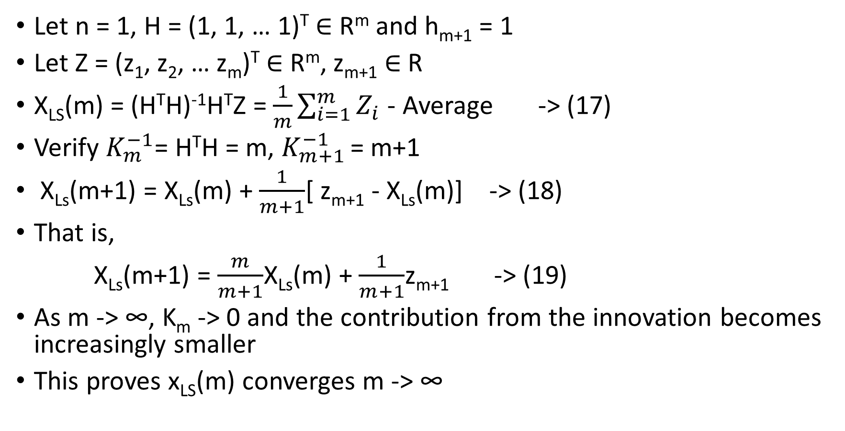
SEQUENTIAL COMPUTATION OF AVERAGE
Let n = 1, H = (1, 1, … 1)^{T} $∈$ R^{m} and h_{m+1} = 1
Let Z = (z₁, z₂, … z_{m})^{T} $∈$ R^{m}, z_{m+1} $∈$ R
X_{LS}(m) = (H^{T}H)⁻¹H^{T}Z = $\frac{1}{m}\sum_{i=1}^{m}{Z_{i}}$ - Average -> (17)
Verify $K_{m}^{−1}$= H^{T}H = m, $K_{m+1}^{−1}$ = m+1
X_{Ls}(m+1) = X_{Ls}(m) + $\frac{1}{m+1}$[ z_{m+1} - X_{Ls}(m)] -> (18)
That is,
X_{Ls}(m+1) = $\frac{m}{m+1}$X_{Ls}(m) + $\frac{1}{m+1}$z_{m+1} -> (19)
As m -> ∞, K_{m} -> 0 and the contribution from the innovation becomes increasingly smaller
This proves x_{LS}(m) converges m -> ∞

Slide 13
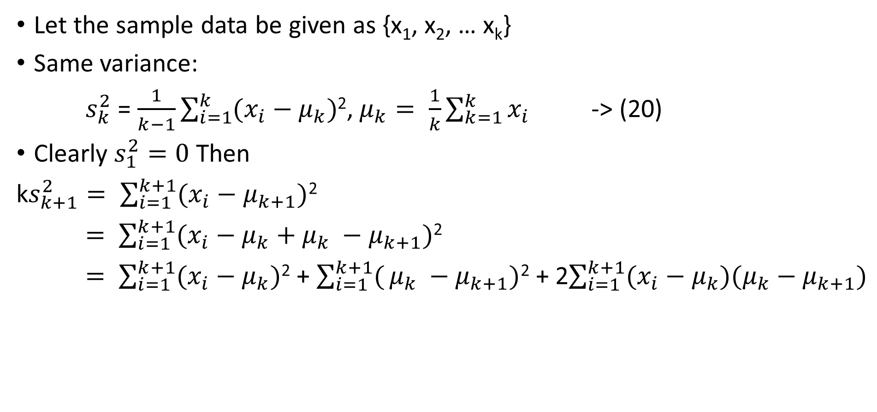
SEQUENTIAL COMPUTATION OF SAMPLE VARIANCE
Let the sample data be given as {x₁, x₂, … x_{k}}
Same variance:
$s_{k}^{2}$ = $\frac{1}{k−1}\sum_{i=1}^{k}{(x_{i}}−μ_{k})$², $μ_{k}= \frac{1}{k}\sum_{k=1}^{k}{x_{i}}$ -> (20)
Clearly $s_{1}^{2}=0$ Then
k$s_{k+1}^{2}= \sum_{i=1}^{k+1}{(x_{i}}−μ_{k+1})$²
$= \sum_{i=1}^{k+1}{(x_{i}}−μ_{k}+μ_{k} −μ_{k+1})$²
$= \sum_{i=1}^{k+1}{(x_{i}}−μ_{k})$² + $\sum_{i=1}^{k+1}{(}μ_{k} −μ_{k+1})$² + 2$\sum_{i=1}^{k+1}{(x_{i}}−μ_{k}){(μ}_{k} − μ_{k+1})$
-> (21)
I
II
III

Slide 14
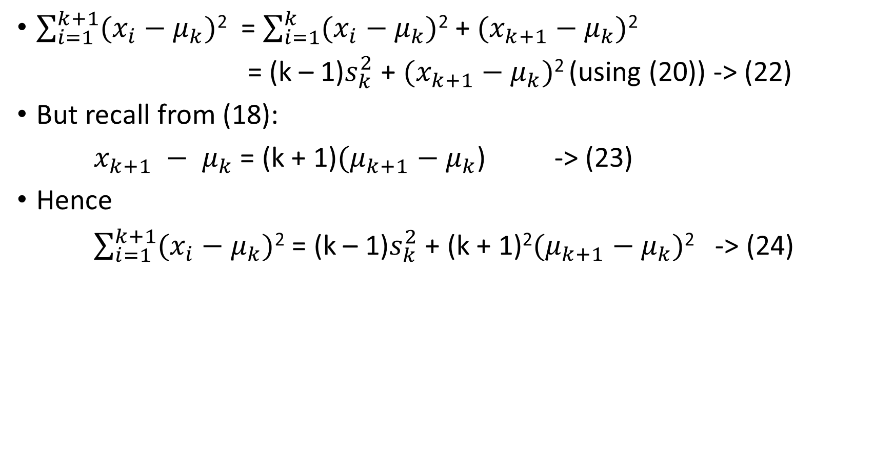
TERM I
$\sum_{i=1}^{k+1}{(x_{i}}−μ_{k})$² = $\sum_{i=1}^{k}{(x_{i}}−μ_{k})$² + ${(x}_{k+1} − μ_{k})$²
= (k – 1)$s_{k}^{2}$ + ${(x}_{k+1} − μ_{k})$² (using (20)) -> (22)
But recall from (18):
$x_{k+1} − μ_{k}$ = (k + 1)${(μ}_{k+1} − μ_{k}$) -> (23)
Hence
$\sum_{i=1}^{k+1}{(x_{i}}−μ_{k})$² = (k – 1)$s_{k}^{2}$ + (k + 1)²${(μ}_{k+1} − μ_{k})$² -> (24)

Slide 15
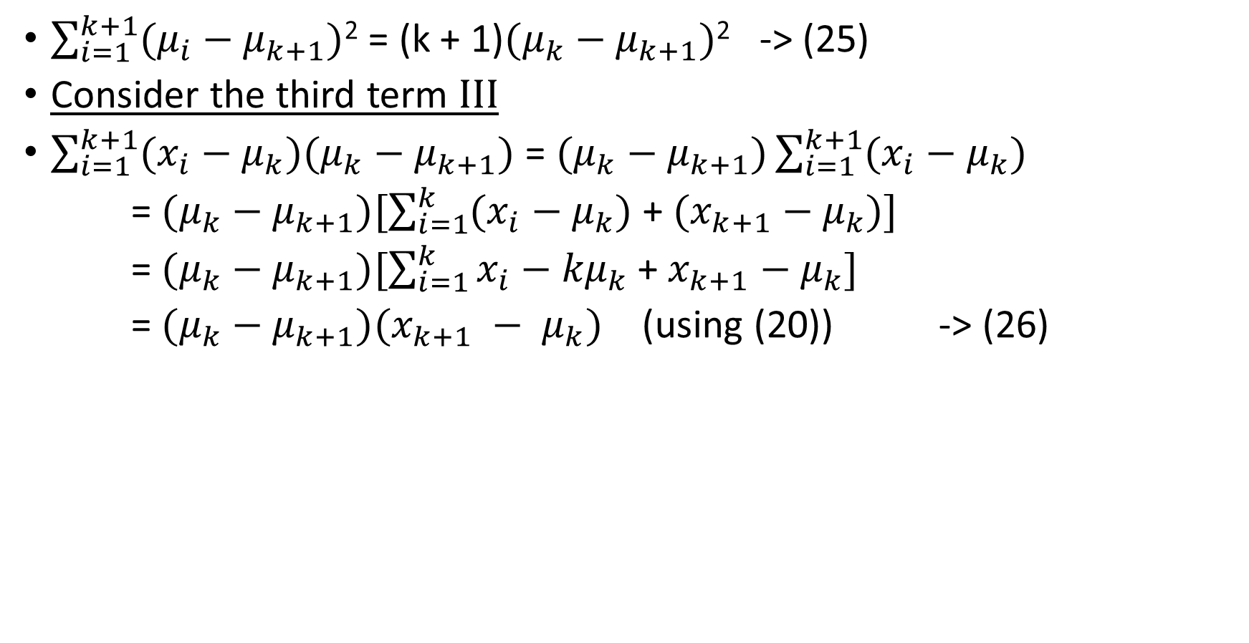
TERM II AND III
$\sum_{i=1}^{k+1}{(μ_{i}}−μ_{k+1})$² = (k + 1)${(μ}_{k} − μ_{k+1})$² -> (25)
Consider the third term III
$\sum_{i=1}^{k+1}{(x_{i}}−μ_{k}){(μ}_{k} − μ_{k+1})$ = ${(μ}_{k} − μ_{k+1})\sum_{i=1}^{k+1}{(x_{i}}−μ_{k})$
= ${(μ}_{k} − μ_{k+1})[\sum_{i=1}^{k}{(x_{i}}−μ_{k})$ +${ (x}_{k+1} − μ_{k})]$
= ${(μ}_{k} − μ_{k+1})[\sum_{i=1}^{k}{x_{i}}−{kμ}_{k}$+${ x}_{k+1} − μ_{k}]$
= ${(μ}_{k} − μ_{k+1})(x_{k+1} − μ_{k})$ (using (20)) -> (26)

Slide 16

TERM III
But from (18)
$(x_{k+1} − μ_{k})$ = (k + 1)$(μ_{k+1} − μ_{k})$ -> (27)
Using this in (26):
Term III = - (k + 1)($μ_{k} − μ_{k+1})$² -> (28)

Slide 17
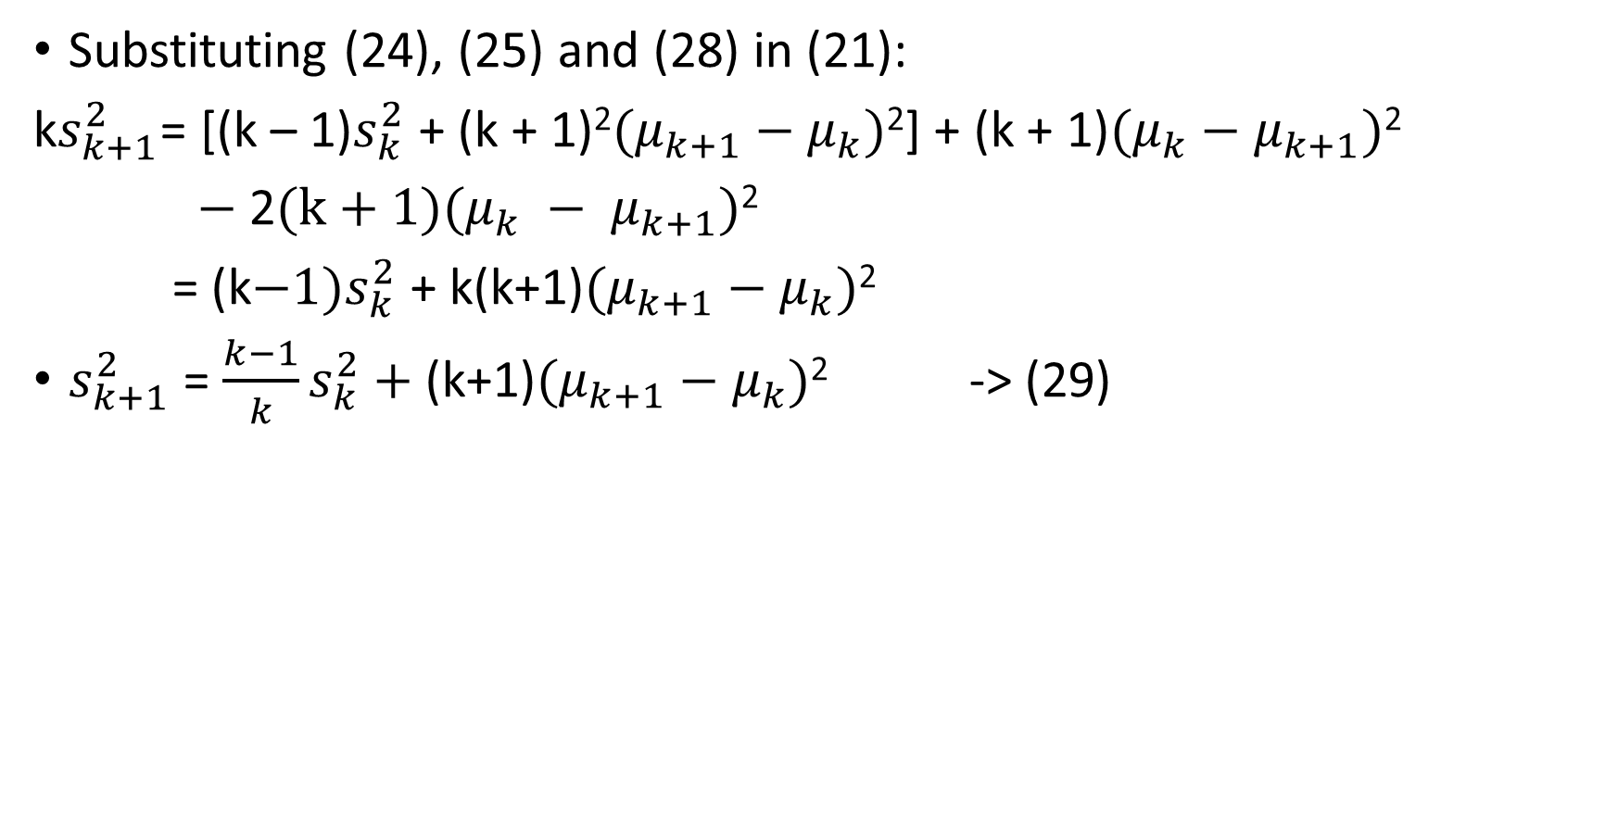
FINAL ASSEMBLY – A RECURSIVE FORMULA
Substituting (24), (25) and (28) in (21):
k$s_{k+1}^{2}$= [(k – 1)$s_{k}^{2}$ + (k + 1)²${(μ}_{k+1} − μ_{k})$²] + (k + 1)${(μ}_{k} − μ_{k+1})$²
$−$ 2(k + 1)($μ_{k} − μ_{k+1})$²
= (k${−1)s}_{k}^{2}$ + k(k+1)${(μ}_{k+1} − μ_{k})$²
$s_{k+1}^{2}$ = $\frac{k−1}{k}s_{k}^{2}+$(k+1)${(μ}_{k+1} − μ_{k})$² -> (29)

Slide 18
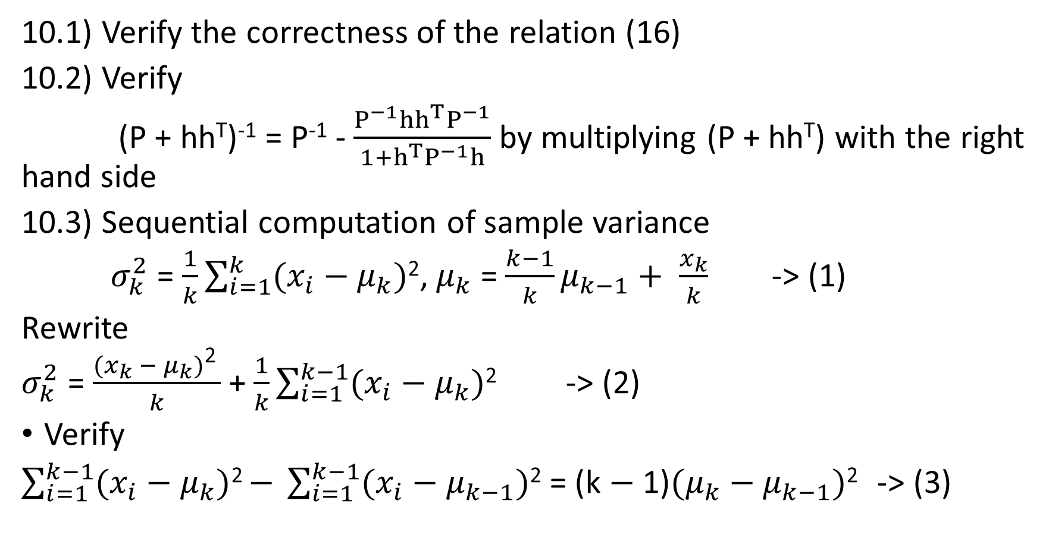
EXERCISES
10.1) Verify the correctness of the relation (16)
10.2) Verify
(P + hh^{T})⁻¹ = P⁻¹ - $\frac{P^{−1}hh^{T}P^{−1}}{1+h^{T}P^{−1}h}$ by multiplying (P + hh^{T}) with the right hand side
10.3) Sequential computation of sample variance
$σ_{k}^{2}$ = $\frac{1}{k}\sum_{i=1}^{k}{(x_{i}}−μ_{k})$², $μ_{k}$ = $\frac{k−1}{k}μ_{k−1}+ \frac{x_{k}}{k}$ -> (1)
Rewrite
$σ_{k}^{2}$ = $\frac{{(x}_{k} − μ_{k})\text{2 }}{k}$ + $\frac{1}{k}\sum_{i=1}^{k−1}{(x_{i}}−μ_{k})$² -> (2)
Verify
$\sum_{i=1}^{k−1}{(x_{i}}−μ_{k})$² $−$ $\sum_{i=1}^{k−1}{(x_{i}}−μ_{k−1})$² = (k $−$ 1)${(μ}_{k} − μ_{k−1})$² -> (3)

Slide 19
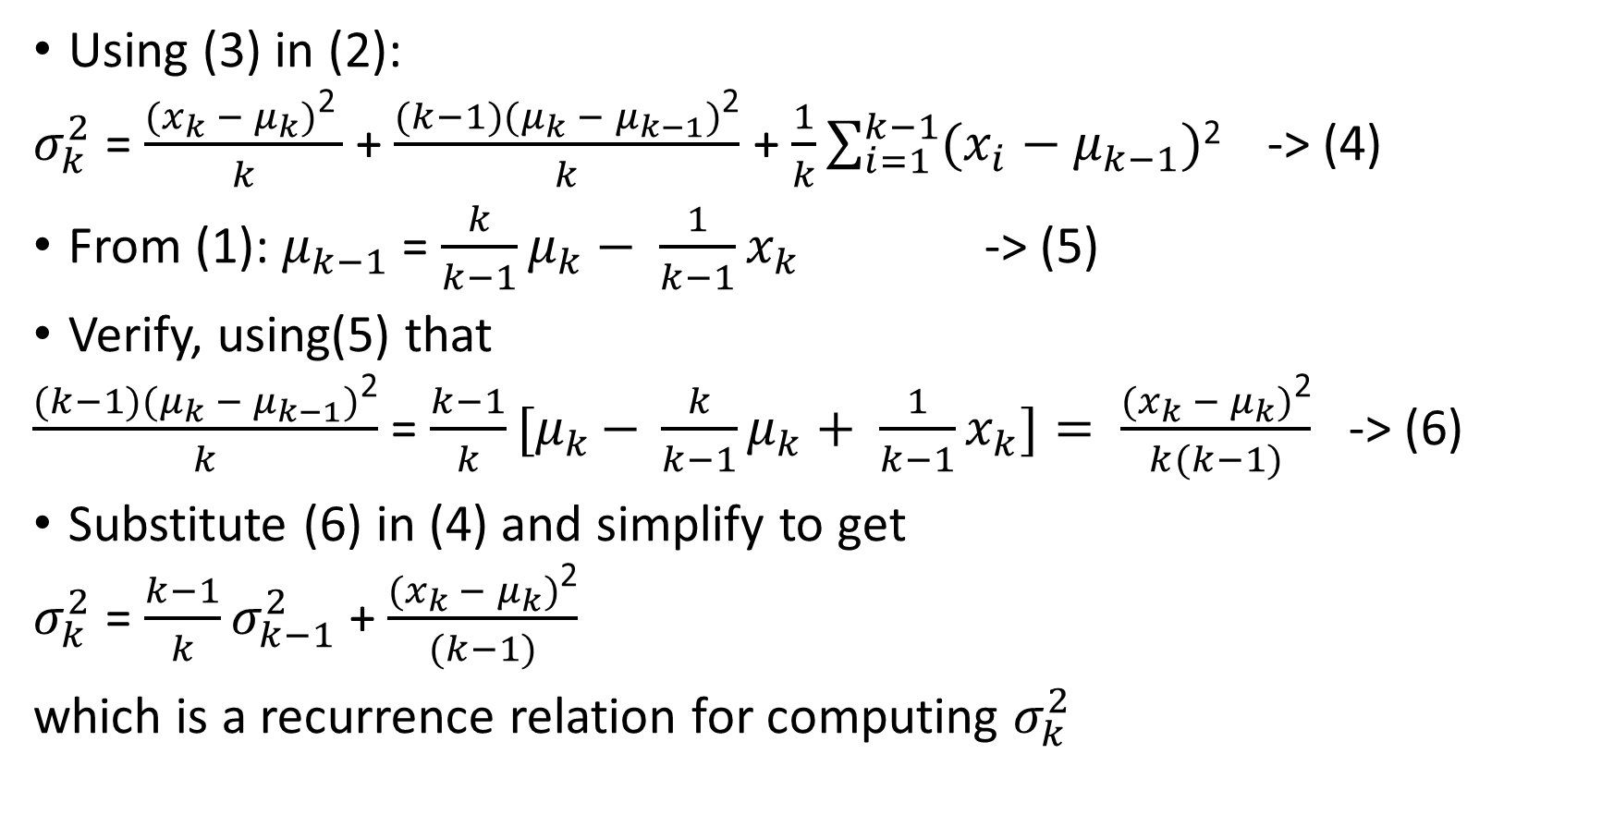
EXERCISES
Using (3) in (2):
$σ_{k}^{2}$ = $\frac{{(x}_{k} − μ_{k})\text{2 }}{k}$ + $\frac{(k−1){(μ}_{k} − μ_{k−1})\text{2}}{k}$ + $\frac{1}{k}\sum_{i=1}^{k−1}{(x_{i}}−μ_{k−1})$² -> (4)
From (1): $μ_{k−1}$ = $\frac{k}{k−1}μ_{k}− \frac{1}{k−1}x_{k}$ -> (5)
Verify, using(5) that
$\frac{(k−1){(μ}_{k} − μ_{k−1})\text{2}}{k}$ = $\frac{k−1}{k}{[μ}_{k }− \frac{k}{k−1}μ_{k}+ \frac{1}{k−1}x_{k}]= \frac{{(x}_{k} − μ_{k})\text{2}}{k(k−1)}$ -> (6)
Substitute (6) in (4) and simplify to get
$σ_{k}^{2}$ = $\frac{k−1}{k}σ_{k−1}^{2}$ + $\frac{{(x}_{k} − μ_{k})\text{2}}{(k−1)}$
which is a recurrence relation for computing $σ_{k}^{2}$

Slide 20
REFERENCES
This module follows closely the developments in chapter 8 of LLD (2006)

