Slide 1
DETERMINISTIC, STATIC, NONLINEAR INVERSE PROBLEM
Module - 9
AN OVERVIEW
S. Lakshmivarahan
School of Computer Science
University of Oklahoma
Norman, Ok – 73069, USA
varahan@ou.edu
Date 10/23/2015

Slide 2


NONLINEAR INVERSE PROBLEM
Let h: R^{n} -> R^{m} be a mapping (also called forward operator) from the model space, R^{n} to the observation space, R^{m}
Let h(x) = ( h₁(x), h₂(x), … h_{m}(x))^{T} where x $∈$ R^{n}
Given Z $∈$ R^{m} and h($∙$), the problem is to estimate x such that Z = h(x)
h
R^{n}
R^{m}
x
z

Slide 3
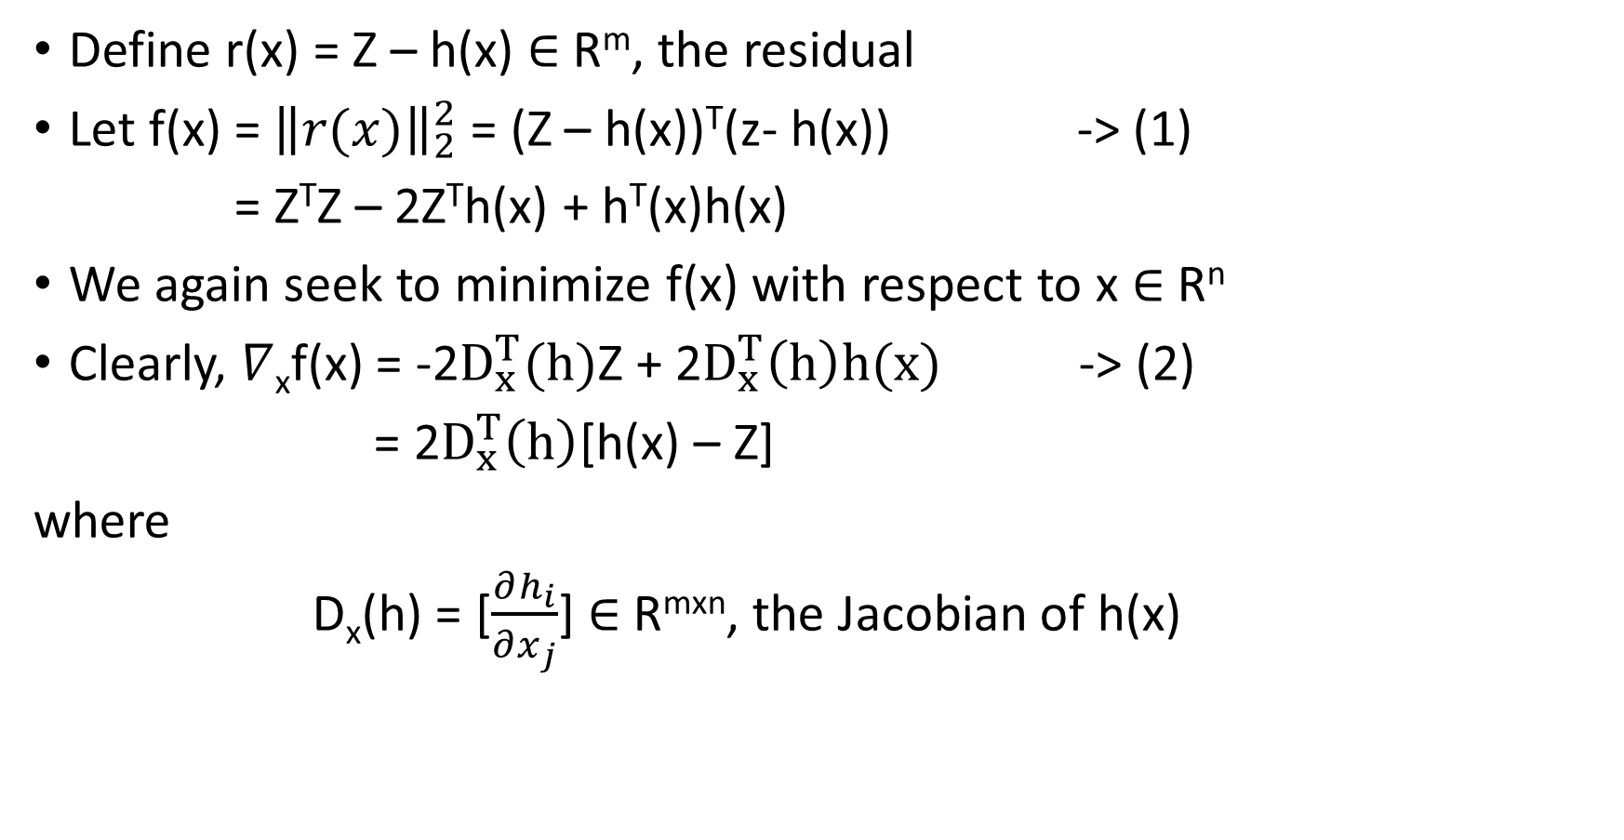
UNCONSTRAINED MINIMIZATION
Define r(x) = Z – h(x) $∈$ R^{m}, the residual
Let f(x) = ${\left\|r(x)\right\|}_{2}^{2}$ = (Z – h(x))^{T}(z- h(x)) -> (1)
= Z^{T}Z – 2Z^{T}h(x) + h^{T}(x)h(x)
We again seek to minimize f(x) with respect to x $∈$ R^{n}
Clearly, $∇$_{x}f(x) = -2$D_{x}^{T}(h)$Z + 2$D_{x}^{T}\left(h\right)h(x)$ -> (2)
= 2$D_{x}^{T}\left(h\right)$[h(x) – Z]
where
D_{x}(h) = [$\frac{∂h_{i}}{∂x_{j}}$] $∈$ R^{mxn}, the Jacobian of h(x)

Slide 4
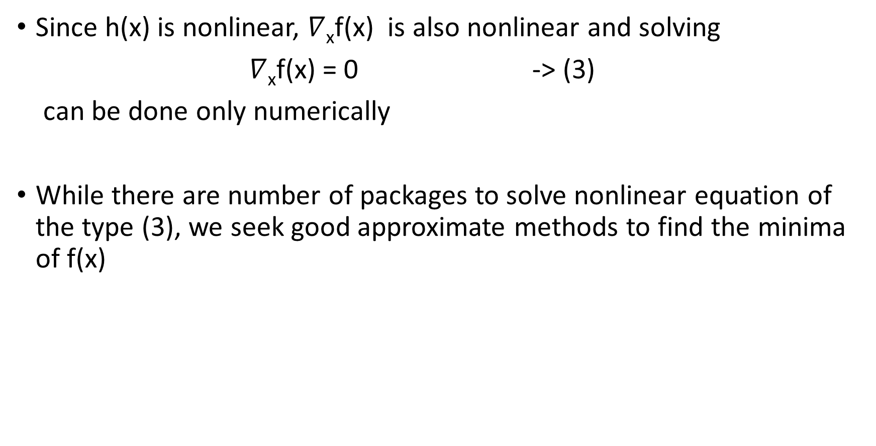
DIFFICULTY OF FINDING NECESSARY CONDITIONS
Since h(x) is nonlinear, $∇$_{x}f(x) is also nonlinear and solving
$∇$_{x}f(x) = 0 -> (3)
can be done only numerically
While there are number of packages to solve nonlinear equation of the type (3), we seek good approximate methods to find the minima of f(x)

Slide 5
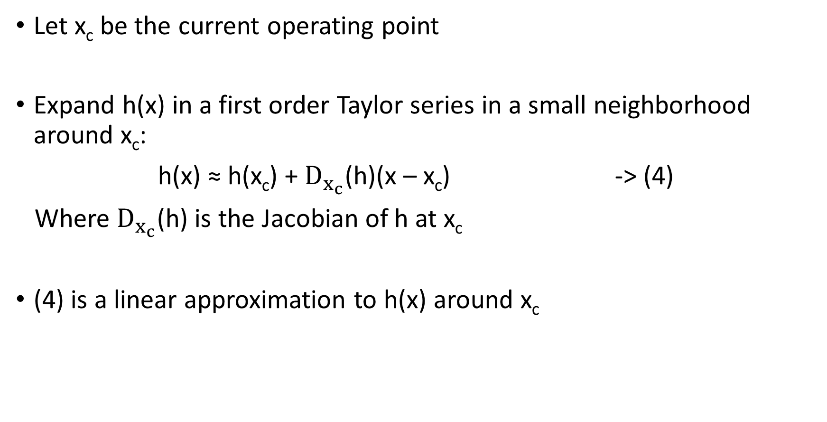
FIRST ORDER APPROXIMATION OF h(x)
Let x_{c} be the current operating point
Expand h(x) in a first order Taylor series in a small neighborhood around x_{c}:
h(x) ≈ h(x_{c}) + $D_{x_{c}}$(h)(x – x_{c}) -> (4)
Where $D_{x_{c}}$(h) is the Jacobian of h at x_{c}
(4) is a linear approximation to h(x) around x_{c}

Slide 6
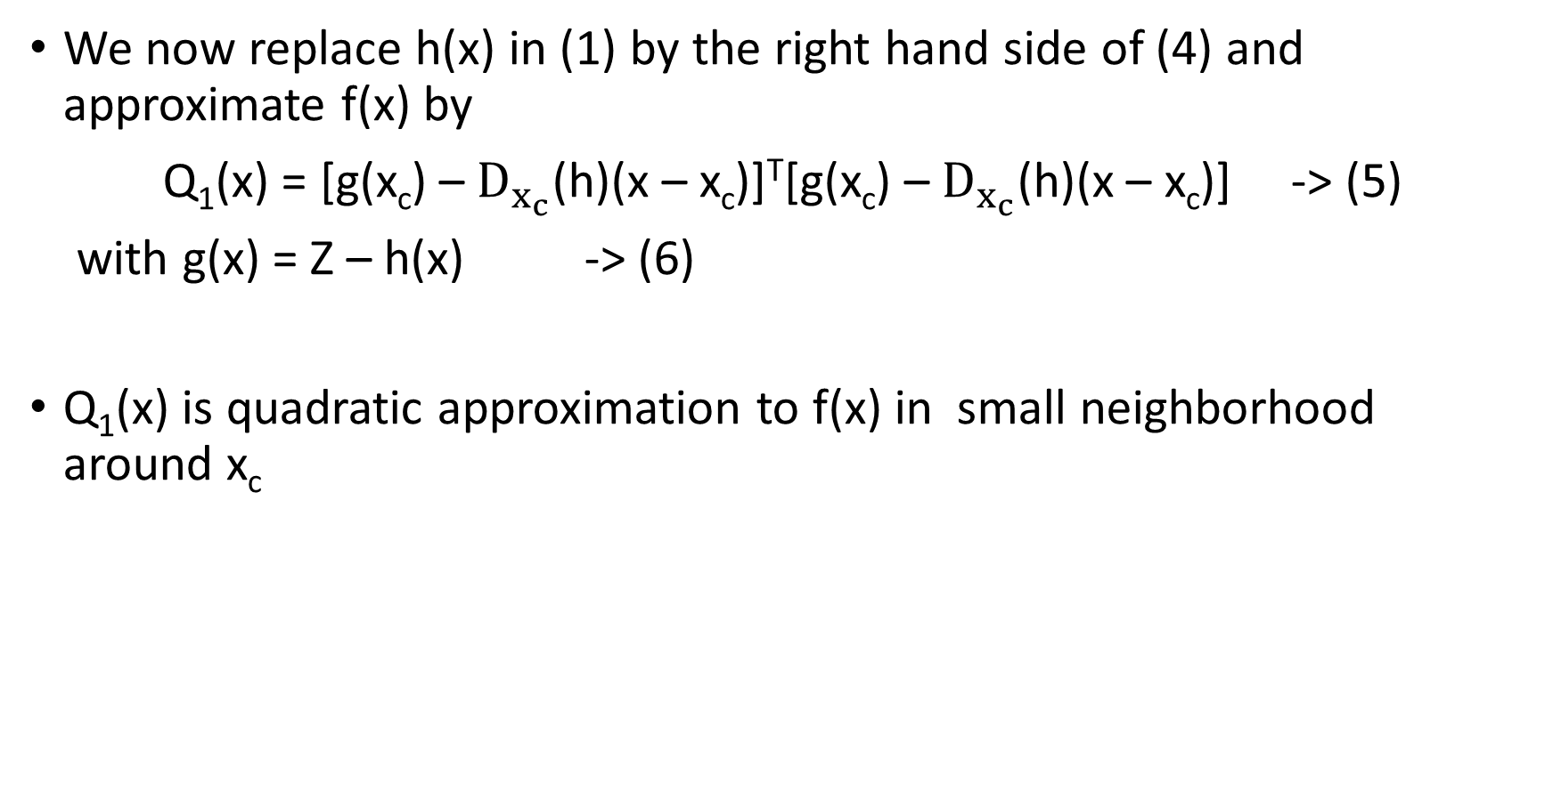
FIRST ORDER METHOD
We now replace h(x) in (1) by the right hand side of (4) and approximate f(x) by
Q₁(x) = [g(x_{c}) – $D_{x_{c}}$(h)(x – x_{c})]^{T}[g(x_{c}) – $D_{x_{c}}$(h)(x – x_{c})] -> (5)
with g(x) = Z – h(x) -> (6)
Q₁(x) is quadratic approximation to f(x) in small neighborhood around x_{c}

Slide 7
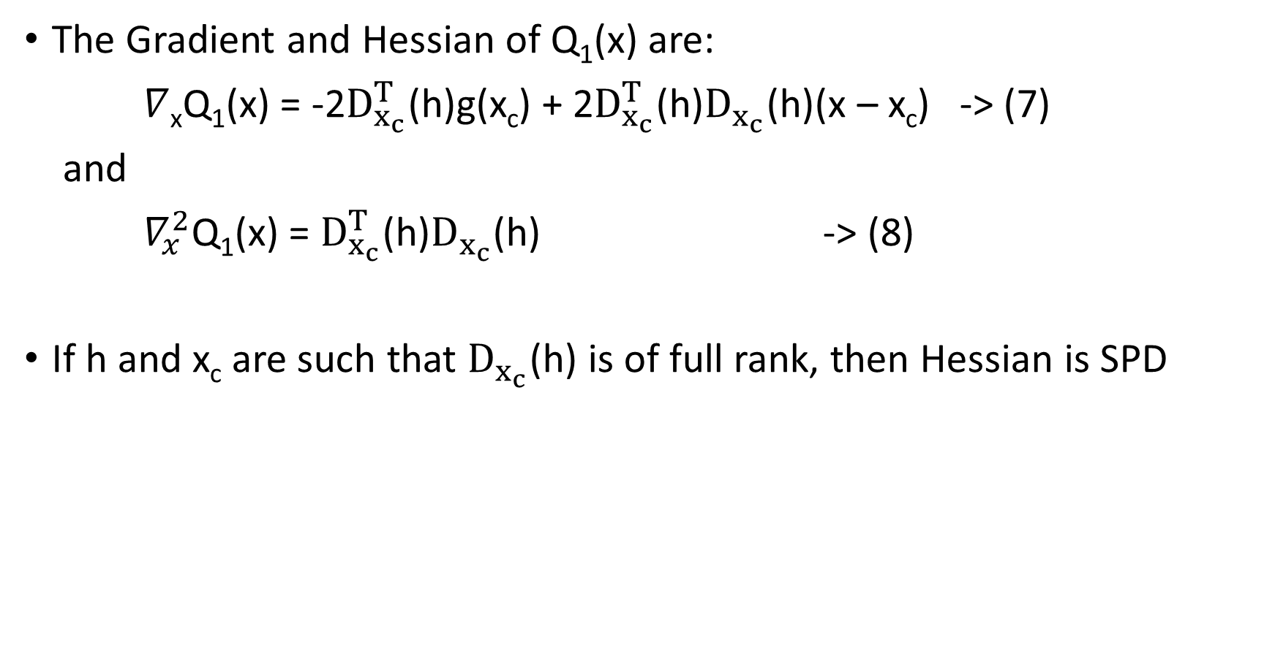
GRADIENT AND HESSIAN OF Q₁(x)
The Gradient and Hessian of Q₁(x) are:
$∇$_{x}Q₁(x) = -2$D_{x_{c}}^{T}$(h)g(x_{c}) + 2$D_{x_{c}}^{T}$(h)$D_{x_{c}}$(h)(x – x_{c}) -> (7)
and
$∇_{x}^{2}$Q₁(x) = $D_{x_{c}}^{T}$(h)$D_{x_{c}}$(h) -> (8)
If h and x_{c} are such that $D_{x_{c}}$(h) is of full rank, then Hessian is SPD

Slide 8
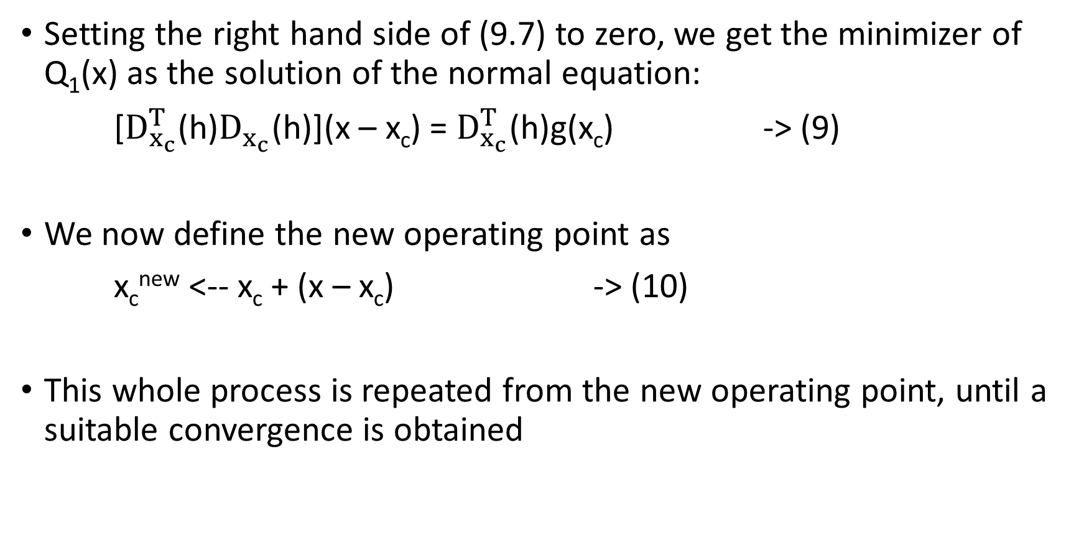
MINIMIZER OF Q₁(x)
Setting the right hand side of (9.7) to zero, we get the minimizer of Q₁(x) as the solution of the normal equation:
[$D_{x_{c}}^{T}$(h)$D_{x_{c}}$(h)](x – x_{c}) = $D_{x_{c}}^{T}$(h)g(x_{c}) -> (9)
We now define the new operating point as
x_{c}^{new} <-- x_{c} + (x – x_{c}) -> (10)
This whole process is repeated from the new operating point, until a suitable convergence is obtained

Slide 9
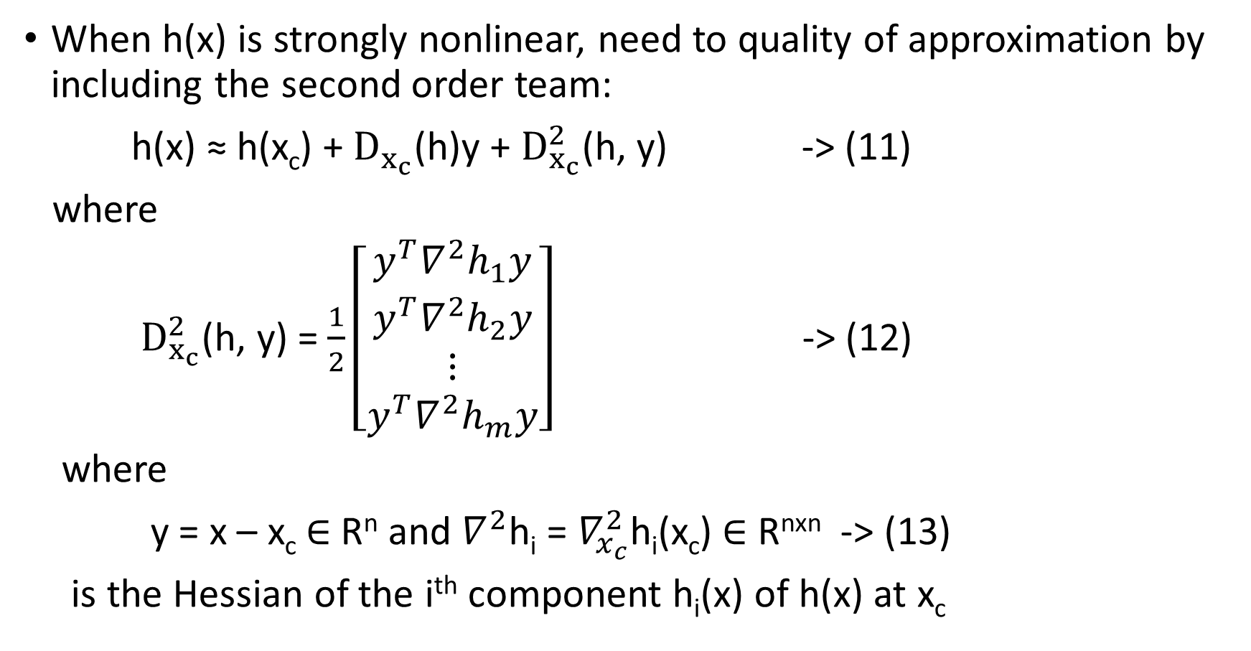
SECOND ORDER APPROXIMATION OF h(x)
When h(x) is strongly nonlinear, need to quality of approximation by including the second order team:
h(x) ≈ h(x_{c}) + $D_{x_{c}}$(h)y + $D_{x_{c}}^{2}$(h, y) -> (11)
where
$D_{x_{c}}^{2}$(h, y) = $\frac{1}{2}\left[\begin{aligned}y^{T}∇^{2}h_{1}y \\ y^{T}∇^{2}h_{2}y \\ ⋮ \\ y^{T}∇^{2}h_{m}y\end{aligned}\right]$ -> (12)
where
y = x – x_{c} $∈$ R^{n} and $∇^{2}$h_{i} = $∇_{x_{c}}^{2}$h_{i}(x_{c}) $∈$ R^{nxn} -> (13)
is the Hessian of the i^{th} component h_{i}(x) of h(x) at x_{c}

Slide 10
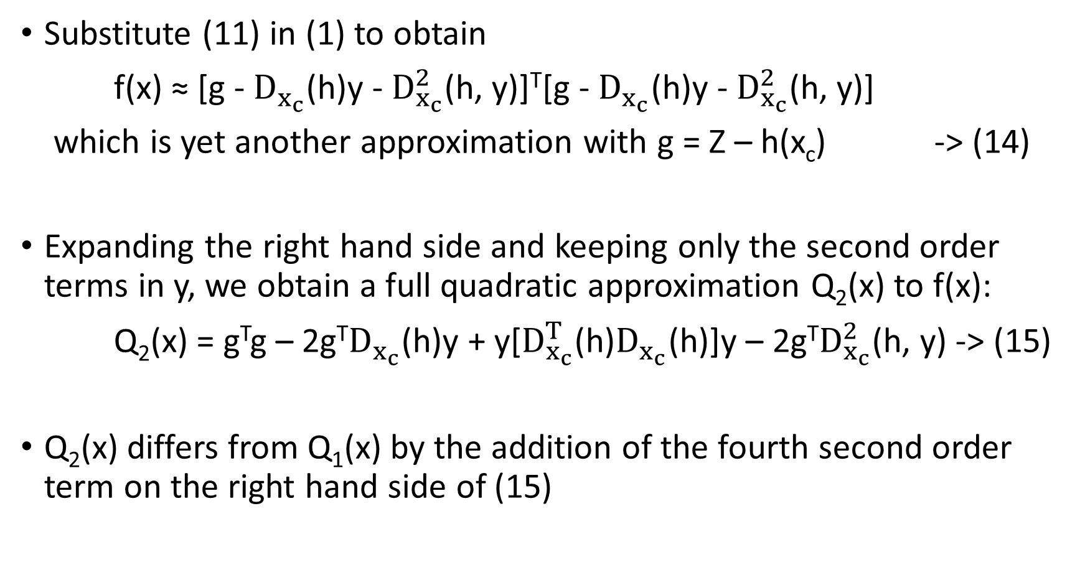
SECOND ORDER METHOD
Substitute (11) in (1) to obtain
f(x) ≈ [g - $D_{x_{c}}$(h)y - $D_{x_{c}}^{2}$(h, y)]^{T}[g - $D_{x_{c}}$(h)y - $D_{x_{c}}^{2}$(h, y)]
which is yet another approximation with g = Z – h(x_{c}) -> (14)
Expanding the right hand side and keeping only the second order terms in y, we obtain a full quadratic approximation Q₂(x) to f(x):
Q₂(x) = g^{T}g – 2g^{T}$D_{x_{c}}$(h)y + y[$D_{x_{c}}^{T}$(h)$D_{x_{c}}$(h)]y – 2g^{T}$D_{x_{c}}^{2}$(h, y) -> (15)
Q₂(x) differs from Q₁(x) by the addition of the fourth second order term on the right hand side of (15)

Slide 11
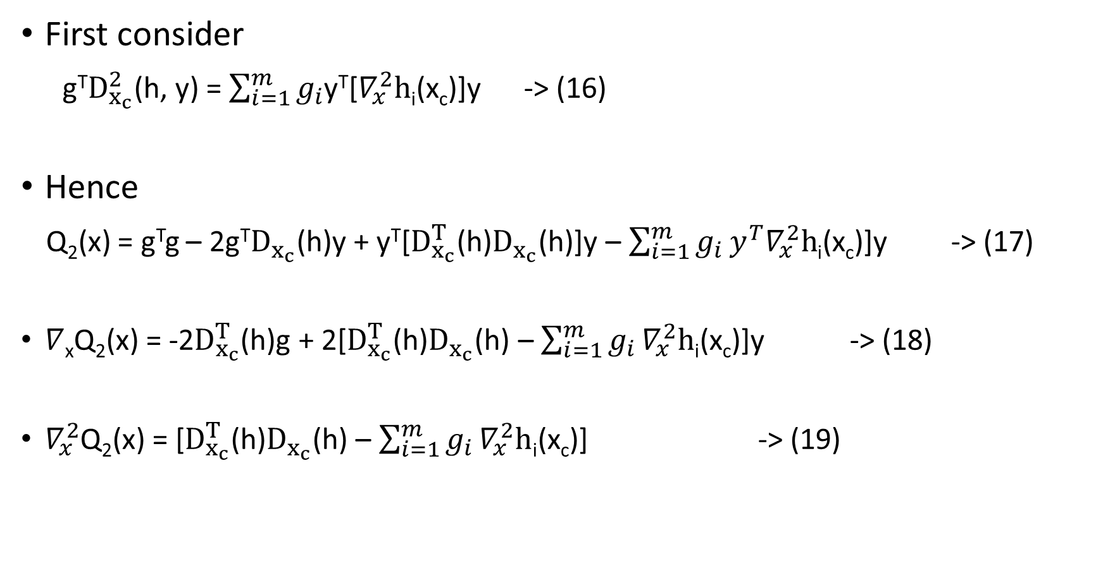
GRADIENT AND HESSIAN OF Q₂(x):
First consider
g^{T}$D_{x_{c}}^{2}$(h, y) = $\sum_{i=1}^{m}{g_{i}}$y^{T}[$∇_{x}^{2}h$_{i}(x_{c})]y -> (16)
Hence
Q₂(x) = g^{T}g – 2g^{T}$D_{x_{c}}$(h)y + y^{T}[$D_{x_{c}}^{T}$(h)$D_{x_{c}}$(h)]y – $\sum_{i=1}^{m}{g_{i}}y^{T}∇_{x}^{2}h$_{i}(x_{c})]y -> (17)
$∇$_{x}Q₂(x) = -2$D_{x_{c}}^{T}$(h)g + 2[$D_{x_{c}}^{T}$(h)$D_{x_{c}}$(h) – $\sum_{i=1}^{m}{g_{i}}∇_{x}^{2}h$_{i}(x_{c})]y -> (18)
$∇_{x}^{2}$Q₂(x) = [$D_{x_{c}}^{T}$(h)$D_{x_{c}}$(h) – $\sum_{i=1}^{m}{g_{i}}∇_{x}^{2}h$_{i}(x_{c})] -> (19)

Slide 12
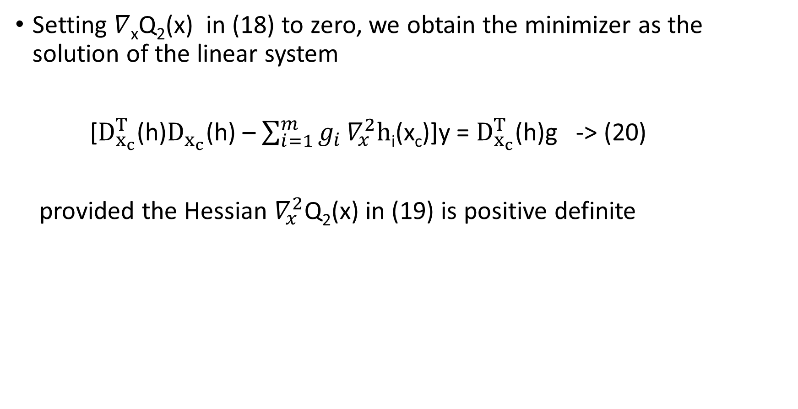
MINIMIZER OF Q₂(x)
Setting $∇$_{x}Q₂(x) in (18) to zero, we obtain the minimizer as the solution of the linear system
[$D_{x_{c}}^{T}$(h)$D_{x_{c}}$(h) – $\sum_{i=1}^{m}{g_{i}}∇_{x}^{2}h$_{i}(x_{c})]y = $D_{x_{c}}^{T}$(h)g -> (20)
provided the Hessian $∇_{x}^{2}$Q₂(x) in (19) is positive definite

Slide 13
AN ITERATIVE SCHEME
Solving (20) for y = x – x_{c}, compute the new operating point as:
x_{c}^{new} <-- x_{c} + (x – x_{c})
This entire process of second-order approximation is repeated until a suitable convergence is obtained
The idea behind these two approximation is that their solutions can be obtained by solving the linear system with SPD matrix as in the normal equation approach

Slide 14
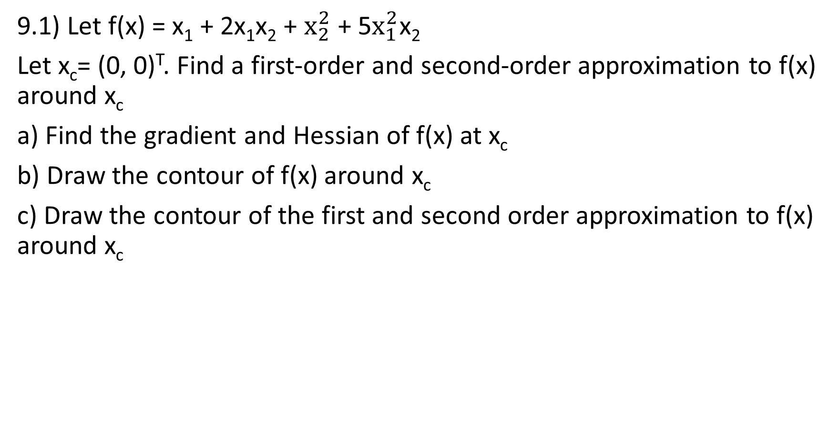
EXERCISES
9.1) Let f(x) = x₁ + 2x₁x₂ + $x_{2}^{2}$ + 5$x_{1}^{2}$x₂
Let x_{c}= (0, 0)^{T}. Find a first-order and second-order approximation to f(x) around x_{c}
a) Find the gradient and Hessian of f(x) at x_{c}
b) Draw the contour of f(x) around x_{c}
c) Draw the contour of the first and second order approximation to f(x) around x_{c}

Slide 15
REFERENCES
This module follows closely chapter 7 of LLD (2006) and the following paper
S.Lakshmivarahan, Y. Honda and J. M. Lewis (2003) “second order approximation to the 3-DVAR cost function: application to analysis/forecast”, Tellus, 55A, 371-384

