Slide 1
A GEOMETRIC VIEW OF LEAST SQUARES - PROJECTIONS
Module - 8
AN OVERVIEW
S. Lakshmivarahan
School of Computer Science
University of Oklahoma
Norman, Ok – 73069, USA
varahan@ou.edu
Date 10/23/2015

Slide 2

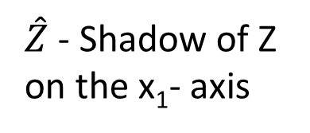




PROJECTIONS
Let Z = (Z₁, Z₂)^{T}, P₁ = $\left[\begin{matrix}1 & 0 \\ 0 & 0\end{matrix}\right]$, P₂ = $\left[\begin{matrix}1 & a \\ 0 & 0\end{matrix}\right]$, a > 0
$\hat{Z_{1}}$ = P₁Z = $\left(\begin{aligned}Z_{1} \\ 0\end{aligned}\right)$, $\hat{Z_{2}}$ = P₂Z = $\left(\begin{aligned}Z_{1}+aZ_{2} \\ 0\end{aligned}\right)$
LIGHT
LIGHT
$\hat{Z}$ - Shadow of Z on the x₁- axis
z
z
90º
ϴ
$$\hat{Z_{1}}$$
$$\hat{Z_{2}}$$
Figure 1
Figure 2
$\hat{Z_{1}}$ - orthogonal projection of Z on the x₁ - axis
$\hat{Z_{2}}$ - oblique projection of Z on the x₁ - axis

Slide 3
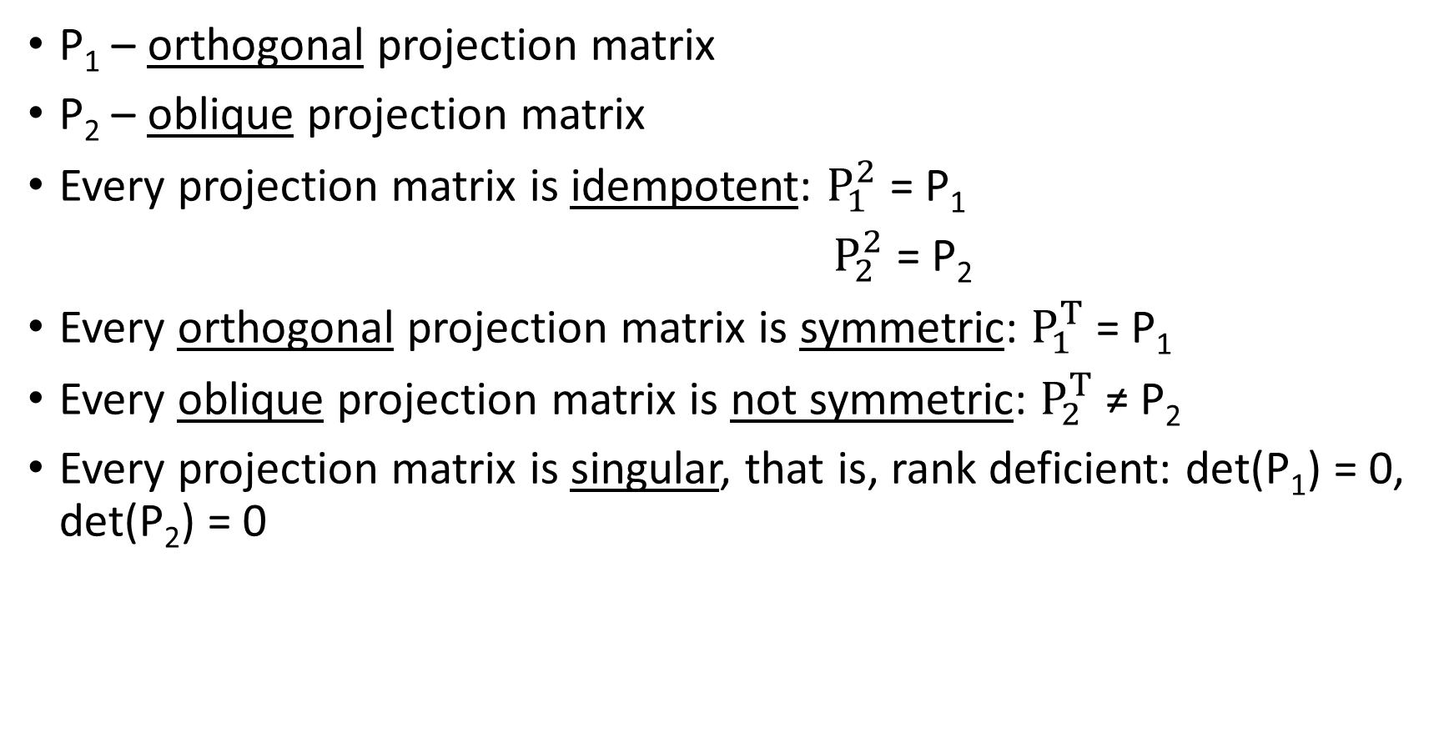
PROJECTION MATRICES/OPERATORS
P₁ – orthogonal projection matrix
P₂ – oblique projection matrix
Every projection matrix is idempotent: $P_{1}^{2}$ = P₁
$P_{2}^{2}$ = P₂
Every orthogonal projection matrix is symmetric: $P_{1}^{T}$ = P₁
Every oblique projection matrix is not symmetric: $P_{2}^{T}$ ≠ P₂
Every projection matrix is singular, that is, rank deficient: det(P₁) = 0, det(P₂) = 0

Slide 4

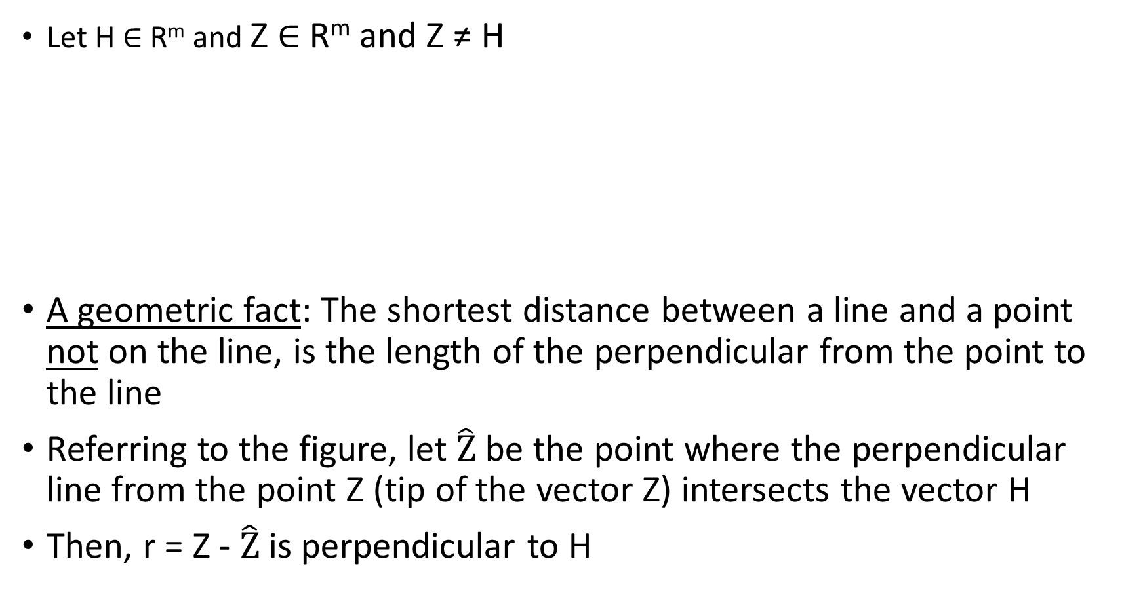
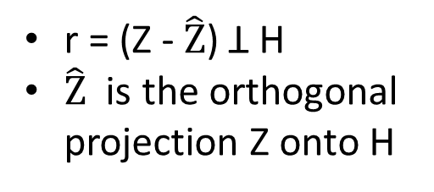

ORDINARY LEAST SQUARES AND ORTHOGONAL PROJECTION
Let H $∈$ R^{m} and Z $∈$ R^{m} and Z ≠ H
A geometric fact: The shortest distance between a line and a point not on the line, is the length of the perpendicular from the point to the line
Referring to the figure, let $\hat{Z}$ be the point where the perpendicular line from the point Z (tip of the vector Z) intersects the vector H
Then, r = Z - $\hat{Z}$ is perpendicular to H
Z
r = Z - $\hat{Z}$
H
r = (Z - $\hat{Z}$) Ʇ H
$\hat{Z}$ is the orthogonal projection Z onto H
90º
$\hat{Z}$ = Hx

Slide 5
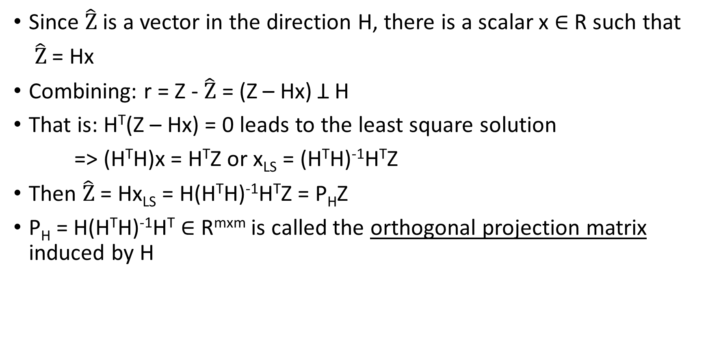
ORTHOGONAL PROJECTION
Since $\hat{Z}$ is a vector in the direction H, there is a scalar x $∈$ R such that
$\hat{Z}$ = Hx
Combining: r = Z - $\hat{Z}$ = (Z – Hx) Ʇ H
That is: H^{T}(Z – Hx) = 0 leads to the least square solution
=> (H^{T}H)x = H^{T}Z or x_{LS} = (H^{T}H)⁻¹H^{T}Z
Then $\hat{Z}$ = Hx_{LS} = H(H^{T}H)⁻¹H^{T}Z = P_{H}Z
P_{H} = H(H^{T}H)⁻¹H^{T} $∈$ R^{mxm} is called the orthogonal projection matrix induced by H

Slide 6


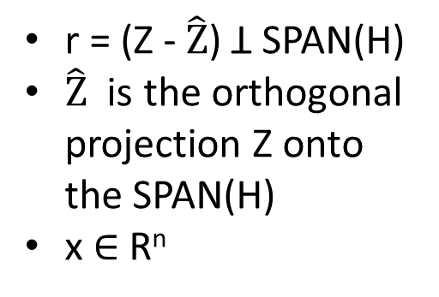

GENERALIZATION
Let H $∈$ R^{mxn}, z $∈$ R^{m} and m > n ≥ 1
Referring to the figure:
r = (Z - $\hat{Z}$) Ʇ columns of H
Since $\hat{Z}$ $∈$ SPAN(H), there exist x $∈$ R^{n}: $\hat{Z}$ = Hx
Combining: r = (Z – Hx) Ʇ H
r = Z - $\hat{Z}$
SPAN(H)
90º
r = (Z - $\hat{Z}$) Ʇ SPAN(H)
$\hat{Z}$ is the orthogonal projection Z onto the SPAN(H)
x $∈$ R^{n}
$\hat{Z}$ = Hx

Slide 7
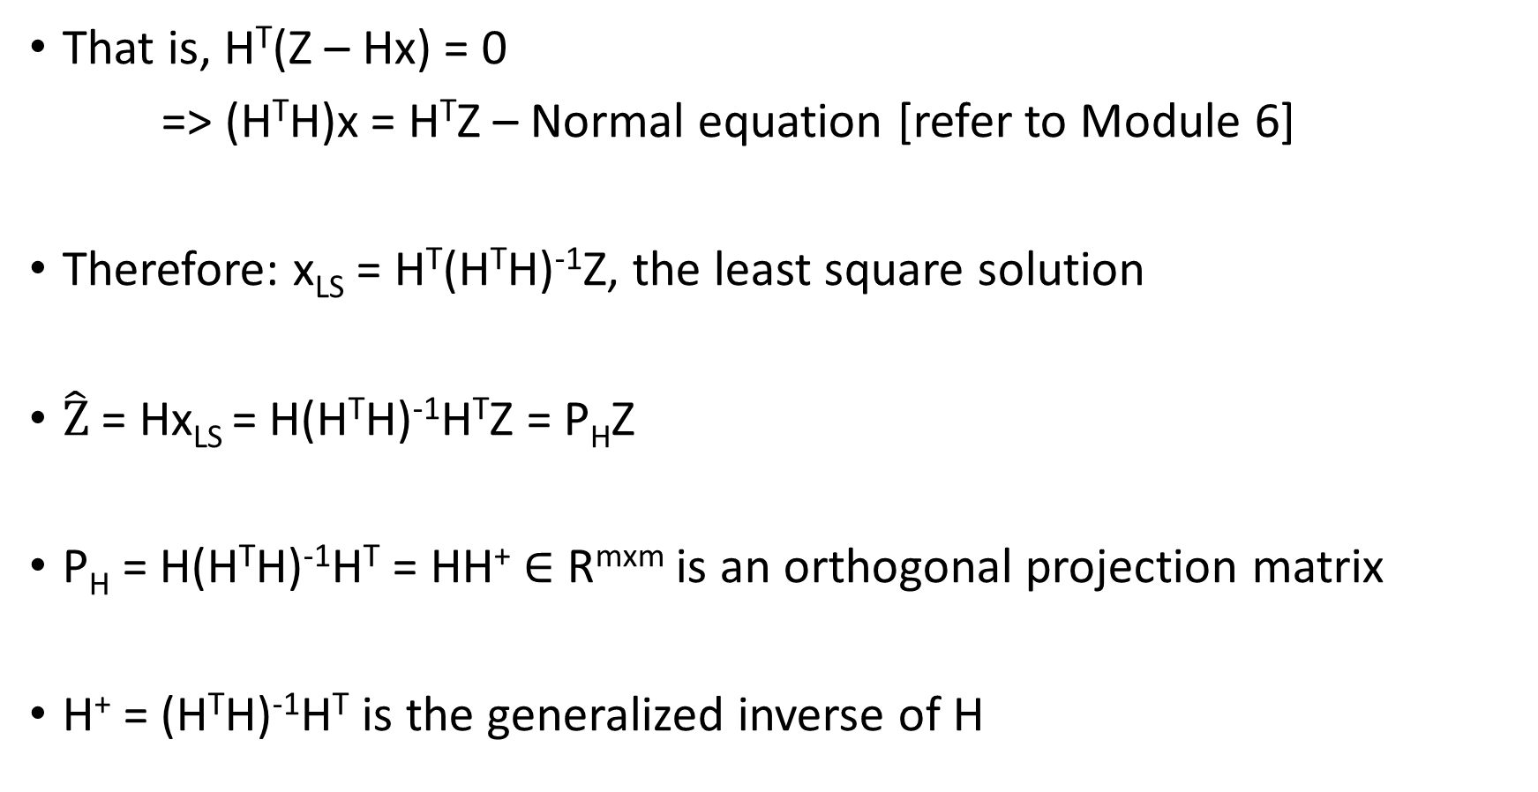
GENERALIZATION
That is, H^{T}(Z – Hx) = 0
=> (H^{T}H)x = H^{T}Z – Normal equation [refer to Module 6]
Therefore: x_{LS} = H^{T}(H^{T}H)⁻¹Z, the least square solution
$\hat{Z}$ = Hx_{LS} = H(H^{T}H)⁻¹H^{T}Z = P_{H}Z
P_{H} = H(H^{T}H)⁻¹H^{T} = HH⁺ $∈$ R^{mxm} is an orthogonal projection matrix
H⁺ = (H^{T}H)⁻¹H^{T} is the generalized inverse of H

Slide 8
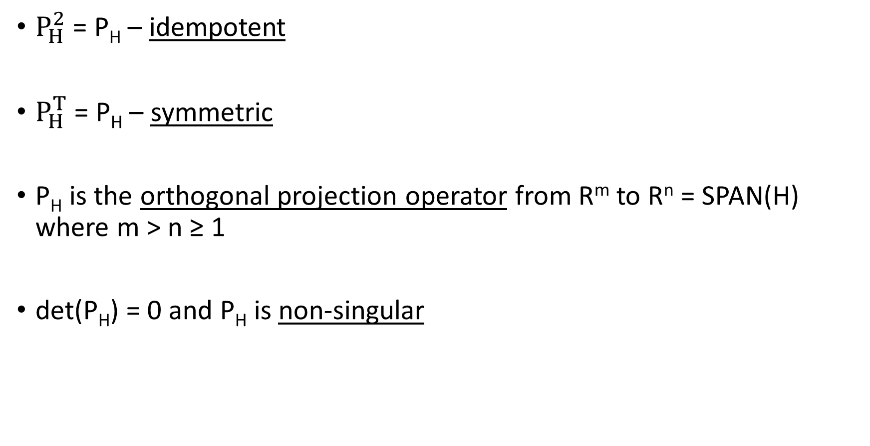
PROPERTIES OF P_{H}
$P_{H}^{2}$ = P_{H} – idempotent
$P_{H}^{T}$ = P_{H} – symmetric
P_{H} is the orthogonal projection operator from R^{m} to R^{n} = SPAN(H) where m > n ≥ 1
det(P_{H}) = 0 and P_{H} is non-singular

Slide 9
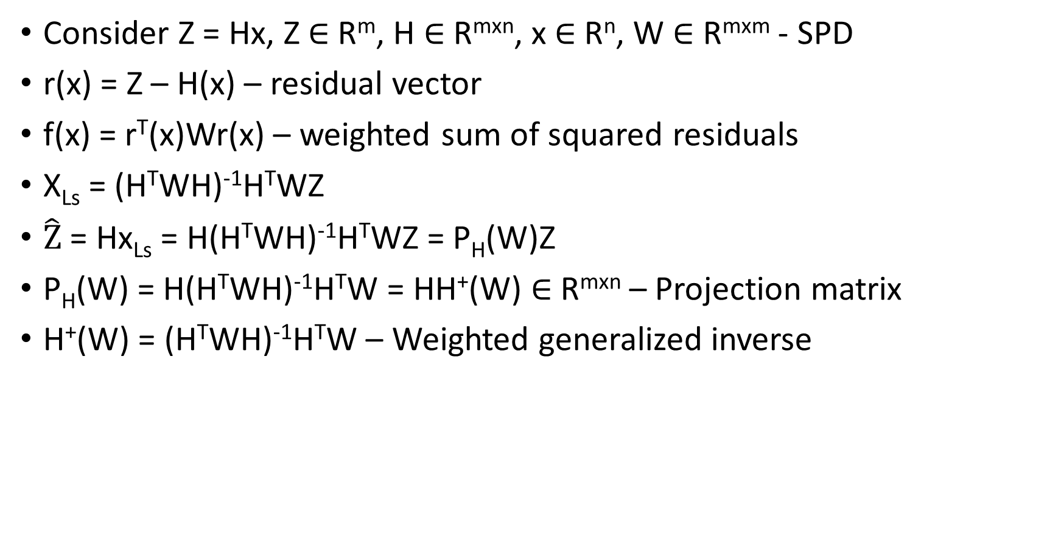
WEIGHTED LEAST SQUARES
Consider Z = Hx, Z $∈$ R^{m}, H $∈$ R^{mxn}, x $∈$ R^{n}, W $∈$ R^{mxm} - SPD
r(x) = Z – H(x) – residual vector
f(x) = r^{T}(x)Wr(x) – weighted sum of squared residuals
X_{Ls} = (H^{T}WH)⁻¹H^{T}WZ
$\hat{Z}$ = Hx_{Ls} = H(H^{T}WH)⁻¹H^{T}WZ = P_{H}(W)Z
P_{H}(W) = H(H^{T}WH)⁻¹H^{T}W = HH⁺(W) $∈$ R^{mxn} – Projection matrix
H⁺(W) = (H^{T}WH)⁻¹H^{T}W – Weighted generalized inverse

Slide 10

P_{H}(W) – OBLIQUE PROJECTION MATRIX
Verify $P_{H}^{2}$(W) = P_{H}(W) – idempotent
Verify $P_{H}^{T}$(W) ≠ P_{H}(W) – not symmetric
Hence, P_{H}(W) is an oblique projection matrix

Slide 11
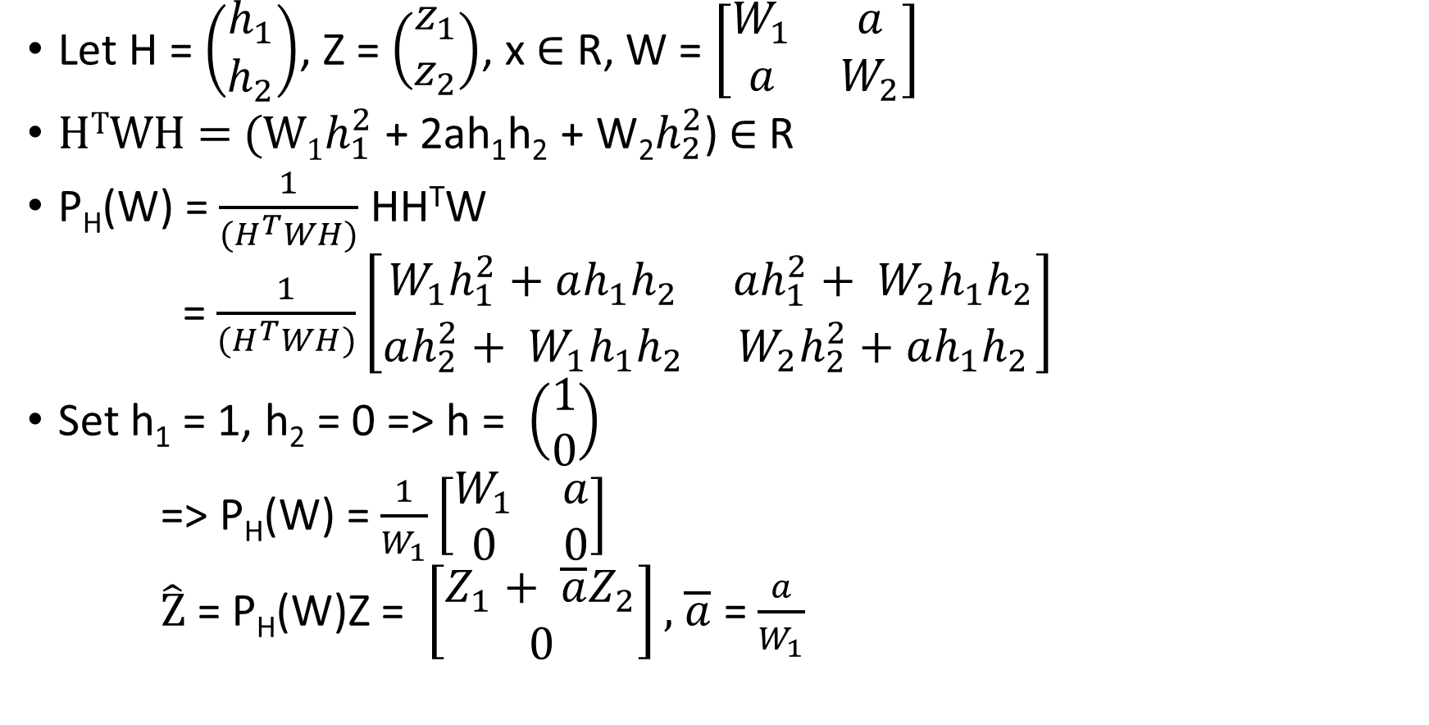
ILLUSTRATION: m = 2, n =1
Let H = $\left(\begin{aligned}h_{1} \\ h_{2}\end{aligned}\right)$, Z = $\left(\begin{aligned}z_{1} \\ z_{2}\end{aligned}\right)$, x $∈$ R, W = $\left[\begin{matrix}W_{1} & a \\ a & W_{2}\end{matrix}\right]$
H^{T}WH = (W₁$h_{1}^{2}$ + 2ah₁h₂ + W₂$h_{2}^{2}$) $∈$ R
P_{H}(W) = $\frac{1}{(H^{T}WH)}$ HH^{T}W
= $\frac{1}{(H^{T}WH)}\left[\begin{matrix}W_{1}h_{1}^{2}+ah_{1}h_{2} & ah_{1}^{2}+ W_{2}h_{1}h_{2} \\ ah_{2}^{2}+ W_{1}h_{1}h_{2} & W_{2}h_{2}^{2}+ah_{1}h_{2}\end{matrix}\right]$
Set h₁ = 1, h₂ = 0 => h = $\left(\begin{aligned}1 \\ 0\end{aligned}\right)$
=> P_{H}(W) = $\frac{1}{W_{1}}\left[\begin{matrix}W_{1} & a \\ 0 & 0\end{matrix}\right]$
$\hat{Z}$ = P_{H}(W)Z = $\left[\begin{aligned}Z_{1}+ \overline{a}Z_{2} \\ 0\end{aligned}\right],$ $\overline{a}$ = $\frac{a}{W_{1}}$

Slide 12

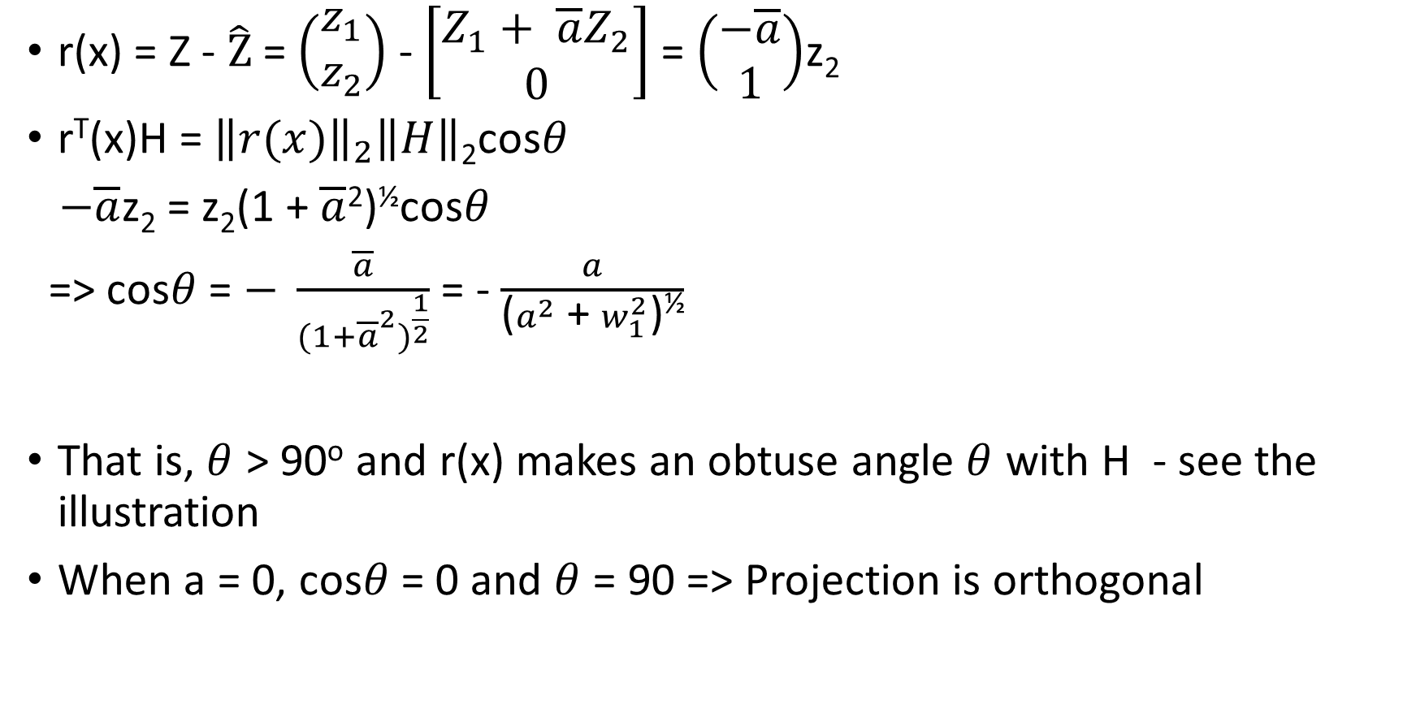
ILLUSTRATION - CONTINUED
r(x) = Z - $\hat{Z}$ = $\left(\begin{aligned}z_{1} \\ z_{2}\end{aligned}\right)$ - $\left[\begin{aligned}Z_{1}+ \overline{a}Z_{2} \\ 0\end{aligned}\right]$ = $\left(\begin{aligned}−\overline{a} \\ 1\end{aligned}\right)$z₂
r^{T}(x)H = ${\left\|r(x)\right\|}_{2}\left\|H\right\|$₂cos$θ$
$−\overline{a}$z₂ = z₂(1 + $\overline{a}$²)^{½}cos$θ$
=> cos$θ$ = $− \frac{\overline{a}}{{(1+{\overline{a}}^{2})}^{\frac{1}{2}}}$ = - $\frac{a}{\text{(}a^{2} \text{+} w_{1}^{2}\text{)}\text{½}}$
That is, $θ$ > 90º and r(x) makes an obtuse angle $θ$ with H - see the illustration
When a = 0, cos$θ$ = 0 and $θ$ = 90 => Projection is orthogonal
Z
ϴ
$$\hat{Z}$$

Slide 13

EXERCISES
8.1) Recall the formula
cos$θ$ = $− \frac{\overline{a}}{{(1+{\overline{a}}^{2})}^{\frac{1}{2}}}$ . Plot the value of $θ$ as $\overline{a}$ ranges in the interval [-1, 1]
8.2) Let H⁺(W) = (H^{T}WH)⁻¹H^{T}W is the expression for the weighted generalized inverse. Check if satisfies the Moore – Penrose condition in Module 3

