Slide 1
STATIC, DETERMINISTIC LINEAR INVERSE PROBLEM
ILL-POSED PROBLEM AND IMPERFECT MODEL
Module - 7
S. Lakshmivarahan
School of Computer Science
University of Oklahoma
Norman, Ok – 73069, USA
varahan@ou.edu
Date 10/25/2015

Slide 2
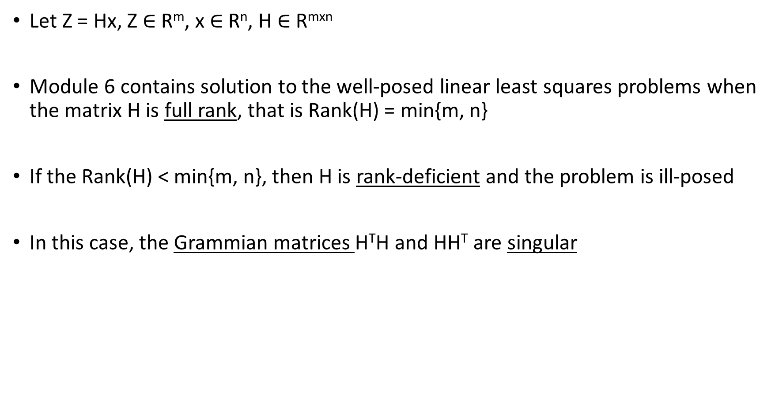
WELL AND ILL-POSED PROBLEMS
    Let Z = Hx, Z $∈$ R^{m}, x $∈$ R^{n}, H $∈$ R^{mxn}
    Module 6 contains solution to the well-posed linear least squares problems when the matrix H is full rank, that is Rank(H) = min{m, n}
    If the Rank(H) < min{m, n}, then H is rank-deficient and the problem is ill-posed
    In this case, the Grammian matrices H^{T}H and HH^{T} are singular

Slide 3
ILL-POSED PROBLEM – TIKHONOV REGULARIZATION
When is H is rank deficient, we cannot use the formula
H⁺ = (H^{T}H)⁻¹H^{T} or H⁺ = H^{T}(HH^{T})⁻¹
for the generalized inverse of H in computing X_{LS}
While we could still compute H⁺ using the method of singular value decomposition (SVD) (Module – 13), we seek alternate formulation of the least squares problem
The method of regularization due to Tikhonov is used to get around the rank deficiency of H

Slide 4
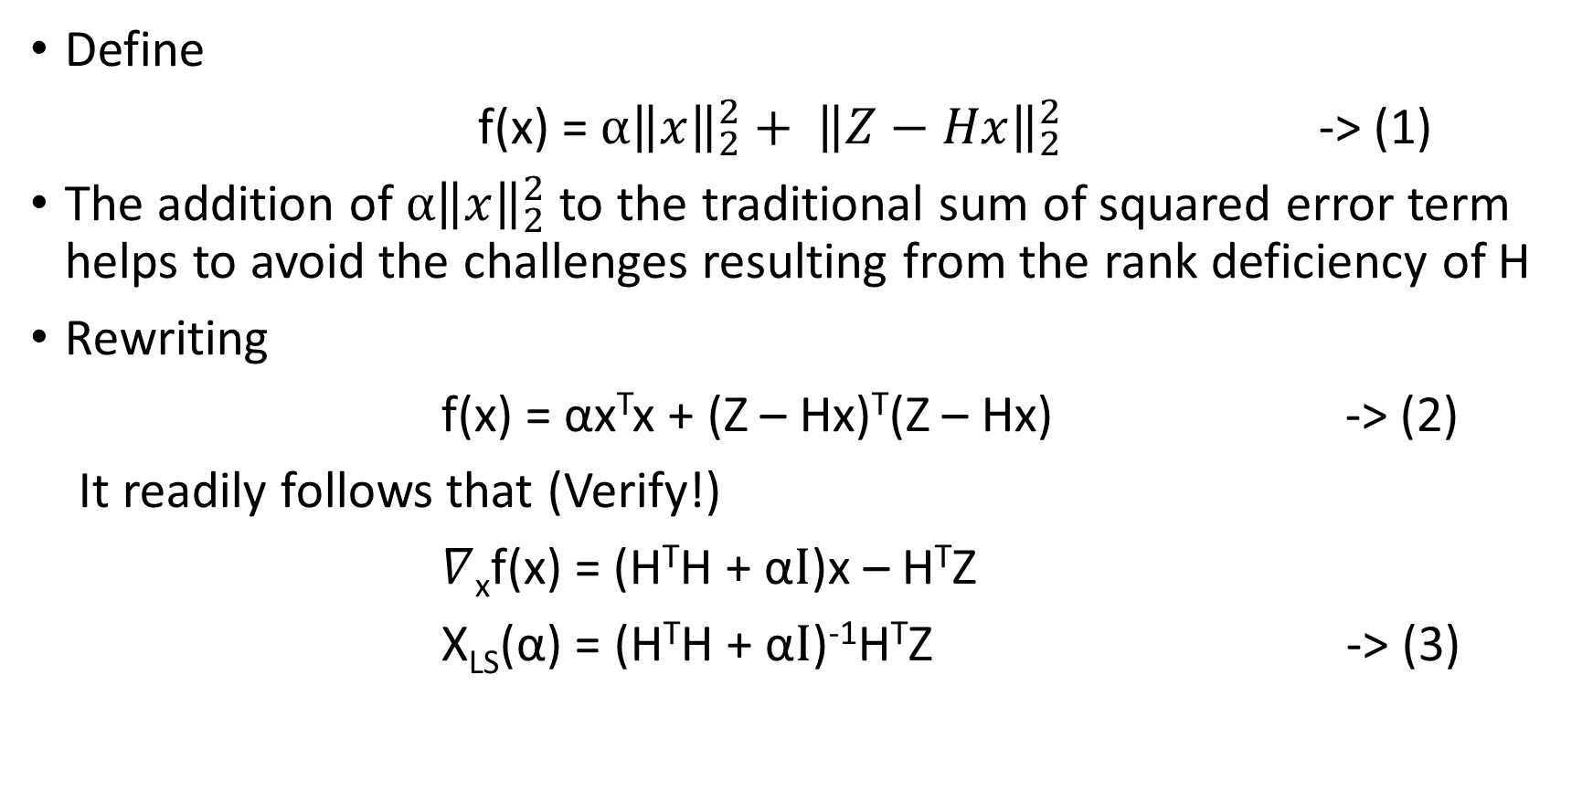
TIKHONOV’S METHOD
Define
f(x) = ${α\left\|x\right\|}_{2}^{2}+ {\left\|Z−Hx\right\|}_{2}^{2}$ -> (1)
The addition of ${α\left\|x\right\|}_{2}^{2}$ to the traditional sum of squared error term helps to avoid the challenges resulting from the rank deficiency of H
Rewriting
f(x) = αx^{T}x + (Z – Hx)^{T}(Z – Hx) -> (2)
It readily follows that (Verify!)
$∇$_{x}f(x) = (H^{T}H + α$I$)x – H^{T}Z
X_{LS}(α) = (H^{T}H + α$I$)⁻¹H^{T}Z -> (3)

Slide 5
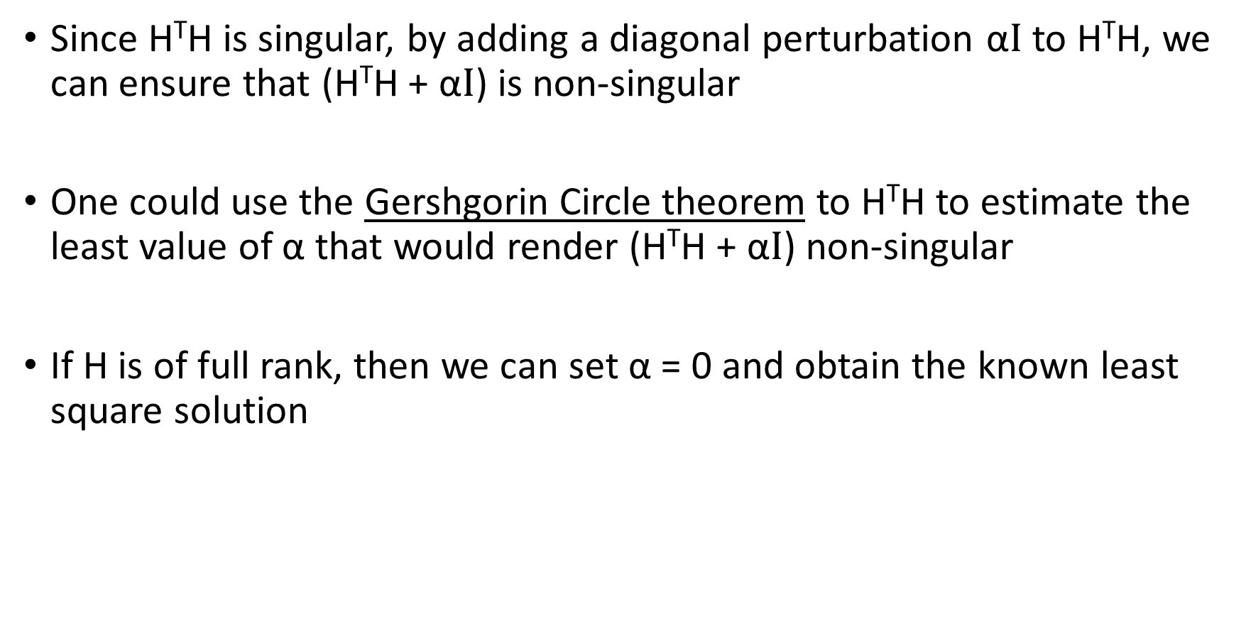
TIKHONOV’S METHOD
Since H^{T}H is singular, by adding a diagonal perturbation α$I$to H^{T}H, we can ensure that (H^{T}H + α$I$) is non-singular
One could use the Gershgorin Circle theorem to H^{T}H to estimate the least value of α that would render (H^{T}H + α$I$) non-singular
If H is of full rank, then we can set α = 0 and obtain the known least square solution

Slide 6
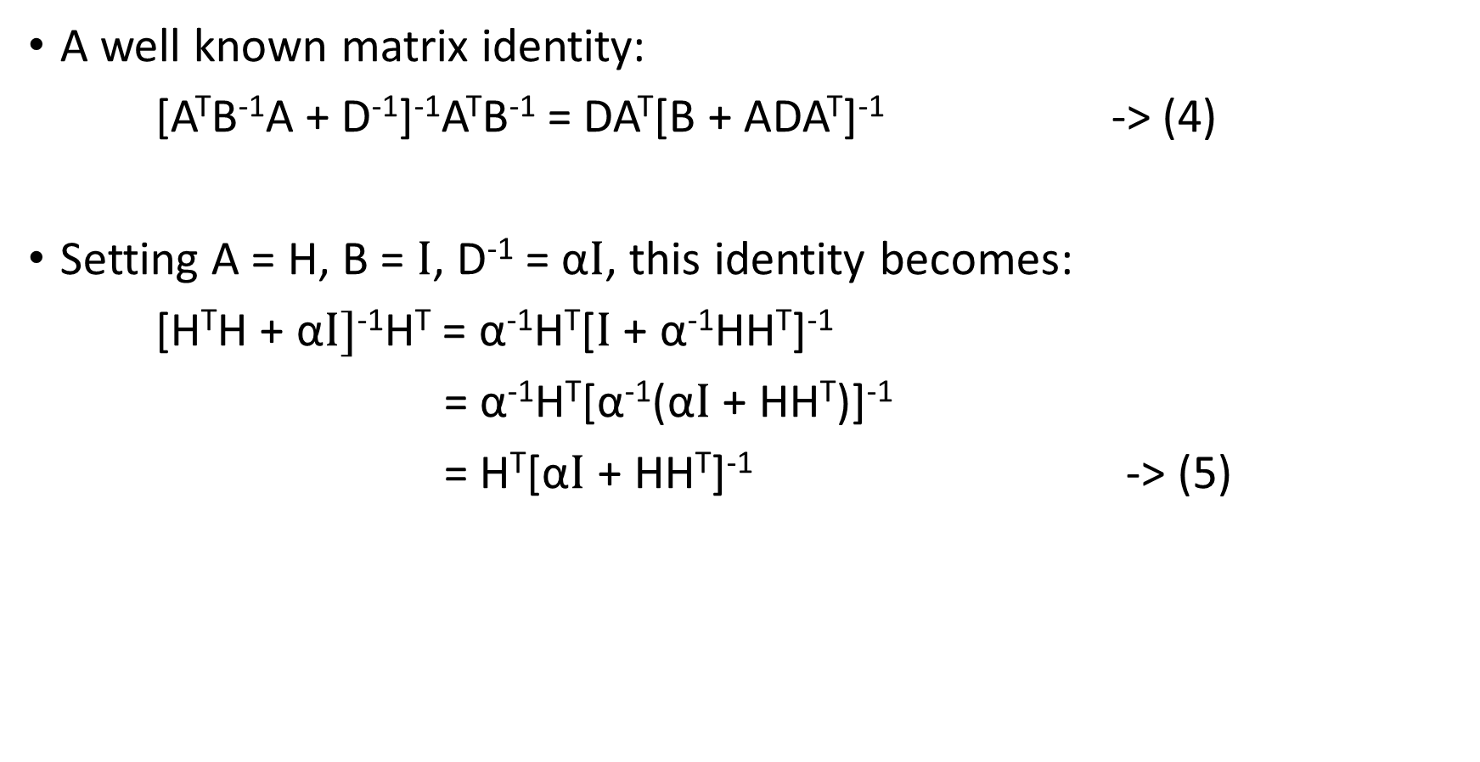
A MATRIX IDENTITY
A well known matrix identity:
[A^{T}B⁻¹A + D⁻¹]⁻¹A^{T}B⁻¹ = DA^{T}[B + ADA^{T}]⁻¹ -> (4)
Setting A = H, B = $I$, D⁻¹ = α$I$, this identity becomes:
[H^{T}H + α$I]$⁻¹H^{T} = α⁻¹H^{T}[$I$ + α⁻¹HH^{T}]⁻¹
= α⁻¹H^{T}[α⁻¹(α$I$ + HH^{T})]⁻¹
= H^{T}[α$I$ + HH^{T}]⁻¹ -> (5)

Slide 7
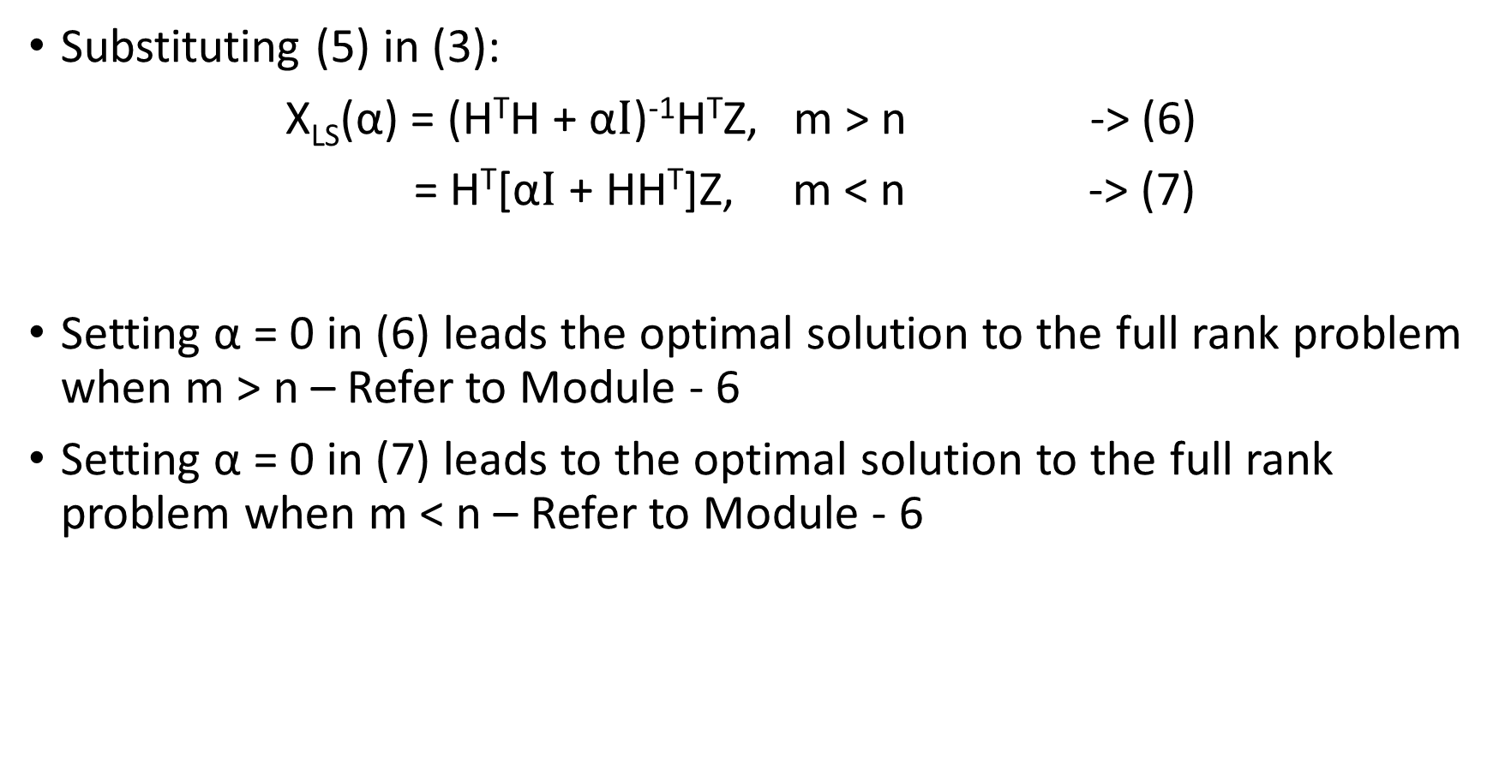
A UNIFIED APPROACH
Substituting (5) in (3):
X_{LS}(α) = (H^{T}H + α$I$)⁻¹H^{T}Z, m > n -> (6)
= H^{T}[α$I$ + HH^{T}]Z, m < n -> (7)
Setting α = 0 in (6) leads the optimal solution to the full rank problem when m > n – Refer to Module - 6
Setting α = 0 in (7) leads to the optimal solution to the full rank problem when m < n – Refer to Module - 6

Slide 8
PERFECT VS IMPERFECT MODEL
The saying goes: “no model is perfect, but some models are useful”
Often assume that a model is perfect
Imperfection is a model come from various directions:
- complete physics, wrong parametrization, etc
Irrespective of whether the model is perfect or not, in the overdetermined case, the model is inconsistent in the sense we saw in Module 6
In the underdetermined case, the choice of the method depends on whether or not the model is perfect

Slide 9
STRONG VS WEAK CONSTRAINED FORMULATION: m < n
When m < n, and the model is perfect, we strictly enforce the model constraint using the Lagrangian multiplier method – see Module 6 for details
This is often called the Strong Constraint formulation
If the model is not perfect, it is pointless to enforce it strictly
We require the model equation to be satisfied only approximately
This is known as the Weak Constraint formulation

Slide 10
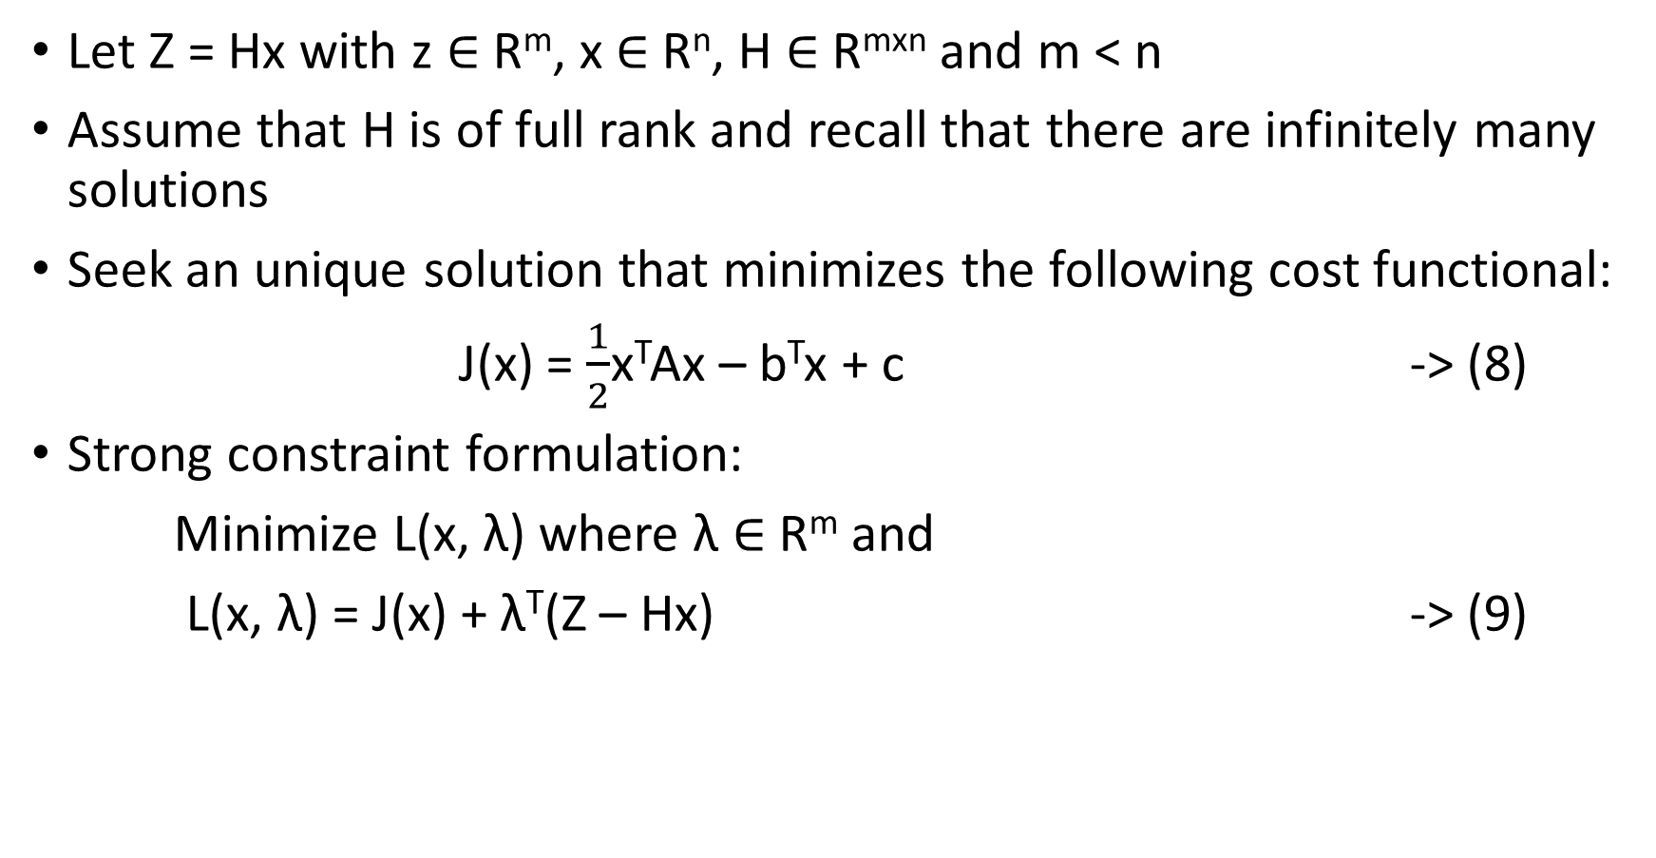
STRONG CONSTRAINT FORMULATION - REVISITED
Let Z = Hx with z $∈$ R^{m}, x $∈$ R^{n}, H $∈$ R^{mxn} and m < n
Assume that H is of full rank and recall that there are infinitely many solutions
Seek an unique solution that minimizes the following cost functional:
J(x) = $\frac{1}{2}$x^{T}Ax – b^{T}x + c -> (8)
Strong constraint formulation:
Minimize L(x, λ) where λ $∈$ R^{m} and
L(x, λ) = J(x) + λ^{T}(Z – Hx) -> (9)

Slide 11
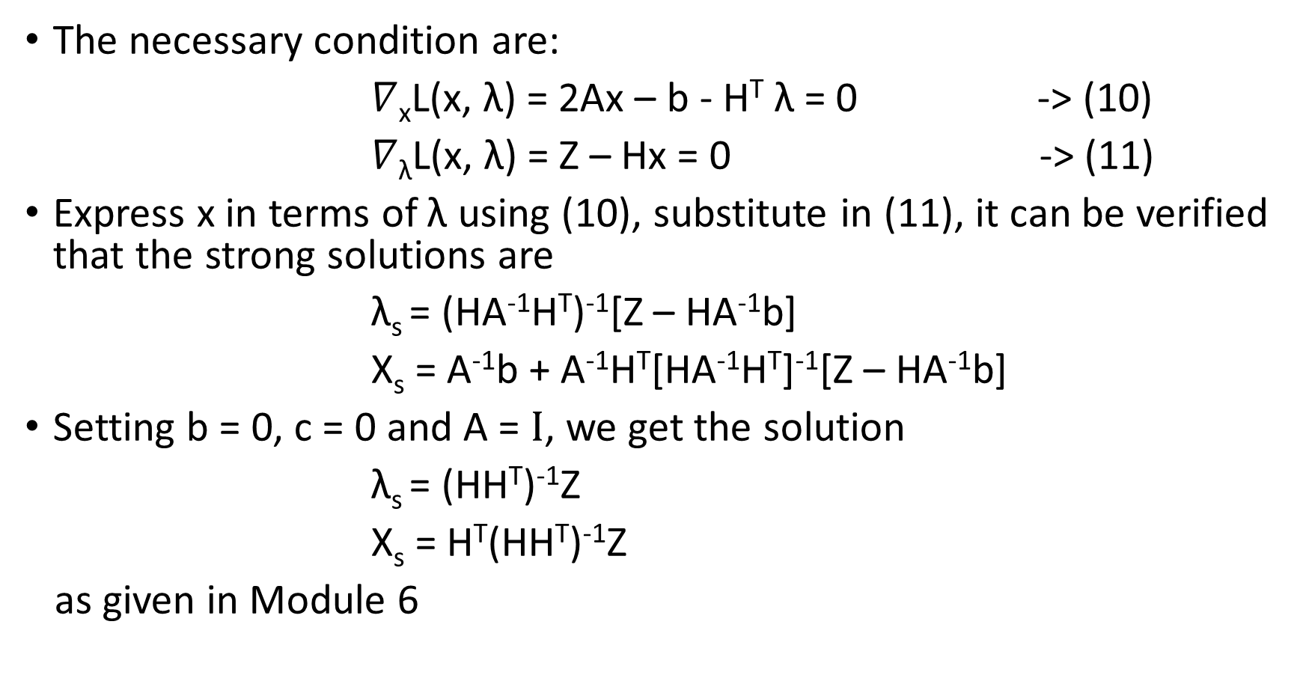
STRONG CONSTRAINT - CONTINUED
The necessary condition are:
$∇$_{x}L(x, λ) = 2Ax – b - H^{T} λ = 0 -> (10)
$∇$_{λ}L(x, λ) = Z – Hx = 0 -> (11)
Express x in terms of λ using (10), substitute in (11), it can be verified that the strong solutions are
λ_{s} = (HA⁻¹H^{T})⁻¹[Z – HA⁻¹b]
X_{s} = A⁻¹b + A⁻¹H^{T}[HA⁻¹H^{T}]⁻¹[Z – HA⁻¹b]
Setting b = 0, c = 0 and A = $I$, we get the solution
λ_{s} = (HH^{T})⁻¹Z
X_{s} = H^{T}(HH^{T})⁻¹Z
as given in Module 6
-> (12)
-> (11)

Slide 12
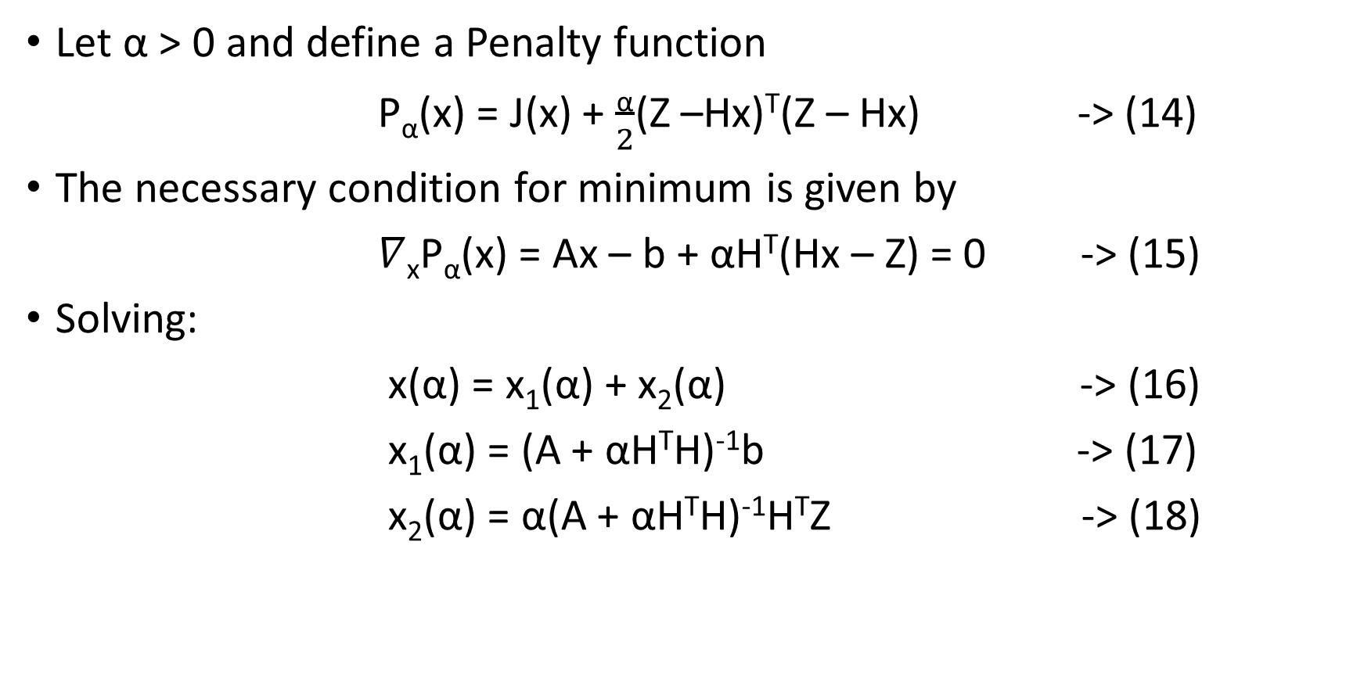
WEAK CONSTRAINED FORMULATION
Let α > 0 and define a Penalty function
P_{α}(x) = J(x) + $\frac{\text{α}}{2}$(Z –Hx)^{T}(Z – Hx) -> (14)
The necessary condition for minimum is given by
$∇$_{x}P_{α}(x) = Ax – b + αH^{T}(Hx – Z) = 0 -> (15)
Solving:
x(α) = x₁(α) + x₂(α) -> (16)
x₁(α) = (A + αH^{T}H)⁻¹b -> (17)
x₂(α) = α(A + αH^{T}H)⁻¹H^{T}Z -> (18)

Slide 13
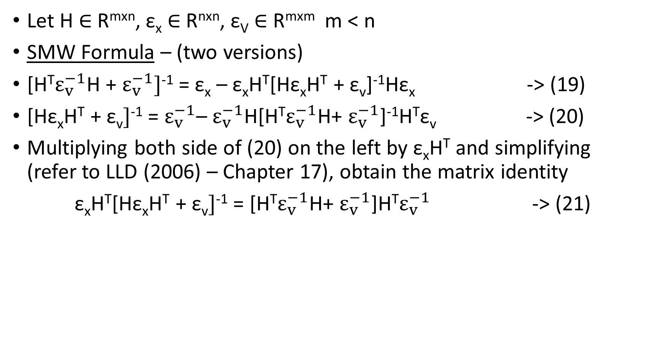
SHERMAN – MORRISON – WOODBURY (SMW) FORMULA
Let H $∈$ R^{mxn}, ε_{x} $∈$ R^{nxn}, ε_{V} $∈$ R^{mxm} m < n
SMW Formula – (two versions)
[H^{T}$ε_{v}^{−1}$H + $ε_{v}^{−1}]$⁻¹ = ε_{x} – ε_{x}H^{T}[Hε_{x}H^{T} + ε_{v}]⁻¹Hε_{x} -> (19)
[Hε_{x}H^{T} + ε_{v}$]$⁻¹ = $ε_{v}^{−1}$– $ε_{v}^{−1}$H[H^{T}$ε_{v}^{−1}$H+ $ε_{v}^{−1}$]⁻¹H^{T}ε_{v} -> (20)
Multiplying both side of (20) on the left by ε_{x}H^{T} and simplifying (refer to LLD (2006) – Chapter 17), obtain the matrix identity
ε_{x}H^{T}[Hε_{x}H^{T} + ε_{v}$]$⁻¹ = [H^{T}$ε_{v}^{−1}$H+ $ε_{v}^{−1}$]H^{T}$ε_{v}^{−1}$ -> (21)

Slide 14
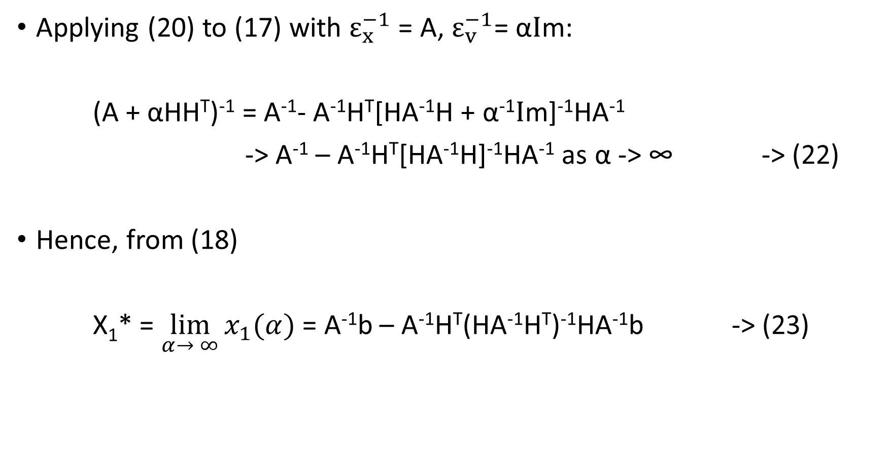
RELATING WEAK AND STRONG SOLUTION
Applying (20) to (17) with $ε_{x}^{−1}$ = A, $ε_{v}^{−1}$= α$I$m:
(A + αHH^{T})⁻¹ = A⁻¹- A⁻¹H^{T}[HA⁻¹H + α⁻¹$I$m]⁻¹HA⁻¹
-> A⁻¹ – A⁻¹H^{T}[HA⁻¹H]⁻¹HA⁻¹ as α -> ∞ -> (22)
Hence, from (18)
X₁* = $\lim_{α→ ∞}{x_{1}(α)}$ = A⁻¹b – A⁻¹H^{T}(HA⁻¹H^{T})⁻¹HA⁻¹b -> (23)

Slide 15
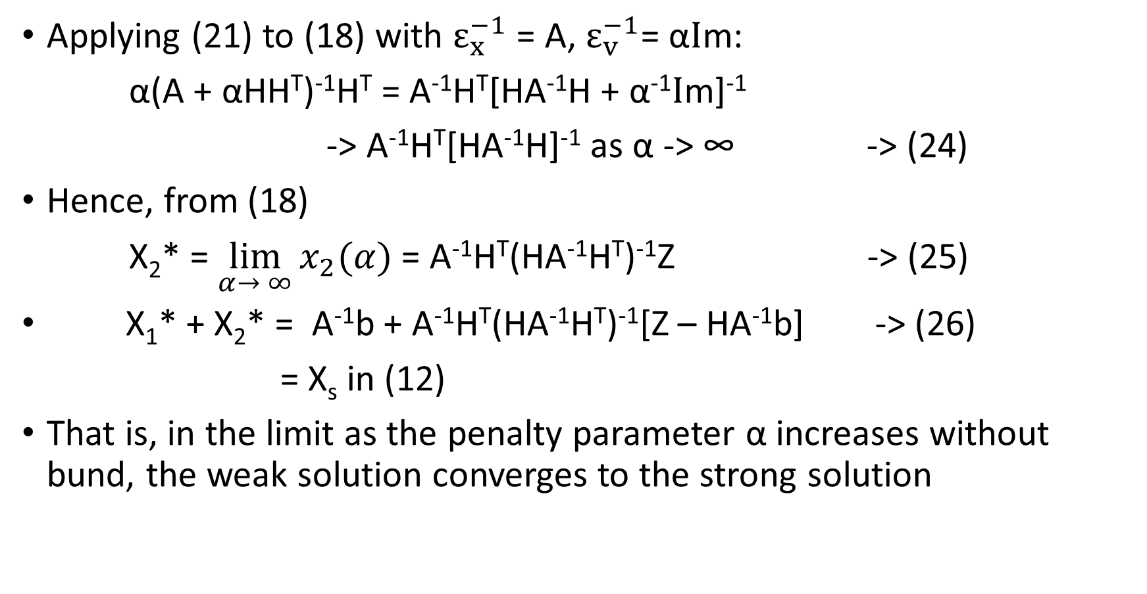
RELATING WEAK AND STRONG SOLUTIONS
Applying (21) to (18) with $ε_{x}^{−1}$ = A, $ε_{v}^{−1}$= α$I$m:
α(A + αHH^{T})⁻¹H^{T} = A⁻¹H^{T}[HA⁻¹H + α⁻¹$I$m]⁻¹
-> A⁻¹H^{T}[HA⁻¹H]⁻¹ as α -> ∞ -> (24)
Hence, from (18)
X₂* = $\lim_{α→ ∞}{x_{2}(α)}$ = A⁻¹H^{T}(HA⁻¹H^{T})⁻¹Z -> (25)
X₁* + X₂* = A⁻¹b + A⁻¹H^{T}(HA⁻¹H^{T})⁻¹[Z – HA⁻¹b] -> (26)
= X_{s} in (12)
That is, in the limit as the penalty parameter α increases without bund, the weak solution converges to the strong solution

Slide 16
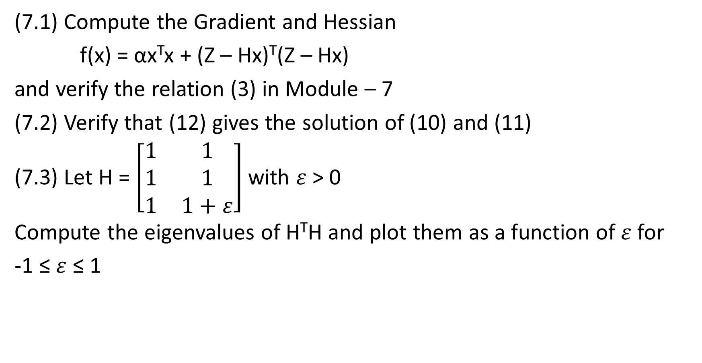
EXERCISES
(7.1) Compute the Gradient and Hessian
f(x) = αx^{T}x + (Z – Hx)^{T}(Z – Hx)
and verify the relation (3) in Module – 7
(7.2) Verify that (12) gives the solution of (10) and (11)
(7.3) Let H = $\left[\begin{matrix}1 & 1 \\ 1 & 1 \\ 1 & 1+ε\end{matrix}\right]$ with $ε$ > 0
Compute the eigenvalues of H^{T}H and plot them as a function of $ε$ for
-1 ≤ $ε$ ≤ 1

Slide 17
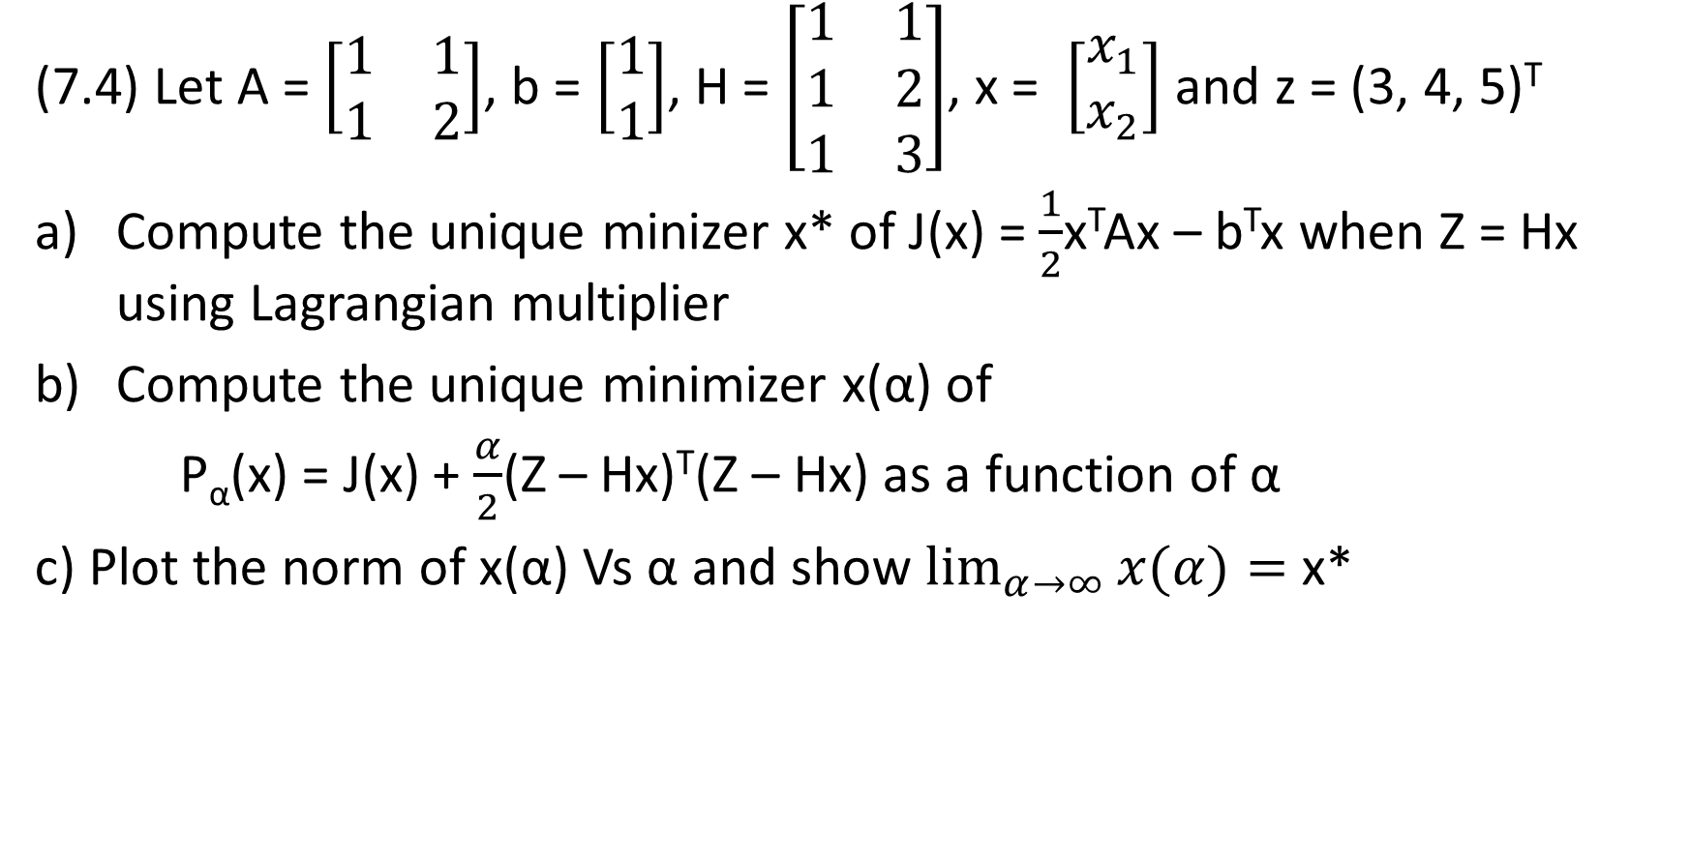
EXERCISES
(7.4) Let A = $\left[\begin{matrix}1 & 1 \\ 1 & 2\end{matrix}\right]$, b = $\left[\begin{aligned}1 \\ 1\end{aligned}\right]$, H = $\left[\begin{matrix}1 & 1 \\ 1 & 2 \\ 1 & 3\end{matrix}\right]$, x = $\left[\begin{aligned}x_{1} \\ x_{2}\end{aligned}\right]$ and z = (3, 4, 5)^{T}
Compute the unique minizer x* of J(x) = $\frac{1}{2}$x^{T}Ax – b^{T}x when Z = Hx using Lagrangian multiplier
Compute the unique minimizer x(α) of
P_{α}(x) = J(x) + $\frac{α}{2}$(Z – Hx)^{T}(Z – Hx) as a function of α
c) Plot the norm of x(α) Vs α and show $\lim_{α→∞}{x(α)}=$ x*

Slide 18
REFERENCES
This module follows from Chapter 5 LLD (2006) and the following report
S.Lakshmivarahan (2015) “On the convergence of class of weak solution to the strong solution of an equality constraint minimization. Problem: A direct proof using matrix identities, School of Computer Science, University of Oklahoma, Norman, Ok - 73019 USA

