Slide 1
STATIC, DETERMINISTIC LINEAR INVERSE PROBLEMS WELL – POSED PROBLEM
Module - 6
S. Lakshmivarahan
School of Computer Science
University of Oklahoma
Norman, Ok – 73069, USA
varahan@ou.edu
Date 10/23/2015

Slide 2
PROBLEM STATEMENT – A ST.LINE PROBLEM
A particle is moving in a st. line:
Constant velocity, V – Not known
Initial position, Z₀ – Not known
Observations of position Z_{i} at time t_{i} for 1 ≤ i ≤ m are available
Problem: Given the pair (t_{i}, Z_{i}), 1 ≤ i ≤ m, estimate the unknowns Z₀, V
TIME | t₁ | t₂ | … t_{i}... | T_{m}
POSITION | Z₁ | Z₂ | … Z_{i} … | Z_{m}

Slide 3
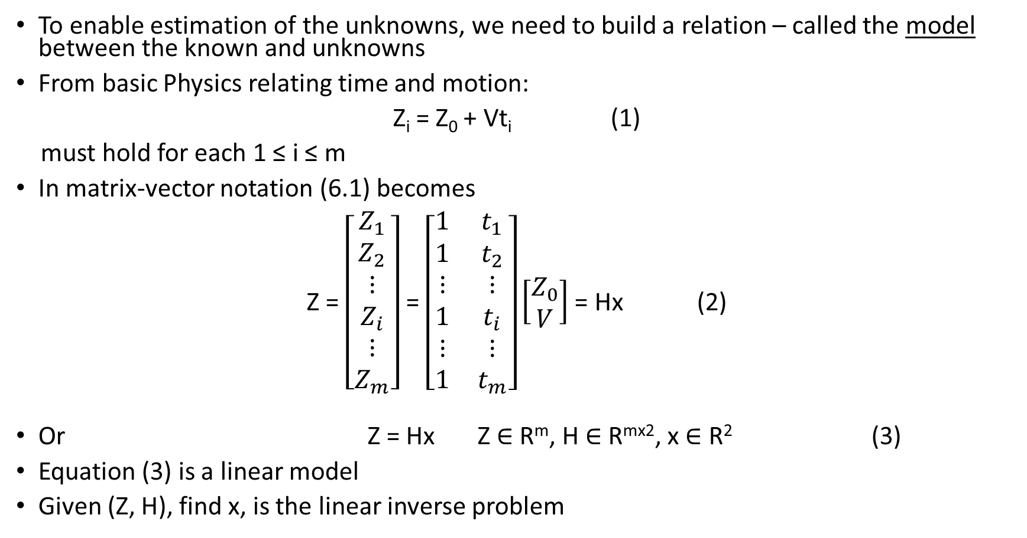
BUILD A LINEAR MODEL
To enable estimation of the unknowns, we need to build a relation – called the model between the known and unknowns
From basic Physics relating time and motion:
Z_{i} = Z₀ + Vt_{i} (1)
must hold for each 1 ≤ i ≤ m
In matrix-vector notation (6.1) becomes
Z = $\left[\begin{aligned}Z_{1} \\ Z_{2} \\ ⋮ \\ Z_{i} \\ ⋮ \\ Z_{m}\end{aligned}\right]$ = $\left[\begin{matrix}1 & t_{1} \\ 1 & t_{2} \\ ⋮ & ⋮ \\ 1 & t_{i} \\ ⋮ & ⋮ \\ 1 & t_{m}\end{matrix}\right]\left[\begin{aligned}Z_{0} \\ V\end{aligned}\right]$ = Hx (2)
Or Z = Hx Z $∈$ R^{m}, H $∈$ R^{mx2}, x $∈$ R² (3)
Equation (3) is a linear model
Given (Z, H), find x, is the linear inverse problem

Slide 4

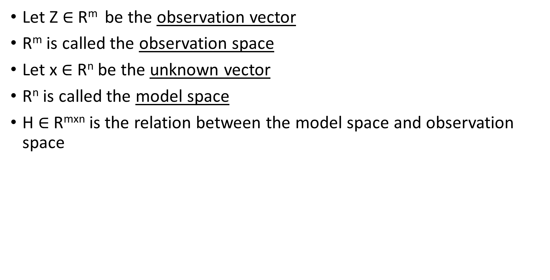
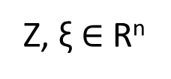
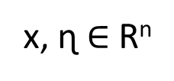
A GENERALIZATION – LINEAR MODEL
Let Z $∈$ R^{m} be the observation vector
R^{m} is called the observation space
Let x $∈$ R^{n} be the unknown vector
R^{n} is called the model space
H $∈$ R^{mxn} is the relation between the model space and observation space
R^{n}
R^{m}
Z, ξ $∈$R^{n}
Z = Hx
ɳ = H^{T}ξ
x, ɳ $∈$R^{n}
H
x
Z
ɳ
ξ
Model space
H^{T}
Observation space

Slide 5
ON SOLVING Z = Hx
When m = n and H is non-singular, then
x = H⁻¹Z (4)
When m ≠ n, H is a rectangular matrix and the standard notion of non-singularity does not apply
Two cases arise:
m > n – overdetermined case – Inconsistent case
m < n – underdetermined case – Infinity many solution

Slide 6
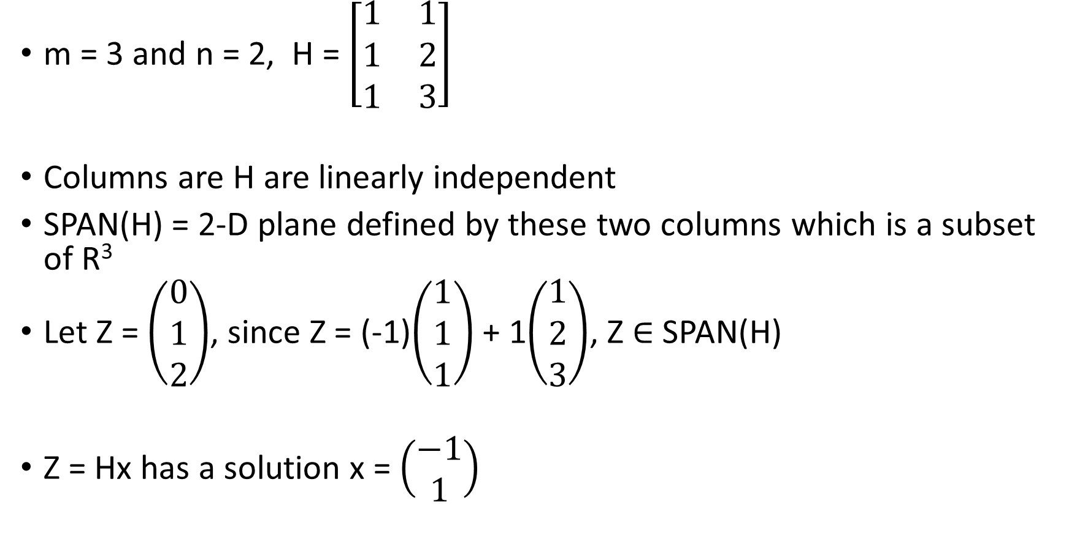
OVERDETERMINED CASE: m > n
m = 3 and n = 2, H = $\left[\begin{matrix}1 & 1 \\ 1 & 2 \\ 1 & 3\end{matrix}\right]$
Columns are H are linearly independent
SPAN(H) = 2-D plane defined by these two columns which is a subset of R³
Let Z = $\left(\begin{aligned}0 \\ 1 \\ 2\end{aligned}\right)$, since Z = (-1)$\left(\begin{aligned}1 \\ 1 \\ 1\end{aligned}\right)$ + 1$\left(\begin{aligned}1 \\ 2 \\ 3\end{aligned}\right)$, Z $∈$ SPAN(H)
Z = Hx has a solution x = $\left(\begin{aligned}−1 \\ 1\end{aligned}\right)$

Slide 7
INCONSISTENT CASE: m > n
Recall that columns of H are defined by the mathematical model but the column Z of observation that come from the real world measurement
Generally, observations have noise embedded in them and models are only approximations to reality
Hence, move often than not, Z does not belong to the SPAN(H)
In such cases Z = HX has no solution in the sense that there is no vector x that will satisfy equation Z = Hx

Slide 8
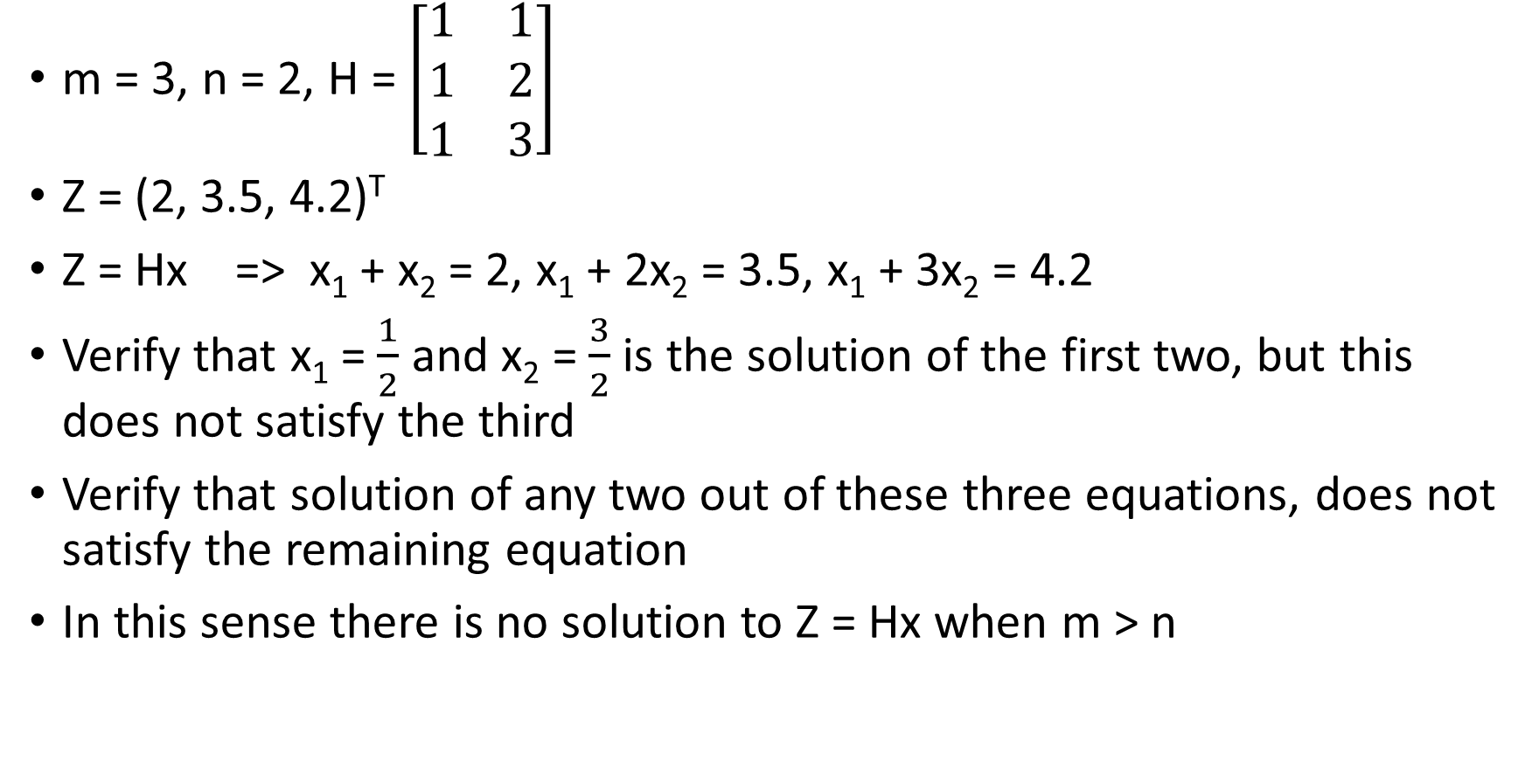
ANOTHER LOOK AT INCONSISTENT CASE: m > n
m = 3, n = 2, H = $\left[\begin{matrix}1 & 1 \\ 1 & 2 \\ 1 & 3\end{matrix}\right]$
Z = (2, 3.5, 4.2)^{T}
Z = Hx => x₁ + x₂ = 2, x₁ + 2x₂ = 3.5, x₁ + 3x₂ = 4.2
Verify that x₁ = $\frac{1}{2}$ and x₂ = $\frac{3}{2}$ is the solution of the first two, but this does not satisfy the third
Verify that solution of any two out of these three equations, does not satisfy the remaining equation
In this sense there is no solution to Z = Hx when m > n

Slide 9
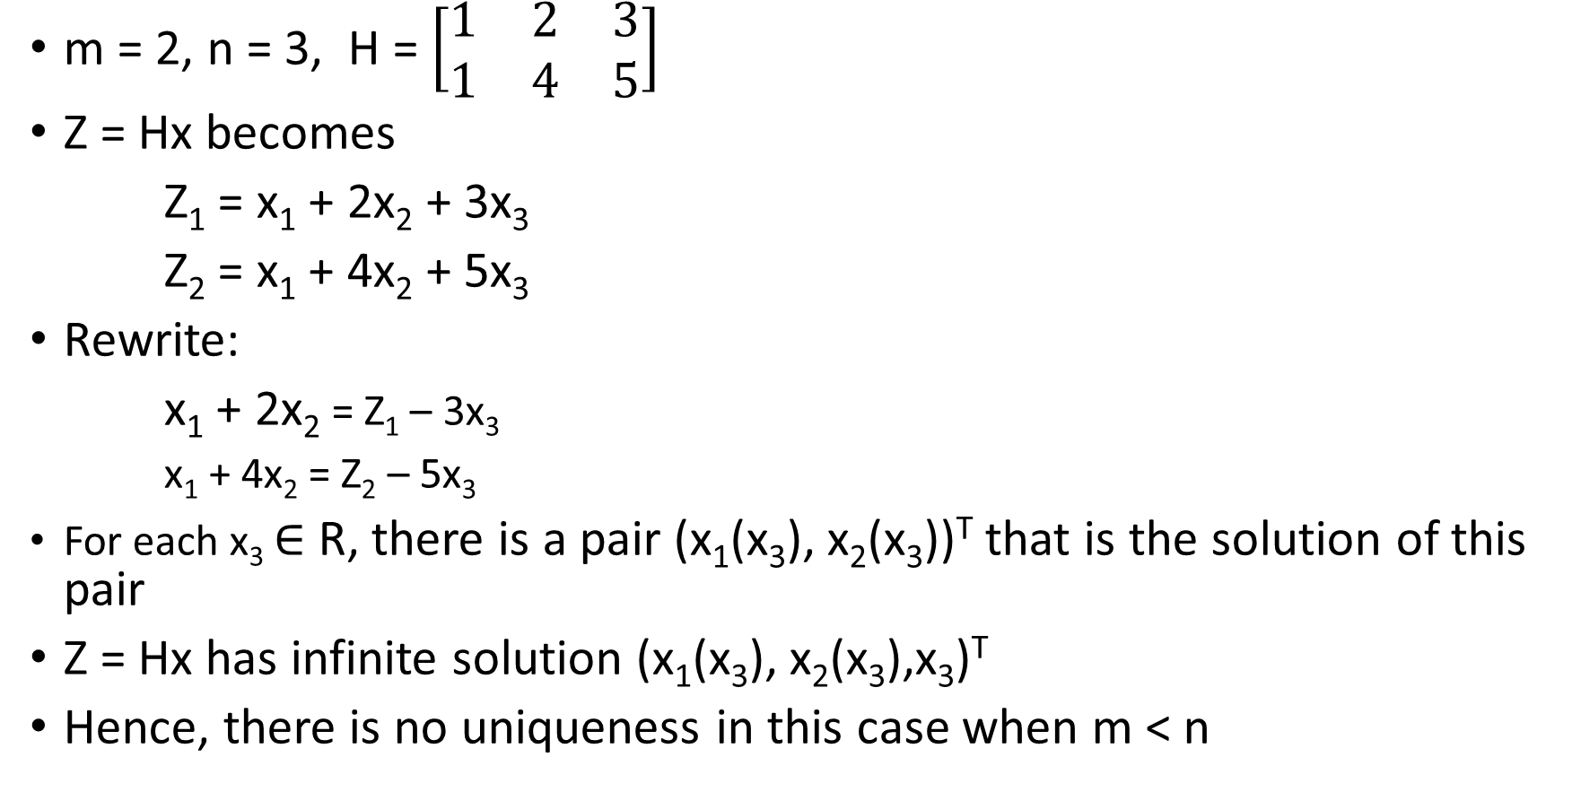
UNDERDETERMINED CASE: m < n
m = 2, n = 3, H = $\left[\begin{matrix}1 & 2 & 3 \\ 1 & 4 & 5\end{matrix}\right]$
Z = Hx becomes
Z₁ = x₁ + 2x₂ + 3x₃
Z₂ = x₁ + 4x₂ + 5x₃
Rewrite:
x₁ + 2x₂ = Z₁ – 3x₃
x₁ + 4x₂ = Z₂ – 5x₃
For each x₃ $∈$ R, there is a pair (x₁(x₃), x₂(x₃))^{T} that is the solution of this pair
Z = Hx has infinite solution (x₁(x₃), x₂(x₃),x₃)^{T}
Hence, there is no uniqueness in this case when m < n

Slide 10
SUMMARY – LINEAR INVERSE PROBLEM
Z = Hx and H is of full rank
m : n
Thus, we need to generalize the concept of solution for the two extreme cases when m > n and m < n
This generalized solution in called the lease square solution
m > n | m = n | m < n
Overdetermined |  | Underdetemined
Rank(H) = n | Rank(H) = n | Rank(H) = m
Inconsistent system |  | Infinitely many solution
No solution | Unique solution X = H⁻¹z | No uniqueness

Slide 11
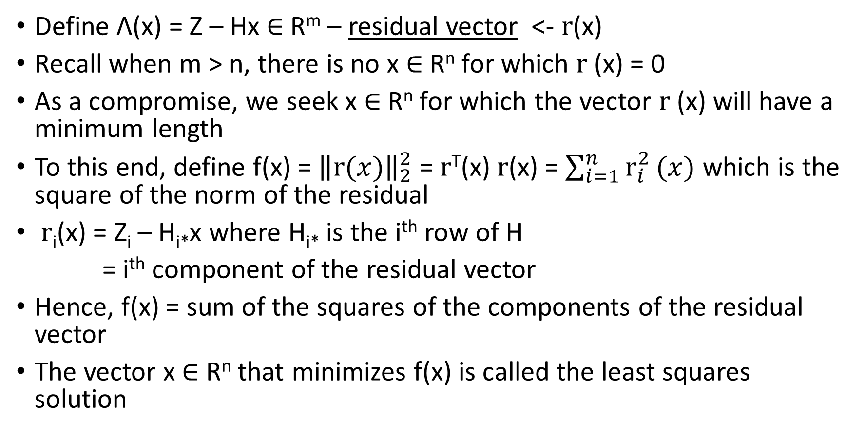
UNWEIGHTED LEAST SQUARES SOLUTION: m > n
Define Λ(x) = Z – Hx $∈$ R^{m} – residual vector <- $r$(x)
Recall when m > n, there is no x $∈$ R^{n} for which $r$(x) = 0
As a compromise, we seek x $∈$ R^{n} for which the vector $r$(x) will have a minimum length
To this end, define f(x) = ${\left\|r(x)\right\|}_{2}^{2}$ = $r$^{T}(x) $r$(x) = $\sum_{i=1}^{n}{r_{i}^{2}}(x)$ which is the square of the norm of the residual
$r$_{i}(x) = Z_{i} – H_{i*}x where H_{i*} is the i^{th} row of H
= i^{th} component of the residual vector
Hence, f(x) = sum of the squares of the components of the residual vector
The vector x $∈$ R^{n} that minimizes f(x) is called the least squares solution

Slide 12
LEAST SQUQARES METHOD: m > n
f(x) = r^{T}(x)r(x) = (Z – Hx)^{T}(Z – Hx)
= (Z^{T} – (Hx)^{T})(Z – Hx)
= (Z^{T} – x^{T}H^{T})(Z – Hx)
= Z^{T}Z – Z^{T}Hx – x^{T}H^{T}Z + x^{T}(H^{T}H)x (5)
Z^{T}Hx being a scalar: Z^{T}Hx = (Z^{T}Hx)^{T}
= x^{T}H^{T}Z (6)
Therefore, f(x) = Z^{T}Z – 2Z^{T}Hx + x^{T}(H^{T}H)x (7)
Find x that minimizes f(x) in (7)

Slide 13
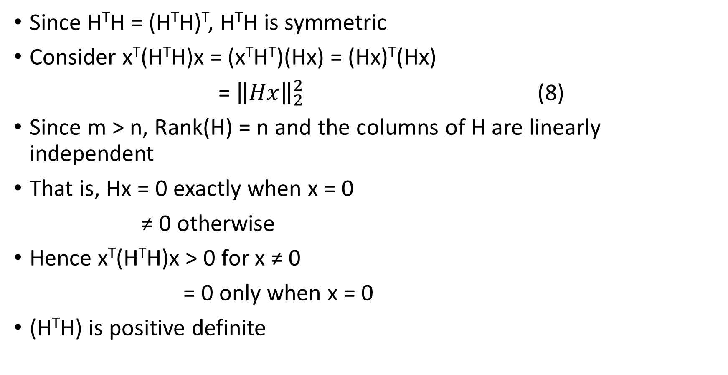
H^{T}H SPD WHEN H IS OF FULL RANK
Since H^{T}H = (H^{T}H)^{T}, H^{T}H is symmetric
Consider x^{T}(H^{T}H)x = (x^{T}H^{T})(Hx) = (Hx)^{T}(Hx)
= ${\left\|Hx\right\|}_{2}^{2}$ (8)
Since m > n, Rank(H) = n and the columns of H are linearly independent
That is, Hx = 0 exactly when x = 0
≠ 0 otherwise
Hence x^{T}(H^{T}H)x > 0 for x ≠ 0
= 0 only when x = 0
(H^{T}H) is positive definite
-> (9)

Slide 14
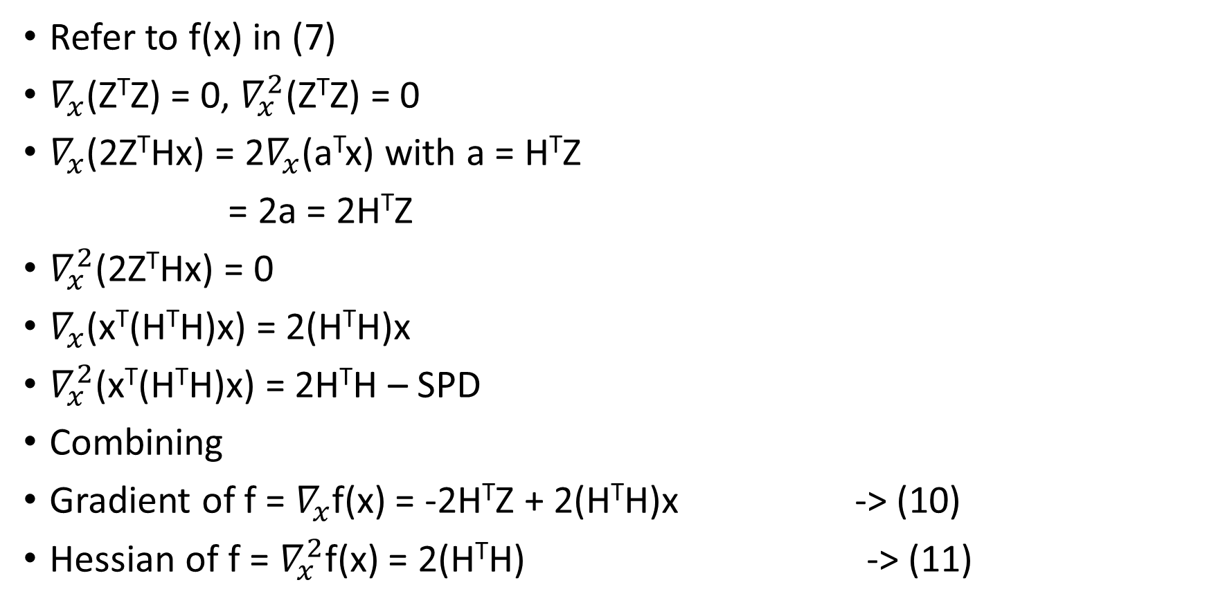
GRADIENT AND HESSIAN OF f(x)
Refer to f(x) in (7)
$∇_{x}$(Z^{T}Z) = 0, $∇_{x}^{2}$(Z^{T}Z) = 0
$∇_{x}$(2Z^{T}Hx) = 2$∇_{x}$(a^{T}x) with a = H^{T}Z
= 2a = 2H^{T}Z
$∇_{x}^{2}$(2Z^{T}Hx) = 0
$∇_{x}$(x^{T}(H^{T}H)x) = 2(H^{T}H)x
$∇_{x}^{2}$(x^{T}(H^{T}H)x) = 2H^{T}H – SPD
Combining
Gradient of f = $∇_{x}$f(x) = -2H^{T}Z + 2(H^{T}H)x -> (10)
Hessian of f = $∇_{x}^{2}$f(x) = 2(H^{T}H) -> (11)

Slide 15
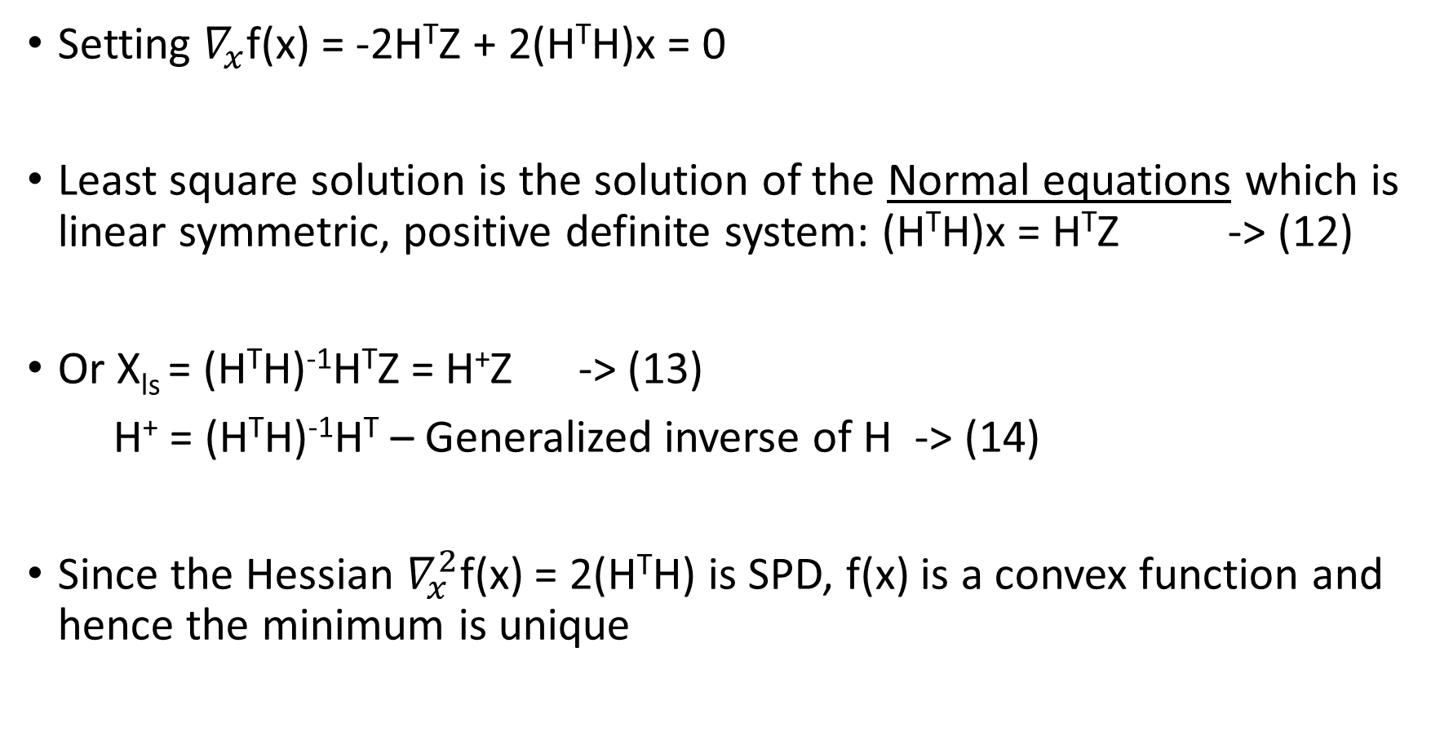
UNCONSTRAINED MINIMIZATION OF f(x) – NORMAL EQUATION
Setting $∇_{x}$f(x) = -2H^{T}Z + 2(H^{T}H)x = 0
Least square solution is the solution of the Normal equations which is linear symmetric, positive definite system: (H^{T}H)x = H^{T}Z -> (12)
Or X_{ls} = (H^{T}H)⁻¹H^{T}Z = H⁺Z -> (13)
H⁺ = (H^{T}H)⁻¹H^{T} – Generalized inverse of H -> (14)
Since the Hessian $∇_{x}^{2}$f(x) = 2(H^{T}H) is SPD, f(x) is a convex function and hence the minimum is unique

Slide 16
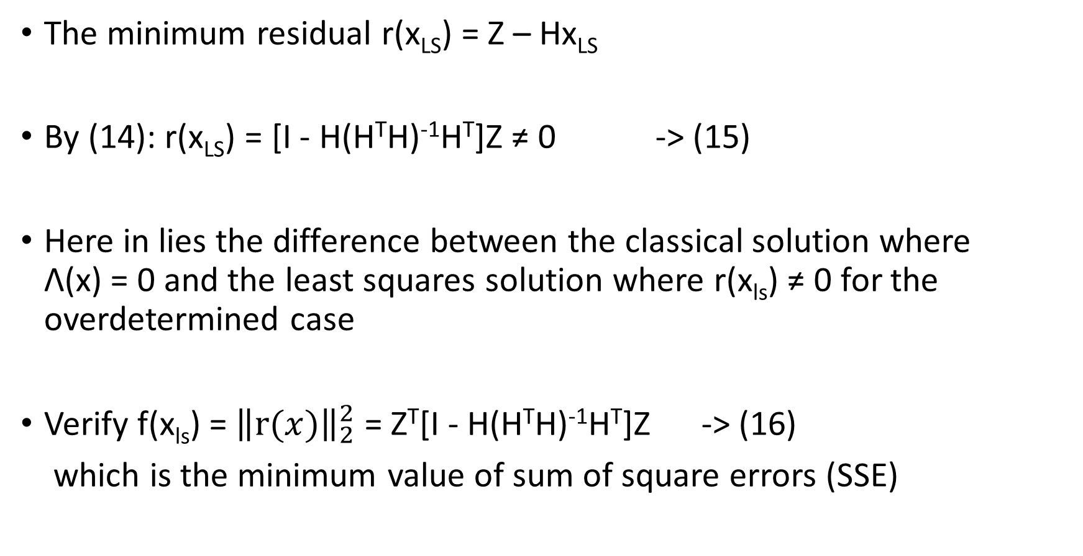
MINIMUM RESIDUAL
The minimum residual r(x_{LS}) = Z – Hx_{LS}
By (14): r(x_{LS}) = [I - H(H^{T}H)⁻¹H^{T}]Z ≠ 0 -> (15)
Here in lies the difference between the classical solution where Λ(x) = 0 and the least squares solution where r(x_{ls}) ≠ 0 for the overdetermined case
Verify f(x_{ls}) = ${\left\|r(x)\right\|}_{2}^{2}$ = Z^{T}[I - H(H^{T}H)⁻¹H^{T}]Z -> (16)
which is the minimum value of sum of square errors (SSE)

Slide 17
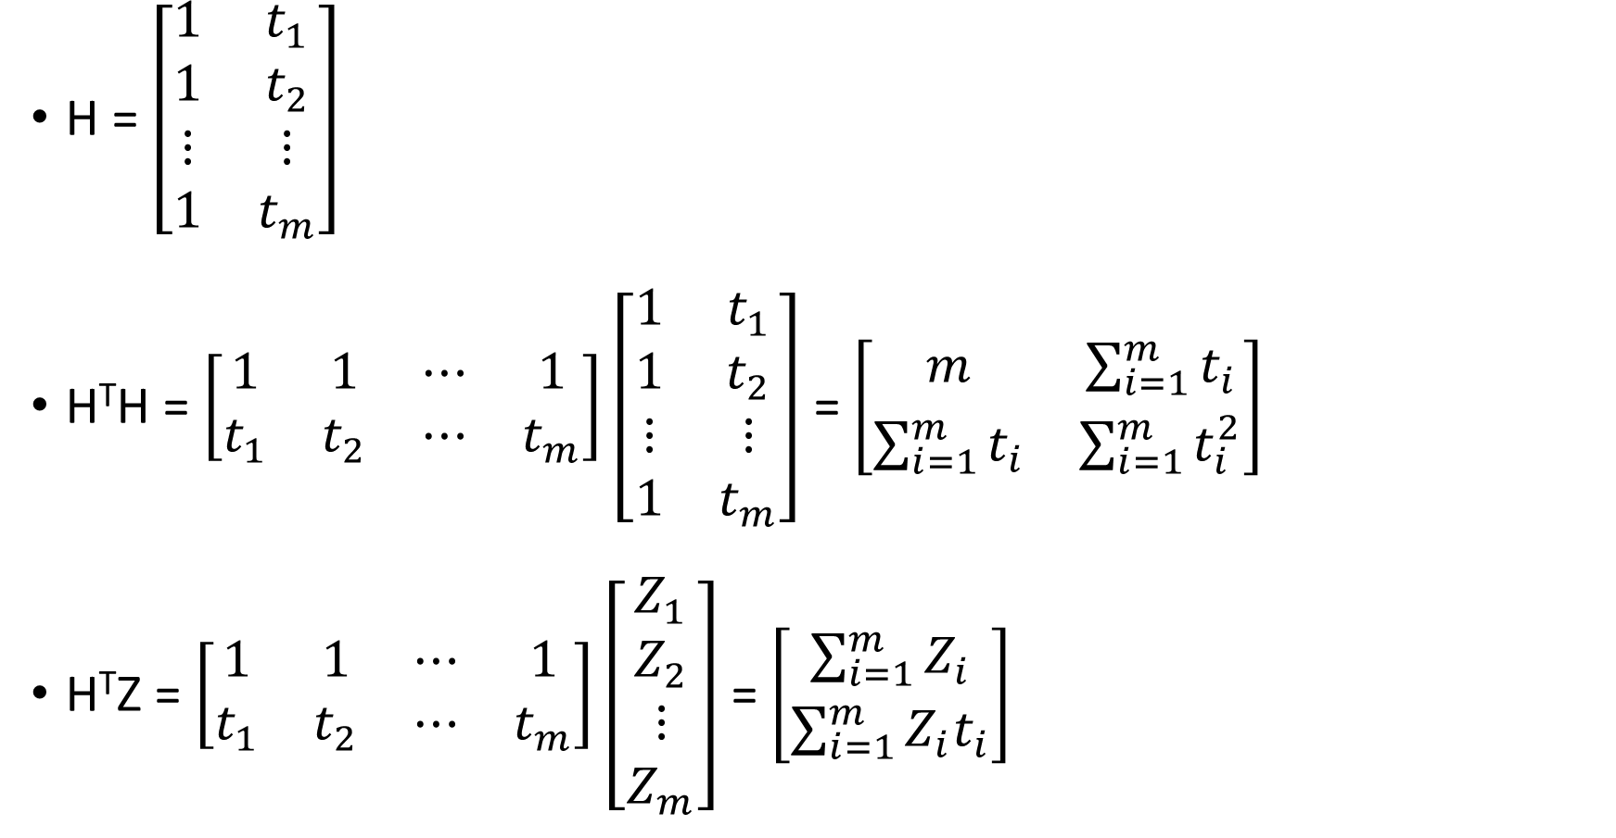
AN ILLUSTRATION – ST.LINE PROBLEM
H = $\left[\begin{matrix}1 & t_{1} \\ 1 & t_{2} \\ ⋮ & ⋮ \\ 1 & t_{m}\end{matrix}\right]$
H^{T}H = $\left[\begin{matrix}1 & 1 & ⋯ & 1 \\ t_{1} & t_{2} & ⋯ & t_{m}\end{matrix}\right]\left[\begin{matrix}1 & t_{1} \\ 1 & t_{2} \\ ⋮ & ⋮ \\ 1 & t_{m}\end{matrix}\right]$ = $\left[\begin{matrix}m & \sum_{i=1}^{m}{t_{i}} \\ \sum_{i=1}^{m}{t_{i}} & \sum_{i=1}^{m}{t_{i}^{2}}\end{matrix}\right]$
H^{T}Z = $\left[\begin{matrix}1 & 1 & ⋯ & 1 \\ t_{1} & t_{2} & ⋯ & t_{m}\end{matrix}\right]\left[\begin{aligned}Z_{1} \\ Z_{2} \\ ⋮ \\ Z_{m}\end{aligned}\right]$ = $\left[\begin{aligned}\sum_{i=1}^{m}{Z_{i}} \\ \sum_{i=1}^{m}{Z_{i}t_{i}}\end{aligned}\right]$

Slide 18
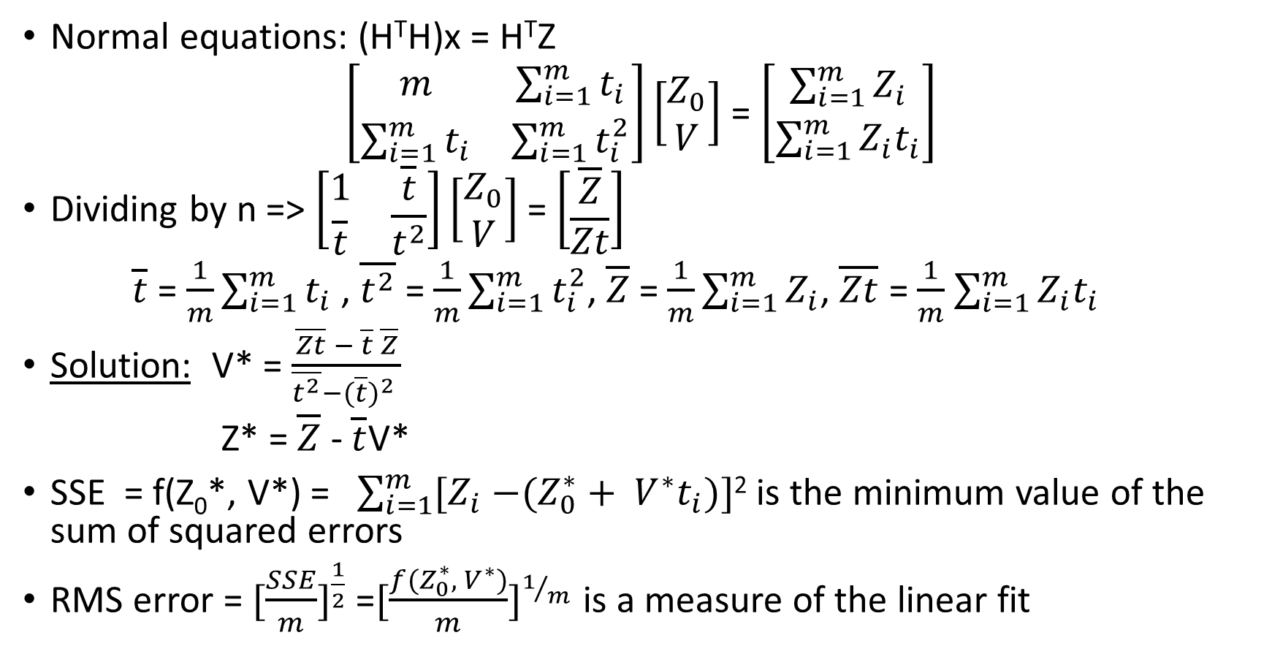
ILLUSTRATION CONTINUED
Normal equations: (H^{T}H)x = H^{T}Z
$\left[\begin{matrix}m & \sum_{i=1}^{m}{t_{i}} \\ \sum_{i=1}^{m}{t_{i}} & \sum_{i=1}^{m}{t_{i}^{2}}\end{matrix}\right]\left[\begin{aligned}Z_{0} \\ V\end{aligned}\right]$ = $\left[\begin{aligned}\sum_{i=1}^{m}{Z_{i}} \\ \sum_{i=1}^{m}{Z_{i}t_{i}}\end{aligned}\right]$
Dividing by n => $\left[\begin{matrix}1 & \overline{t} \\ \overline{t} & \overline{t^{2}}\end{matrix}\right]\left[\begin{aligned}Z_{0} \\ V\end{aligned}\right]$ = $\left[\begin{aligned}\overline{Z} \\ \overline{Zt}\end{aligned}\right]$
$\overline{t}$ = $\frac{1}{m}\sum_{i=1}^{m}{t_{i}}$ , $\overline{t^{2}}$ = $\frac{1}{m}\sum_{i=1}^{m}{t_{i}^{2}}$, $\overline{Z}$ = $\frac{1}{m}\sum_{i=1}^{m}{Z_{i}}$, $\overline{Zt}$ = $\frac{1}{m}$ $\sum_{i=1}^{m}{Z_{i}t_{i}}$
Solution: V* = $\frac{\overline{Zt} − \overline{t} \overline{Z}}{\overline{t^{2}}−{(\overline{t})}^{2} }$
Z* = $\overline{Z}$ - $\overline{t}$V*
SSE = f(Z₀*, V*) = $\sum_{i=1}^{m}{{[Z}_{i} −(Z_{0}^{∗}}+ V^{∗}t_{i})]$² is the minimum value of the sum of squared errors
RMS error = ${[\frac{SSE}{m}]}^{\frac{1}{2}}$ =${[\frac{f(Z_{0}^{∗}, { V}^{∗})}{m}]}^{1/m}$ is a measure of the linear fit

Slide 19
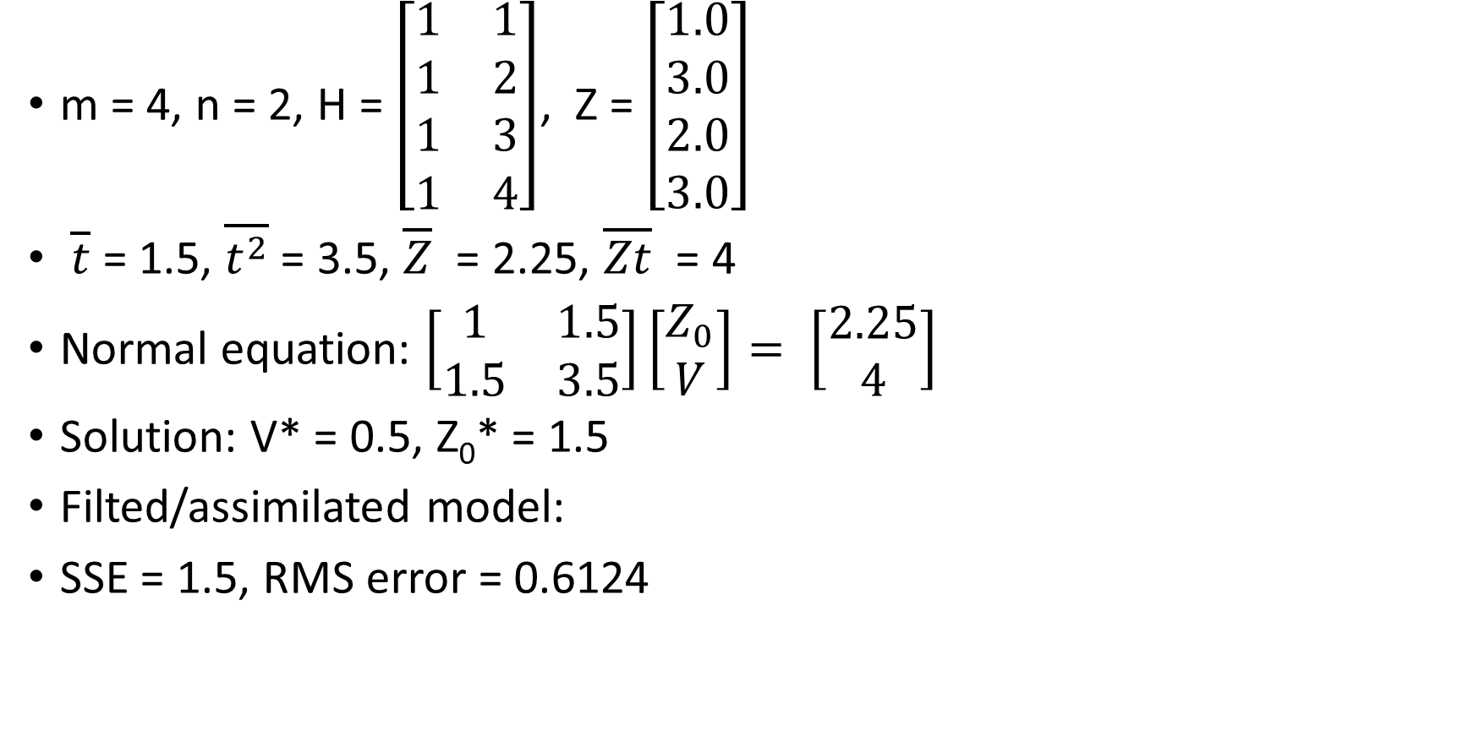
NUMERICAL EXAMPLE – ALGEBRAIC METHOD
m = 4, n = 2, H = $\left[\begin{matrix}1 & 1 \\ 1 & 2 \\ 1 & 3 \\ 1 & 4\end{matrix}\right]$, Z = $\left[\begin{aligned}1.0 \\ 3.0 \\ 2.0 \\ 3.0\end{aligned}\right]$
$\overline{t}$ = 1.5, $\overline{t^{2}}$ = 3.5, $\overline{Z}$ = 2.25, $\overline{Zt}$ = 4
Normal equation: $\left[\begin{matrix}1 & 1.5 \\ 1.5 & 3.5\end{matrix}\right]\left[\begin{aligned}Z_{0} \\ V\end{aligned}\right]= \left[\begin{aligned}2.25 \\ 4\end{aligned}\right]$
Solution: V* = 0.5, Z₀* = 1.5
Filted/assimilated model:
SSE = 1.5, RMS error = 0.6124
Z_{i} = 1.5 + 0.5t_{i}

Slide 20
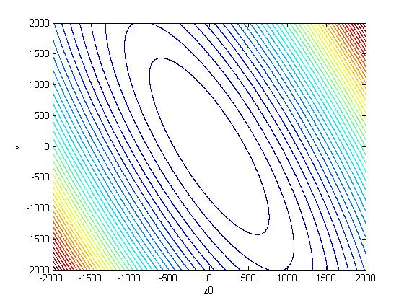

CONTOURS OF f(x) – GRAPHICAL METHOD
Using the data in slide (19) we can get
f(Z₀, V) = Z^{T}Z – 2Z^{T}Hx + x^{T}(H^{T}H)x
= $Z_{0}^{2}$ + 3Z₀V + 3.5V² – 9Z₀ – 25V + 23
The contours of f(Z₀, V) using MATLAB is given below
The minimum is $Z_{0}^{∗}$ = 1.5, V* = 0.5

Slide 21
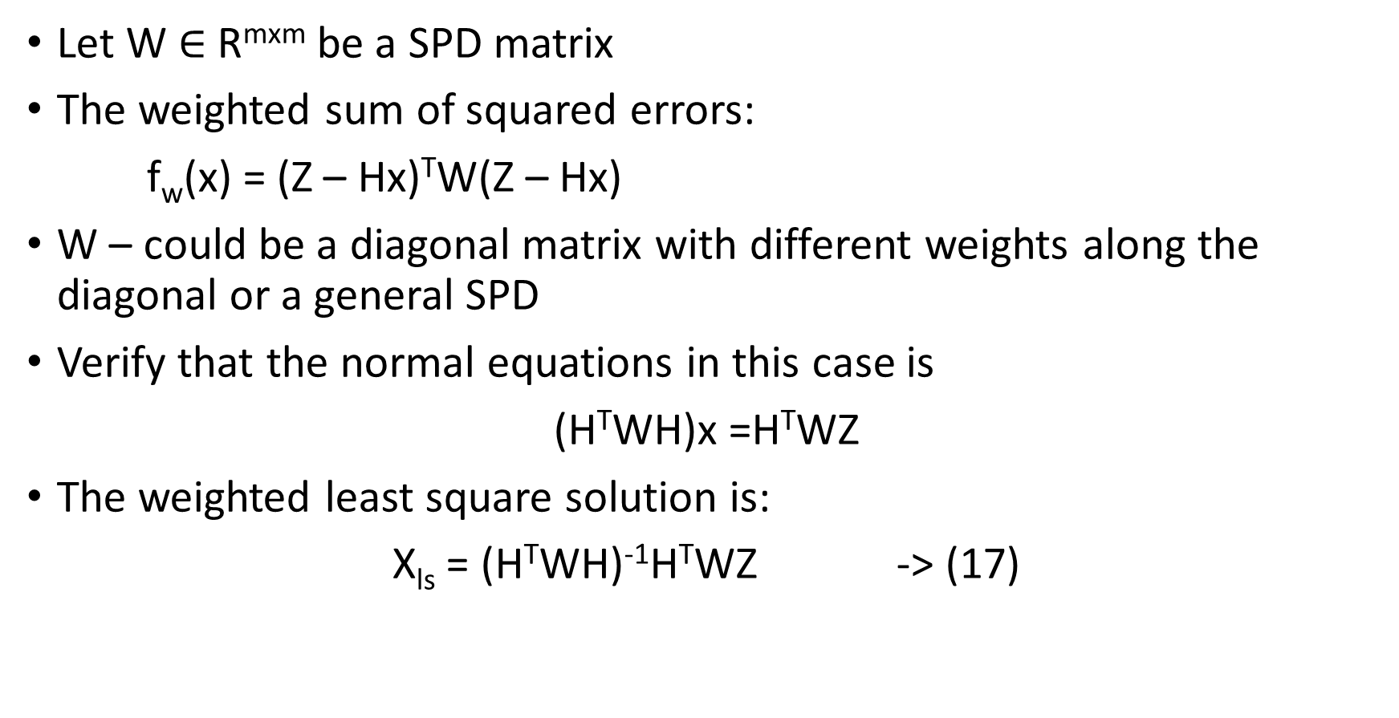
WEIGHTED LEAST SQUARES: m > n
Let W $∈$R^{mxm} be a SPD matrix
The weighted sum of squared errors:
f_{w}(x) = (Z – Hx)^{T}W(Z – Hx)
W – could be a diagonal matrix with different weights along the diagonal or a general SPD
Verify that the normal equations in this case is
(H^{T}WH)x =H^{T}WZ
The weighted least square solution is:
X_{ls} = (H^{T}WH)⁻¹H^{T}WZ -> (17)

Slide 22
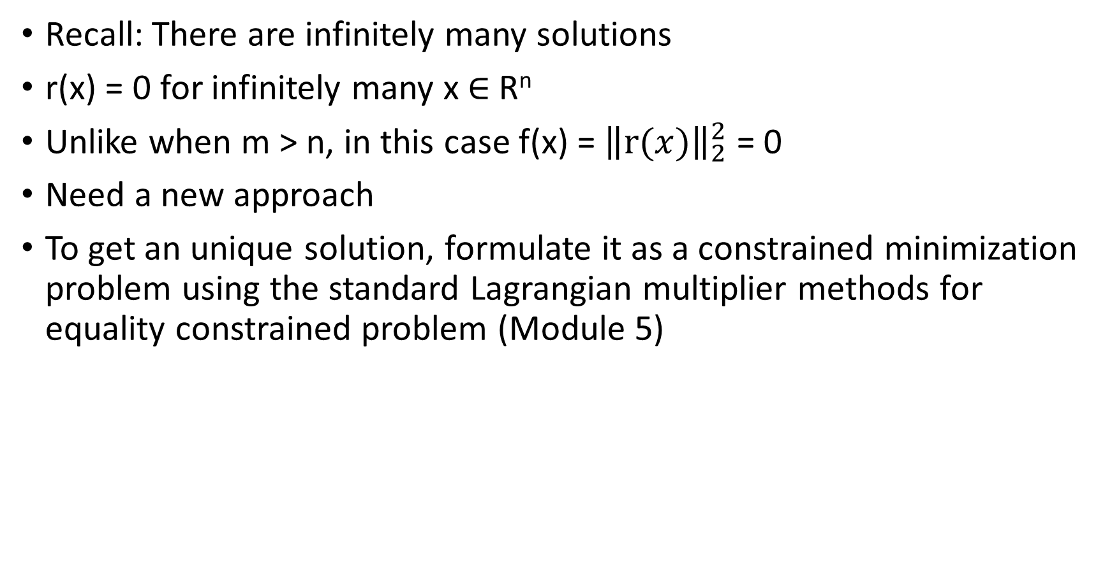
UNDERDETERMINED CASE: m < n
Recall: There are infinitely many solutions
r(x) = 0 for infinitely many x $∈$R^{n}
Unlike when m > n, in this case f(x) = ${\left\|r(x)\right\|}_{2}^{2}$ = 0
Need a new approach
To get an unique solution, formulate it as a constrained minimization problem using the standard Lagrangian multiplier methods for equality constrained problem (Module 5)

Slide 23
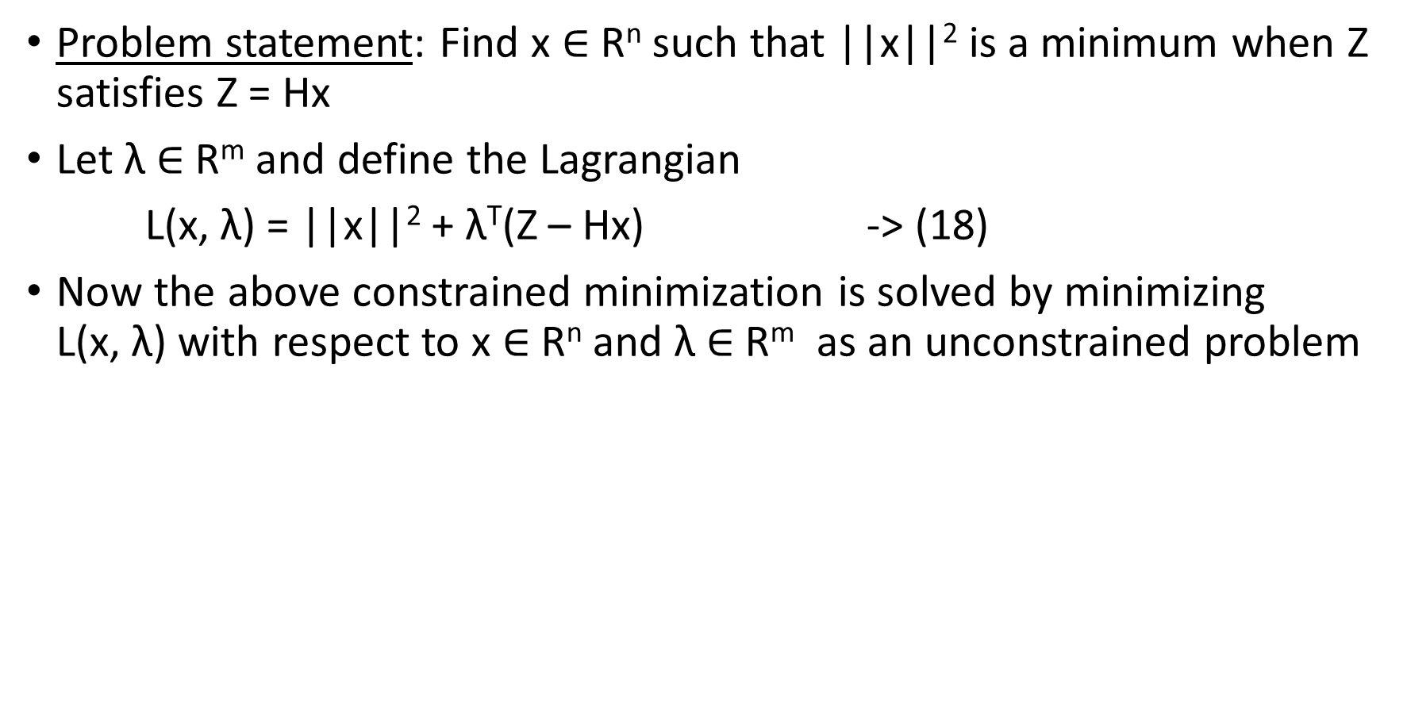
LAGRANGIAN FORMULATION: m < n
Problem statement: Find x $∈$R^{n} such that ||x||² is a minimum when Z satisfies Z = Hx
Let λ $∈$R^{m} and define the Lagrangian
L(x, λ) = ||x||² + λ^{T}(Z – Hx) -> (18)
Now the above constrained minimization is solved by minimizing L(x, λ) with respect to x $∈$R^{n} and λ $∈$R^{m} as an unconstrained problem

Slide 24
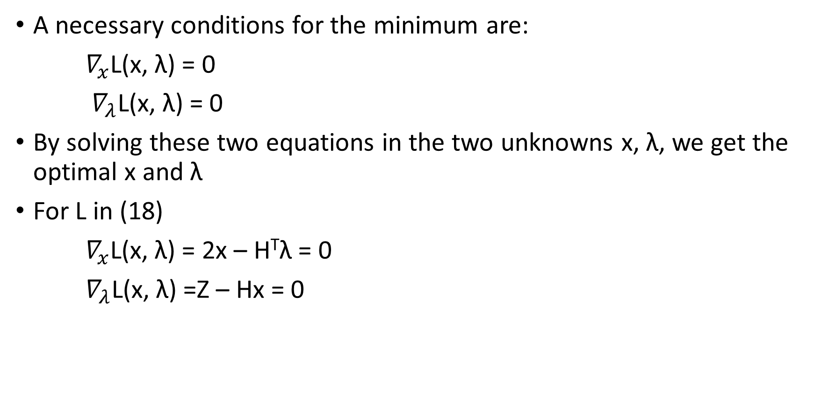
LAGRANGIAN METHOD: m < n
A necessary conditions for the minimum are:
$∇_{x}$L(x, λ) = 0
$∇_{λ}$L(x, λ) = 0
By solving these two equations in the two unknowns x, λ, we get the optimal x and λ
For L in (18)
$∇_{x}$L(x, λ) = 2x – H^{T}λ = 0
$∇_{λ}$L(x, λ) =Z – Hx = 0
-> (19)

Slide 25
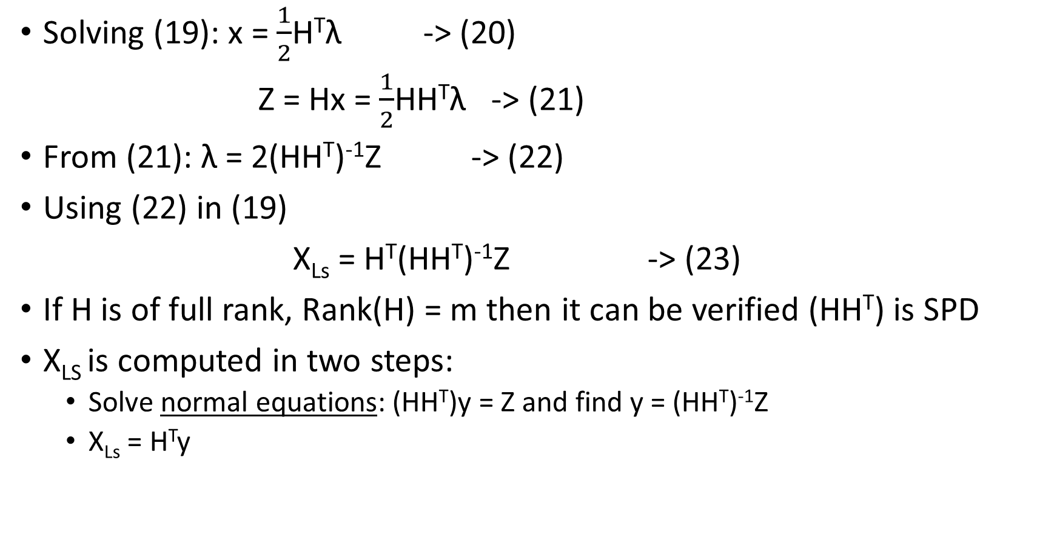
LEAST SQUARES SOLUTION: m < n
Solving (19): x = $\frac{1}{2}$H^{T}λ -> (20)
Z = Hx = $\frac{1}{2}$HH^{T}λ -> (21)
From (21): λ = 2(HH^{T})⁻¹Z -> (22)
Using (22) in (19)
X_{Ls} = H^{T}(HH^{T})⁻¹Z -> (23)
If H is of full rank, Rank(H) = m then it can be verified (HH^{T}) is SPD
X_{LS} is computed in two steps:
Solve normal equations: (HH^{T})y = Z and find y = (HH^{T})⁻¹Z
X_{Ls} = H^{T}y

Slide 26
RESIDUAL AT X_{LS}
r(x_{LS}) = Z – Hx_{LS}
= Z – HH^{T}(HH^{T})⁻¹Z
= Z – Z = 0
This is to be expected since we start with the infinitely many solutions for which r(x) = 0

Slide 27
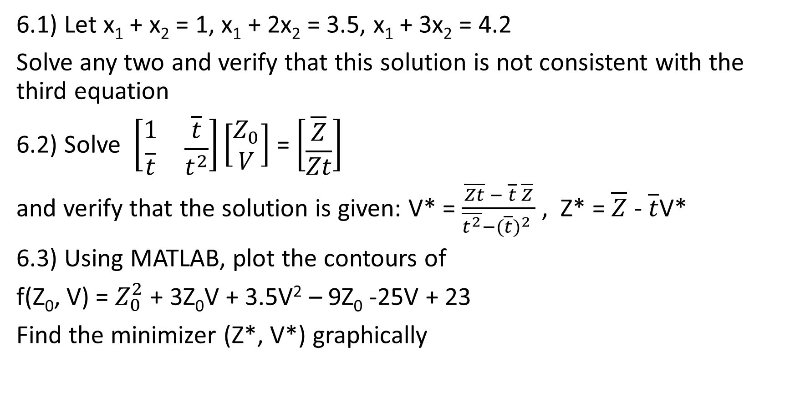
EXERCISES
6.1) Let x₁ + x₂ = 1, x₁ + 2x₂ = 3.5, x₁ + 3x₂ = 4.2
Solve any two and verify that this solution is not consistent with the third equation
6.2) Solve $\left[\begin{matrix}1 & \overline{t} \\ \overline{t} & \overline{t^{2}}\end{matrix}\right]\left[\begin{aligned}Z_{0} \\ V\end{aligned}\right]$ = $\left[\begin{aligned}\overline{Z} \\ \overline{Zt}\end{aligned}\right]$
and verify that the solution is given: V* = $\frac{\overline{Zt} − \overline{t} \overline{Z}}{\overline{t^{2}}−{(\overline{t})}^{2} }$ , Z* = $\overline{Z}$ - $\overline{t}$V*
6.3) Using MATLAB, plot the contours of
f(Z₀, V) = $Z_{0}^{2}$ + 3Z₀V + 3.5V² – 9Z₀ -25V + 23
Find the minimizer (Z*, V*) graphically

Slide 28
EXERCISES
6.4) Find the minimizer of
f_{w}(x) = (Z – Hx)^{T}W(Z – Hx)
and verify that
x_{LS} = (H^{T}WH)⁻¹H^{T}WZ
6.5) The generalized inverse of H is
H⁺ = (H^{T}H)⁻¹H^{T} if m > n
= H^{T}(HH^{T})⁻¹ if m < n
when H is of full rank
Verify that H⁺ satisfies the Moore-Penrose Condition: (Module – 3)
HH⁺H = H
H⁺HH⁺ = H⁺
(HH⁺)^{T} = HH⁺
(H⁺H)^{T} = H⁺H

Slide 29
REFERENCES
J. Lewis, S. Lakshmivarahan, S. Dhall (2006), Dynamic Data Assimilation: a least squares approach, Cambridge University Press – Chapter 5

